Slide 1
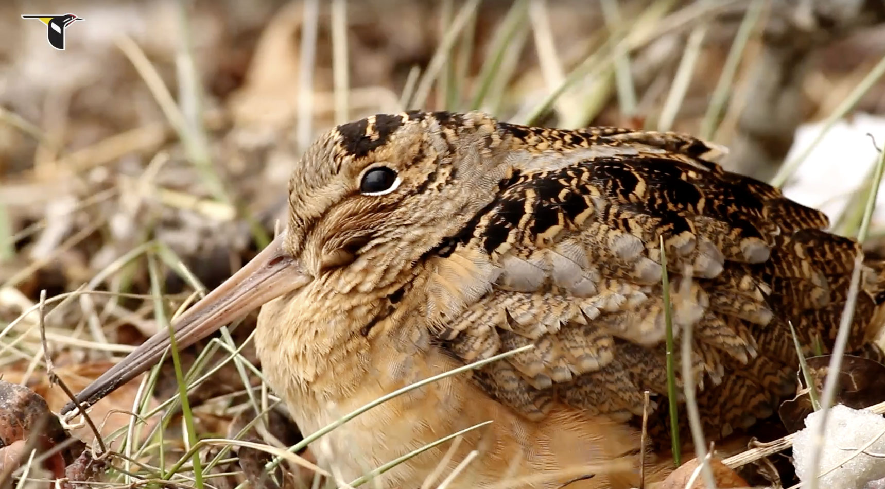
Young Forest Wildlife:
The American Woodcock
RI DEM Division of Fish and Wildlife
Rhody Critter Kits Program

Slide 2
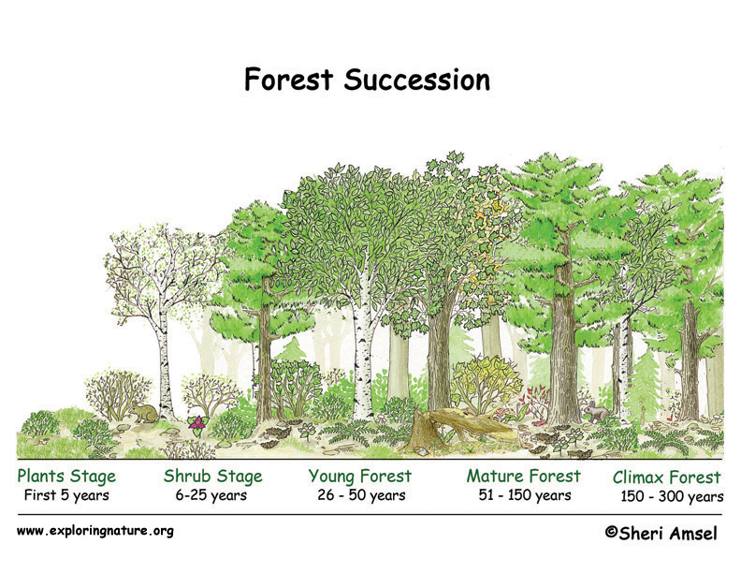
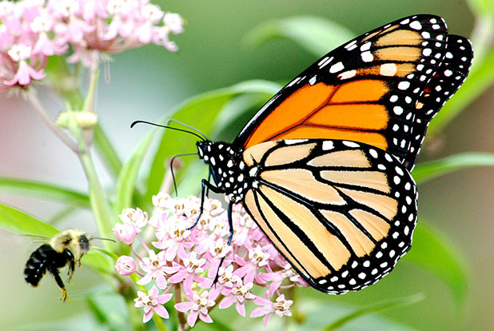
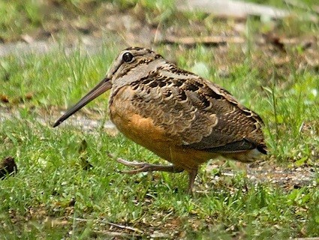
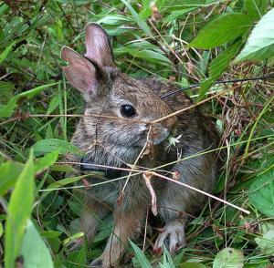
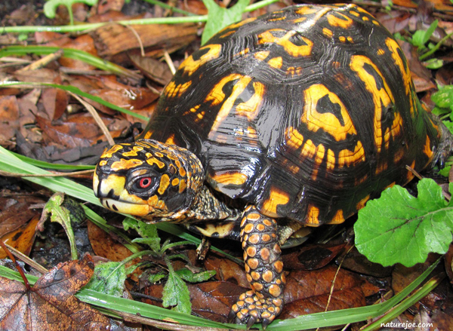
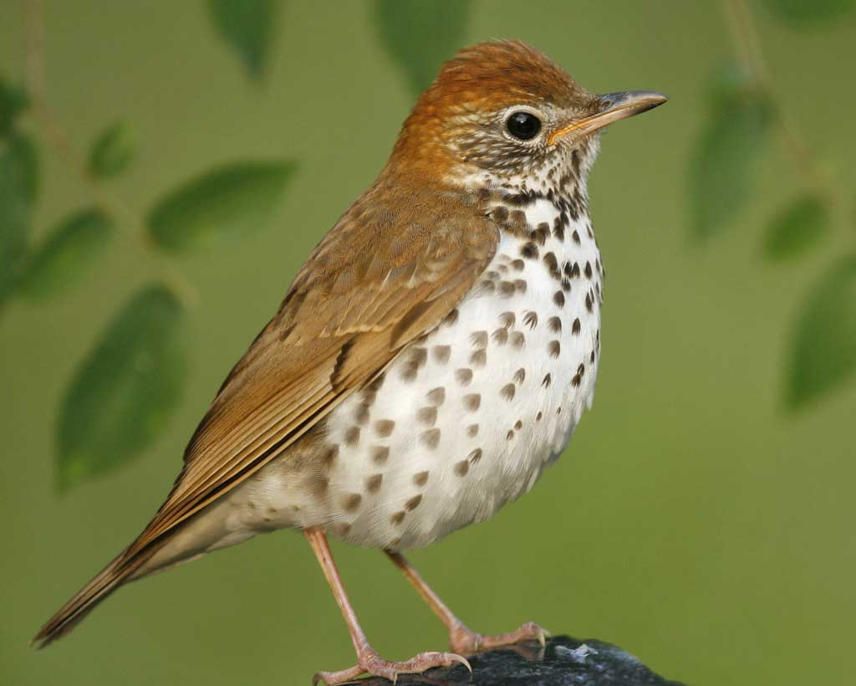
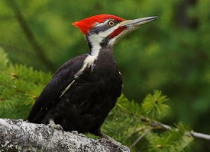
What is a “young forest”?
Notes:
When we think of forests we typically think of any place that has a lot of trees. Forest habitats can vary greatly depending on how long they have been around. Natural events such as fires and floods can reset very old “climax forests”, changing them into fields and meadows. Young forests occur about 26-50 years after a forest is reset. It is made up of dense shrubs and young trees that provide plenty of cover for smaller animals. This diagram shows the different stages of forest succession.

Slide 3
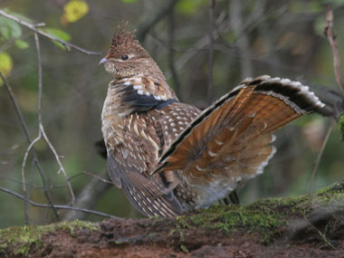
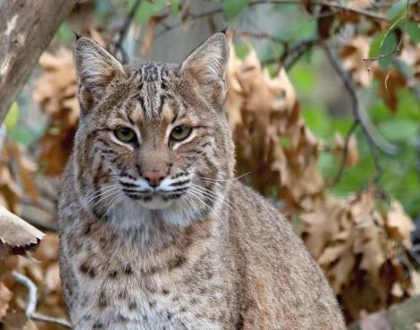
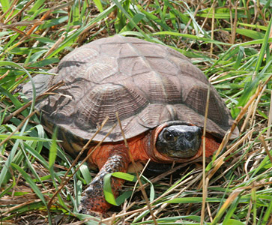
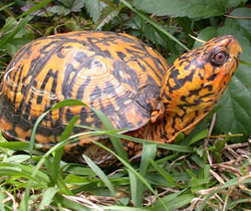
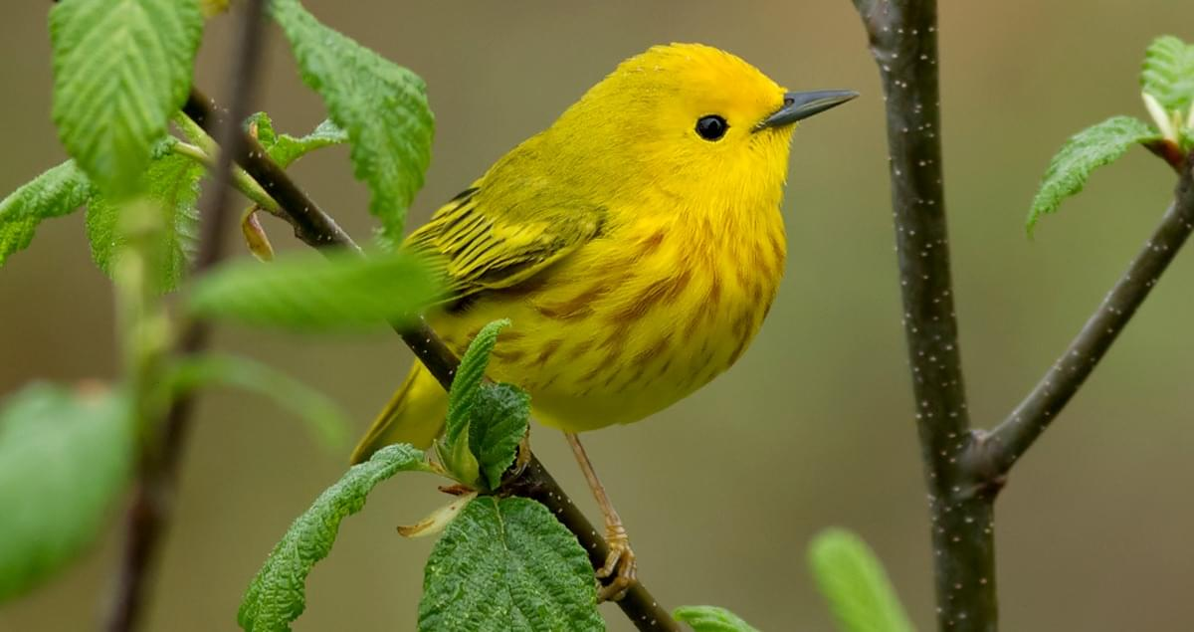
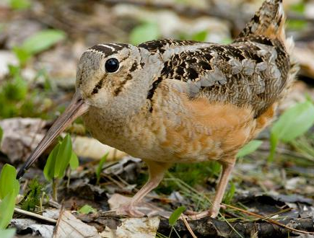
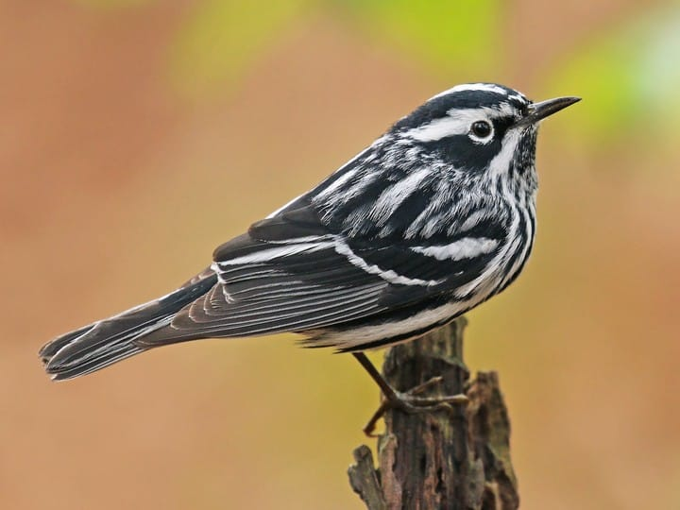
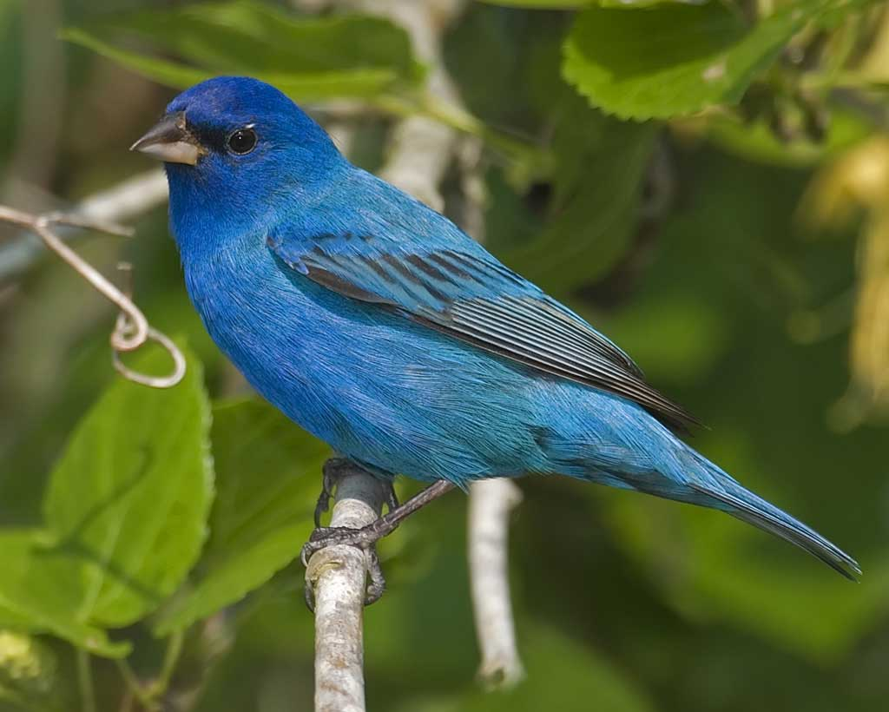
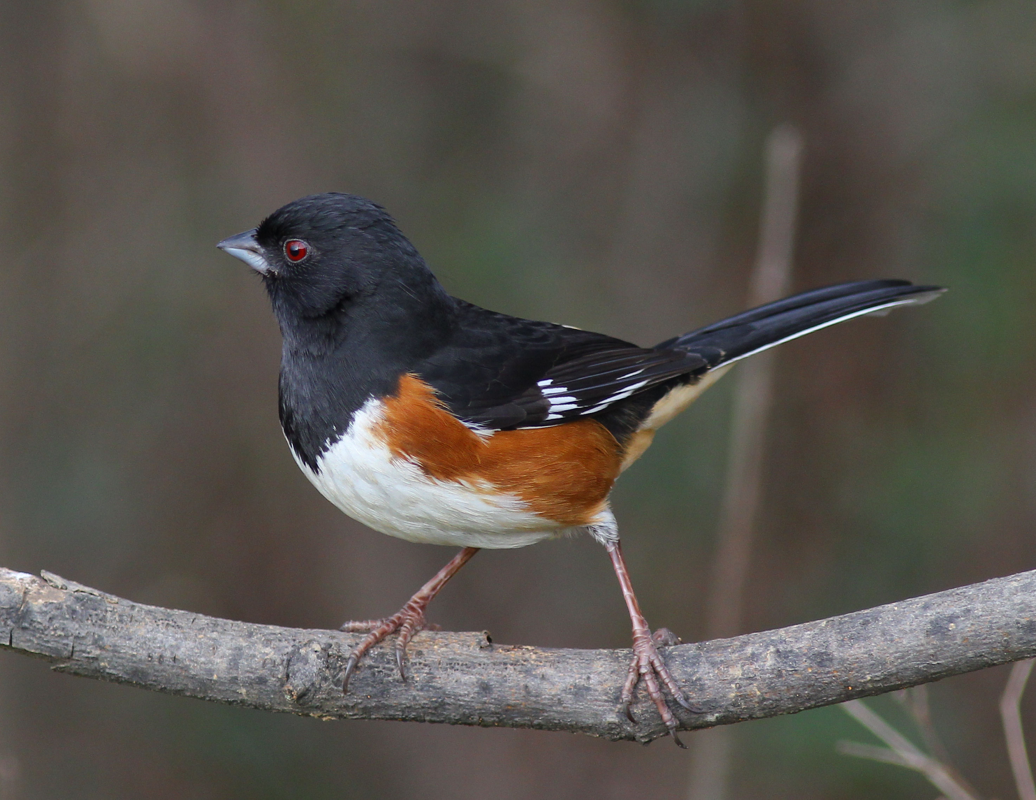
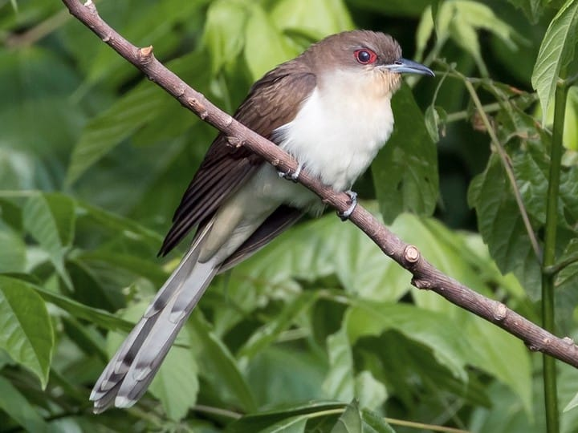
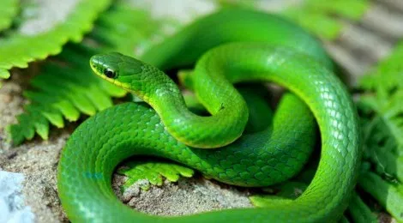
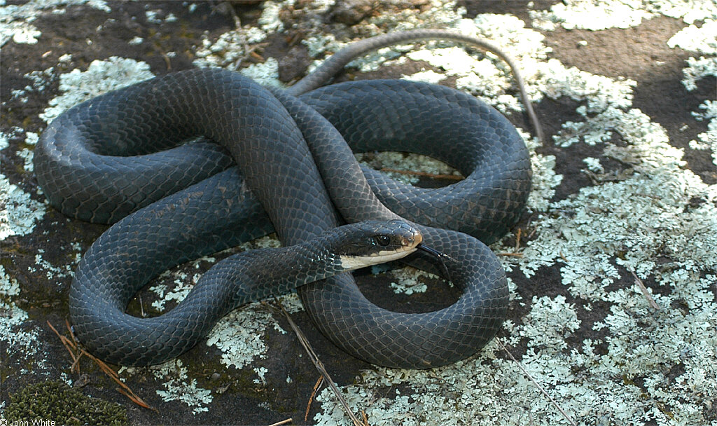
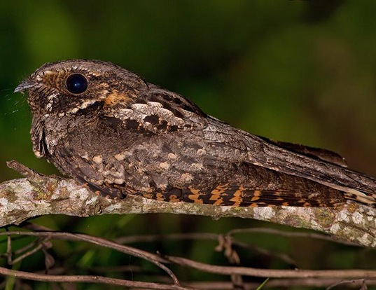
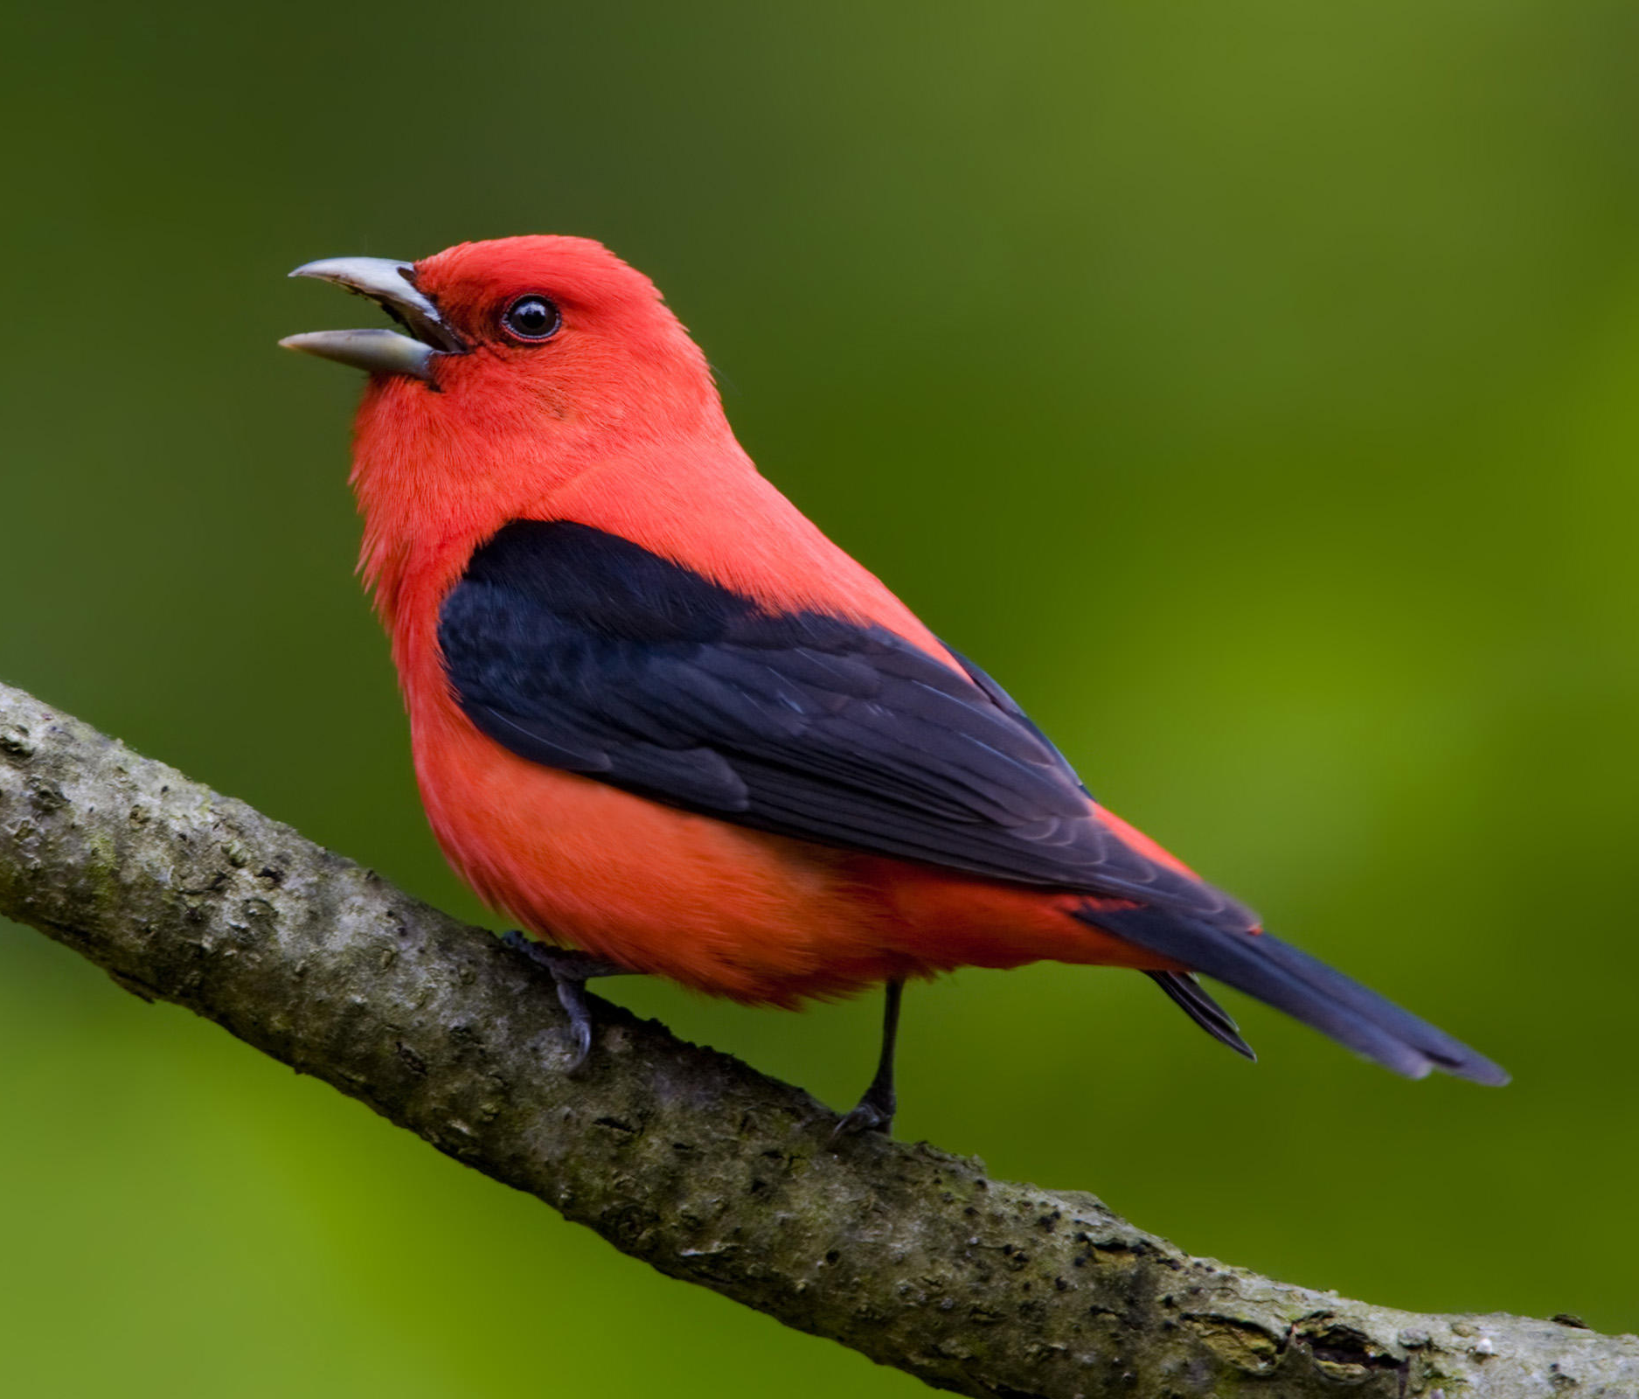
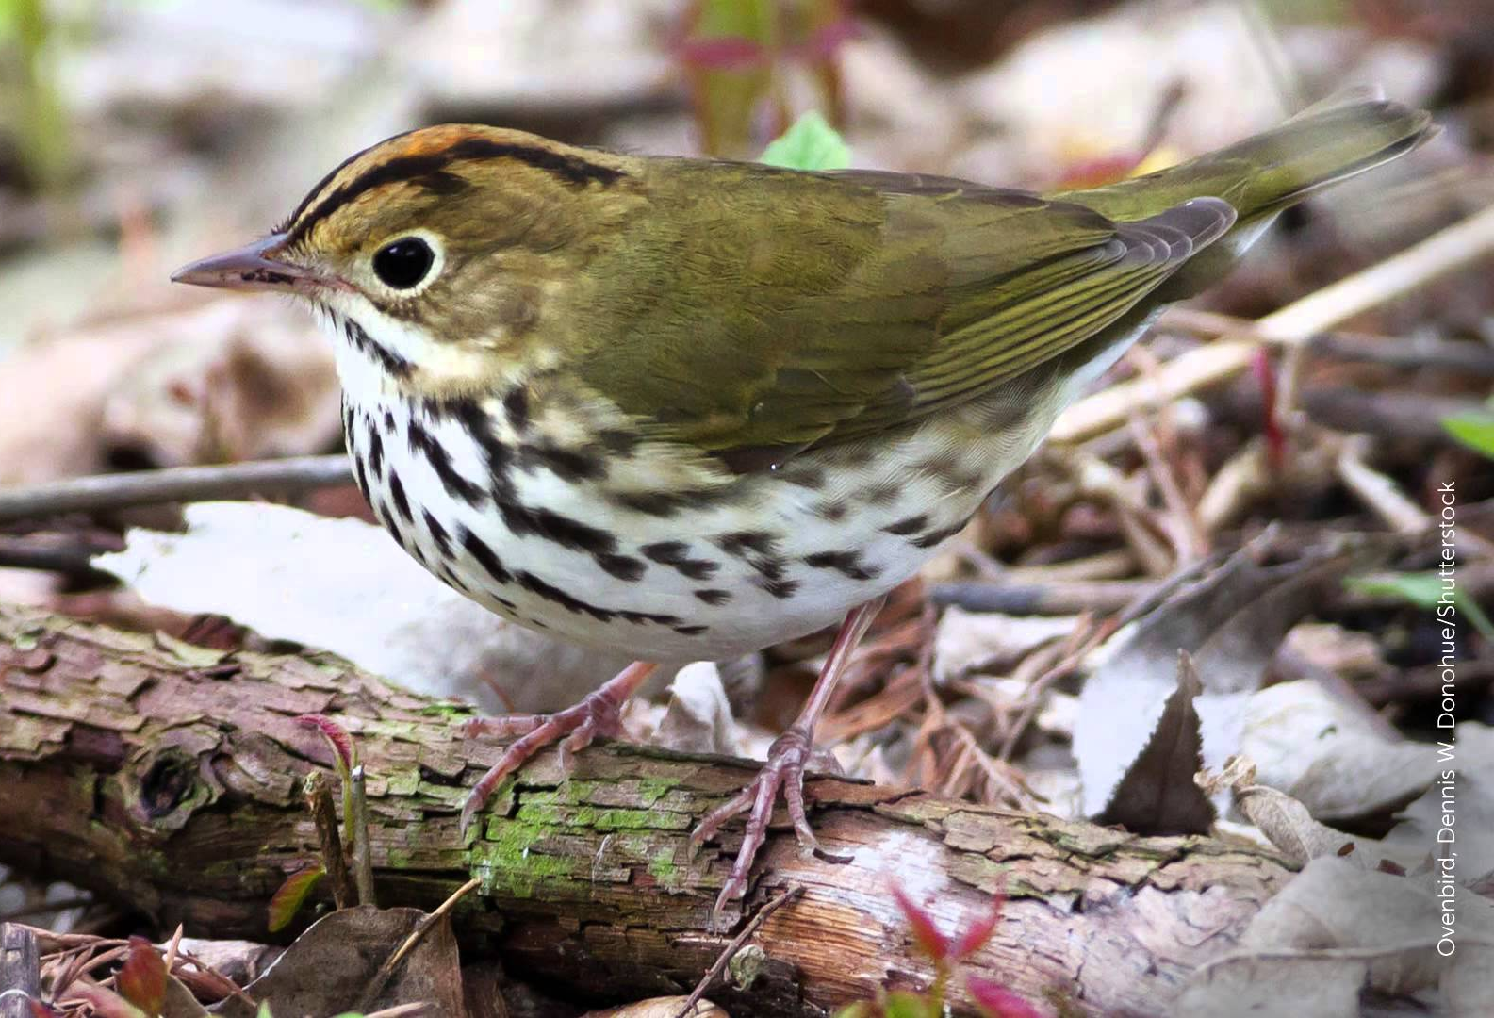
Who lives in a young forest?
Notes:
All of these animals depend on young forests to survive. Today we will discuss an important species that live in young forests in Rhode Island, the American woodcock (circled on click).
From left to right:
Ruffed grouse, bobcat, New England cottontail, wood turtle, box turtle
Yellow warbler, American woodcock, black-and-white warbler, indigo bunting, Eastern towhee, black-billed cuckoo
Smooth green snake, black racer, whip-poor-will, scarlet tanager, ovenbird

Slide 4
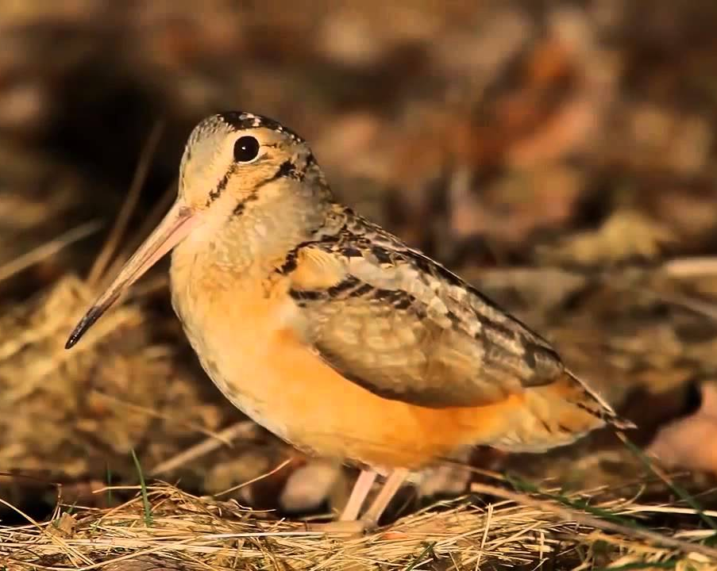
Meet the American Woodcock!
Also called...
“Peentmeister!”
“Timberdoodle!”
“Bogsucker!”
“Hokumpoke!”
“Mudbat!”
Hey, quit calling me names!
Height: 5 inches
Wingspan: 20 inches
Weight: Under 8 ounces

Slide 5
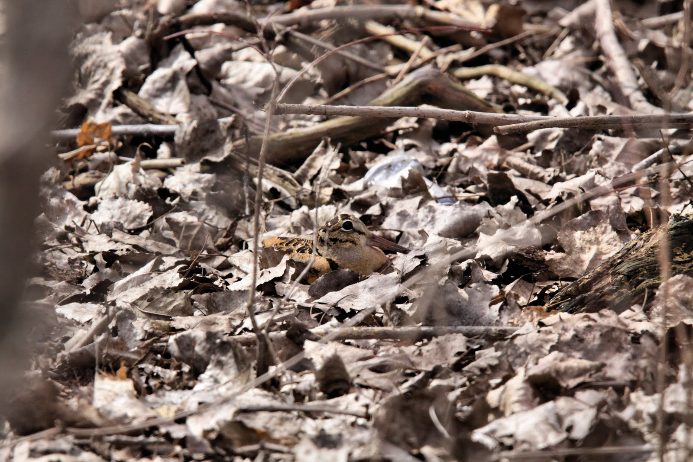
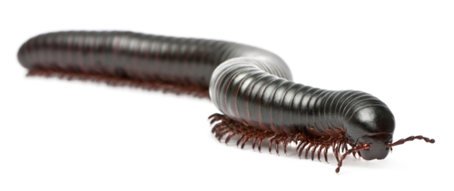
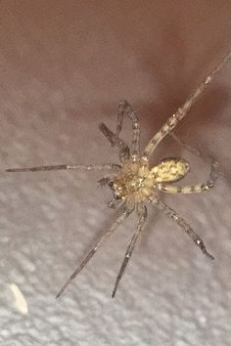
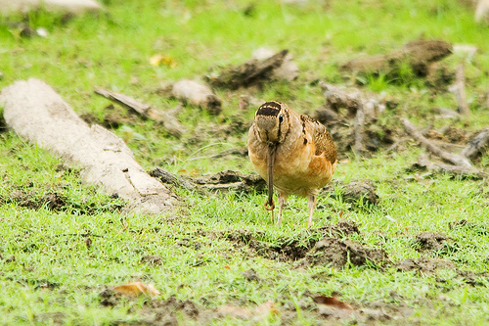
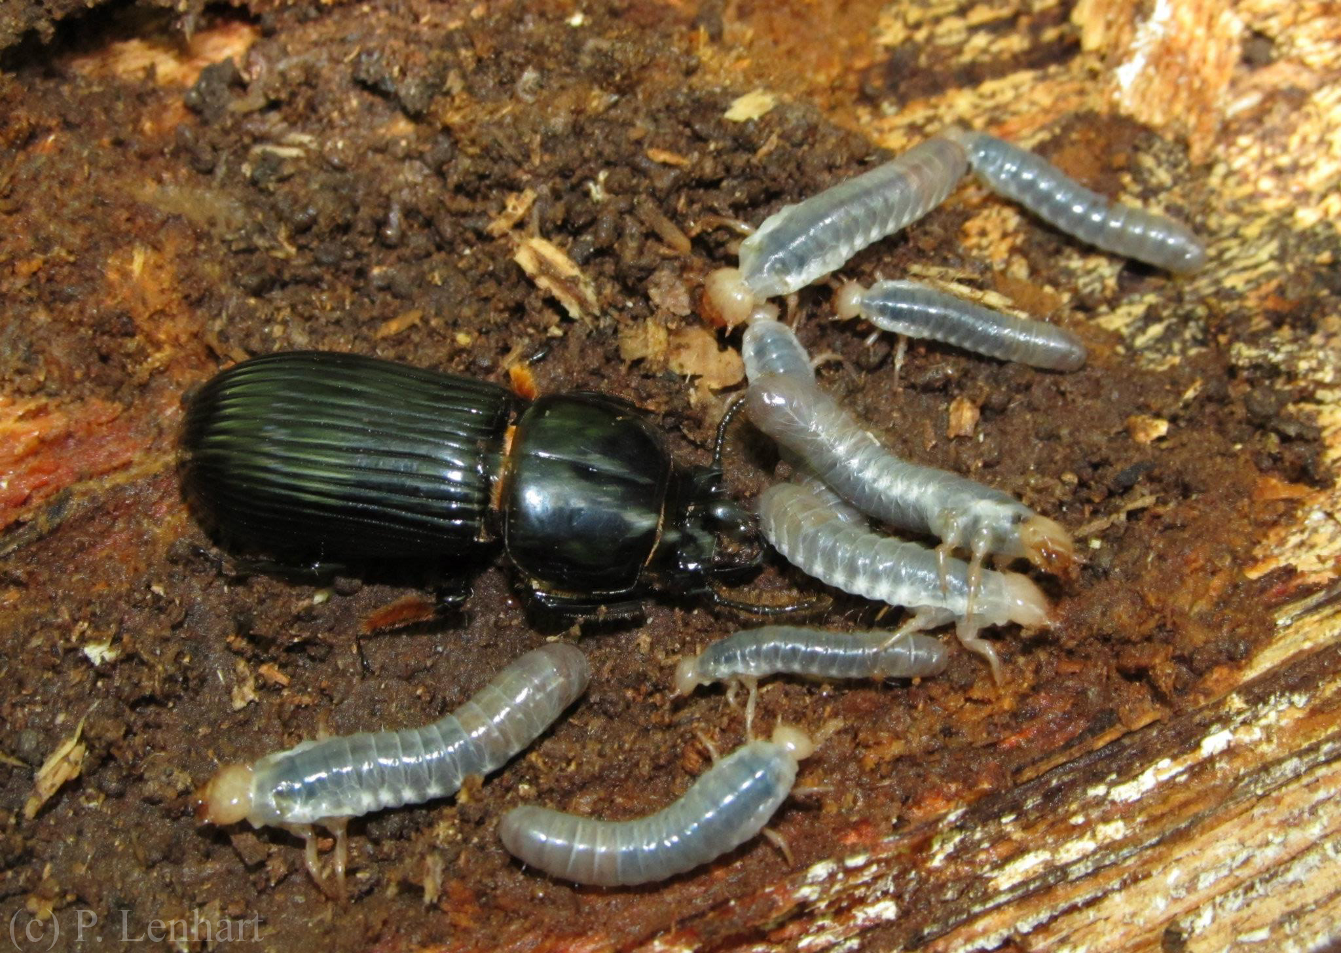
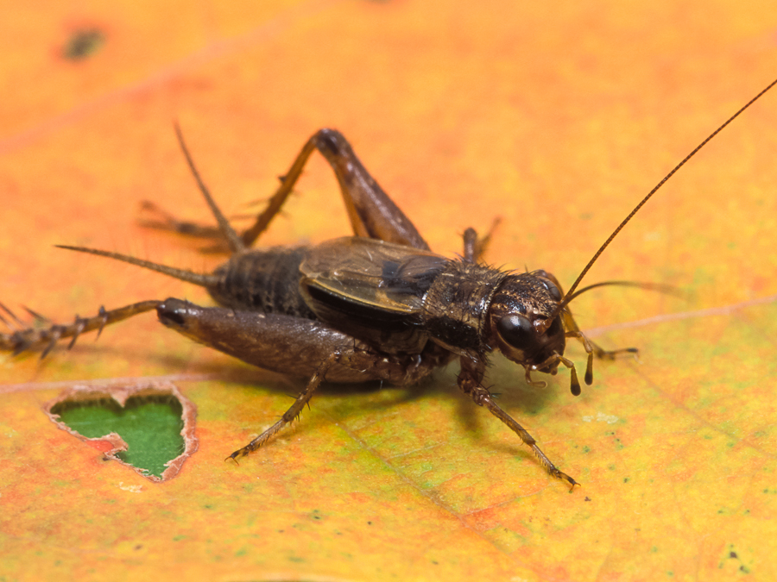
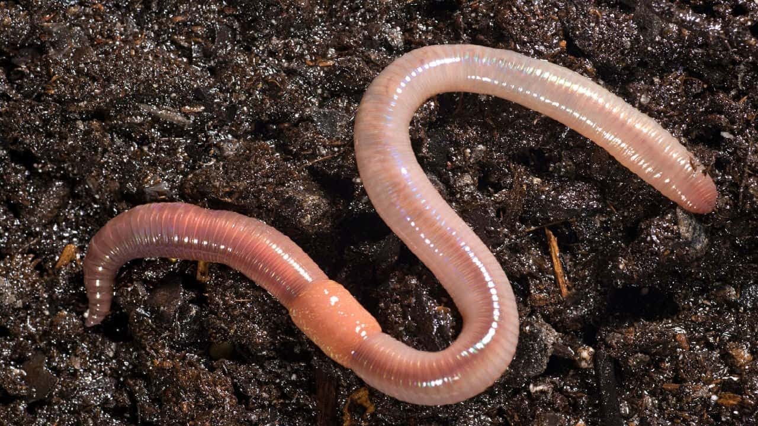
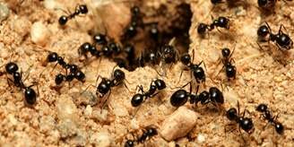
Amazing Adaptations!
Flexible beak
Tongue with rough edges
Camouflage!
360° field of vision
Notes:
Ask the class what how they think these adaptations help woodcock to survive?
Flexible beak and rough tongue help woodcock while foraging for food: eat insects and worms by “bobbing” for them in the dirt! (on click new image with link to video will appear)
Camouflage and 360 degree field of vision helps protect them from predators

Slide 6
The Sky Dance
Notes:
In late winter/early spring, woodcock perform a mating display called the skydance. Read the excerpt by Aldo Leopold:
“Knowing the place and the hour, you seat yourself under a bush to the east of the dance floor and wait, watching against the sunset for the woodcock’s arrival. He flies in low from some neighboring thicket, alights on the bare moss, and at once begins the overture: a series of throaty peents spaced about two seconds apart, and sounding much like the summer call of the nighthawk.
Suddenly the peenting ceases and the bird flutters skyward in a series of wide spirals, emitting a musical twitter. Up and up he goes, the spirals steeper and smaller, the twittering louder and louder, until the performer is only a speck in the sky. Then, without warning, he tumbles like a crippled plane, giving voice in a soft liquid warble that a March bluebird might envy. At a few feet from the ground he levels off and returns to his peenting ground, usually to the exact spot where the performance began, and there resumes his peenting.”

Slide 7
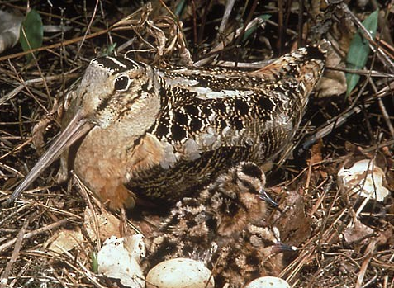
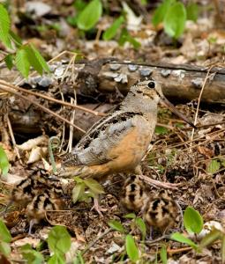
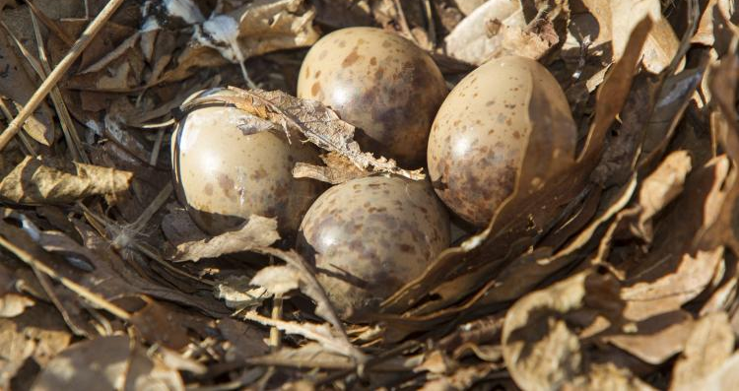
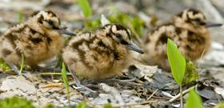
What does a young forest provide for a woodcock?
A safe place to nest and raise their young!

Slide 8
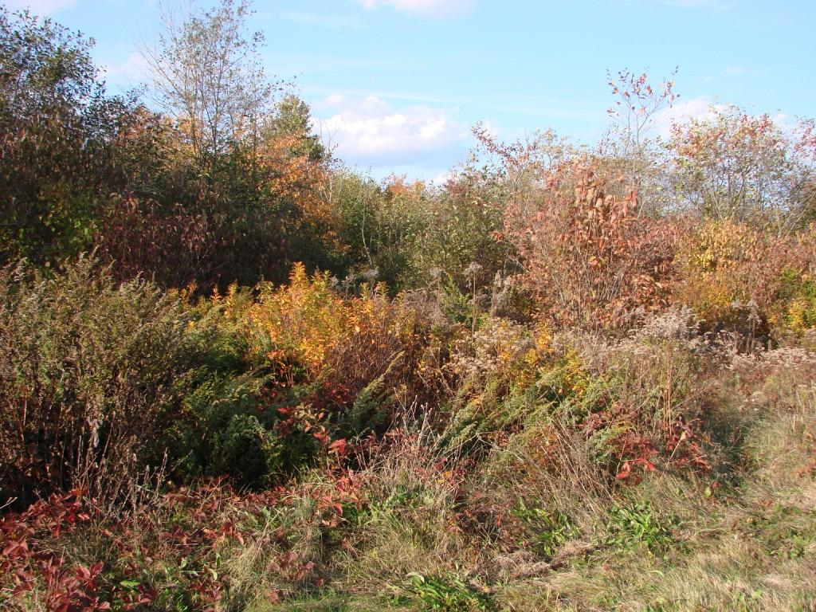
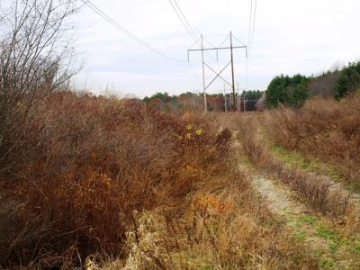
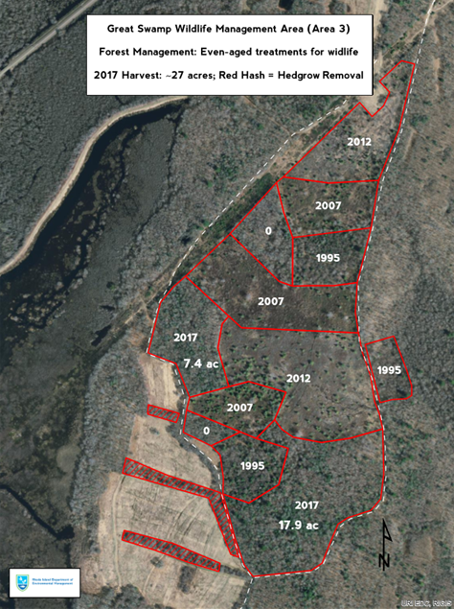
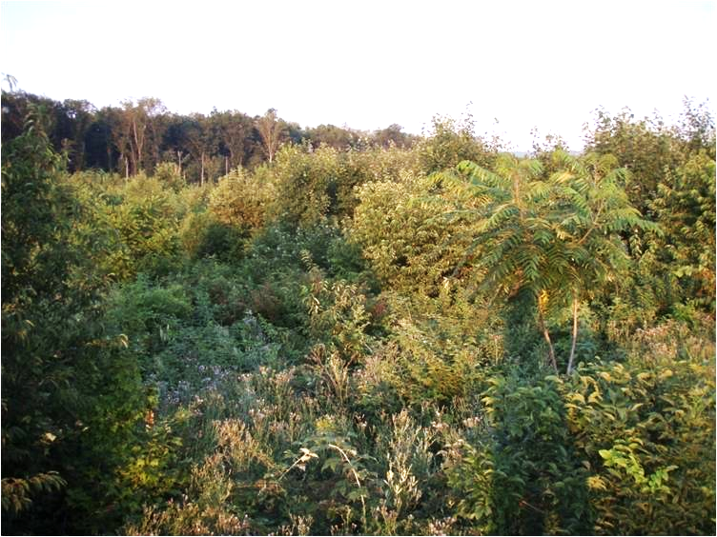
How is the DEM helping young forest wildlife?
By creating more young forest habitat!
Large plots & corridors of thick and shrubby habitat
Thorns ~ Cover ~ Food ~ Protection
Notes:
The DEM clear-cuts areas periodically to replicate the natural clearing that would occur as a result of hurricanes or flooding.
The map (appears on click) shows the Great Swamp Management Area.
The sections are dated by year of the last clear-cut. You can see each patch is at a different stage of forest succession.
The DEM will continue to rotate cutting through these sections to ensure that there are always various stages of forest present in this area.
The current sections of young forests will only last about 25 years before turning into a mature forest and will no longer be useful to young forest wildlife.

Slide 9
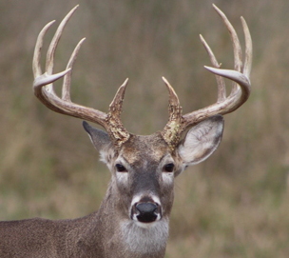
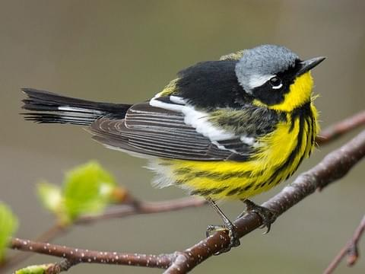
“Umbrella Species”
Notes:
What is an umbrella species?
Umbrellas species are animals that, when protected, indirectly protect other animals that share their same habitat. Just like when you hold an umbrella over your head, it protects some of the space around you as well.
American woodcock and NEC are both umbrella species because they protect all of these other animals that share young forest habitats!

