Slide 1
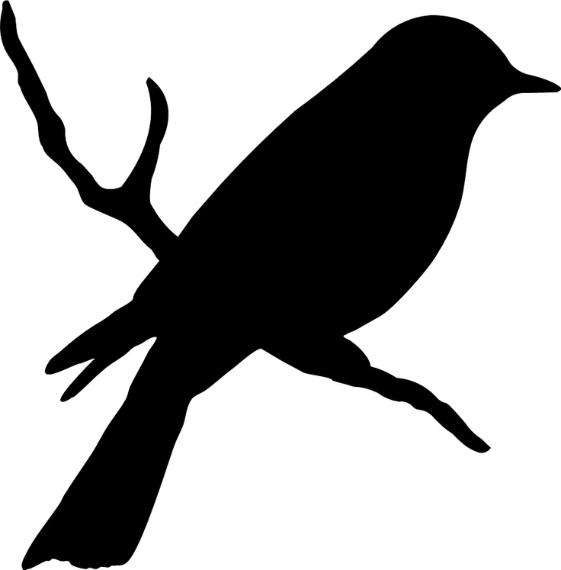
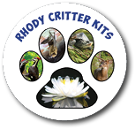
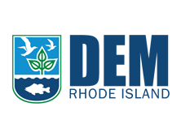
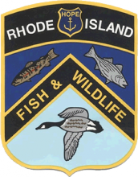
Rhode Island Bird Bingo

Slide 2
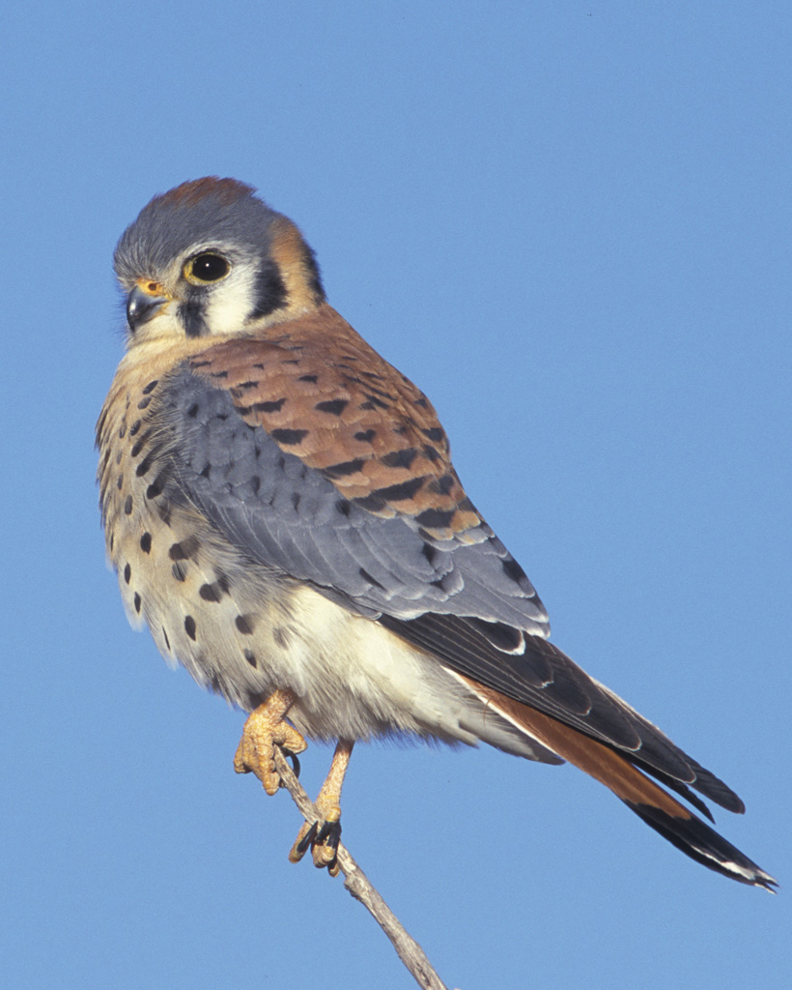
American Kestrel
Voice

Slide 3
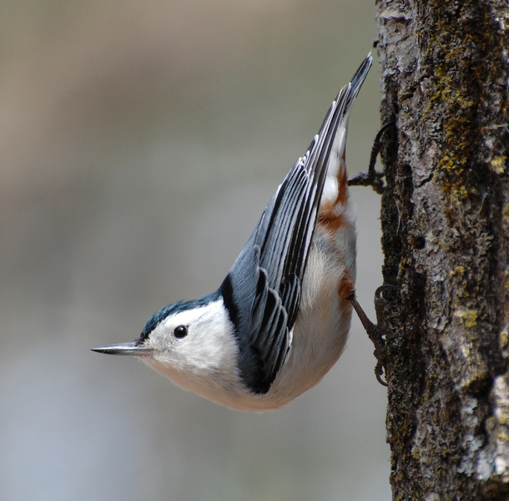
White-breasted Nuthatch
Voice

Slide 4
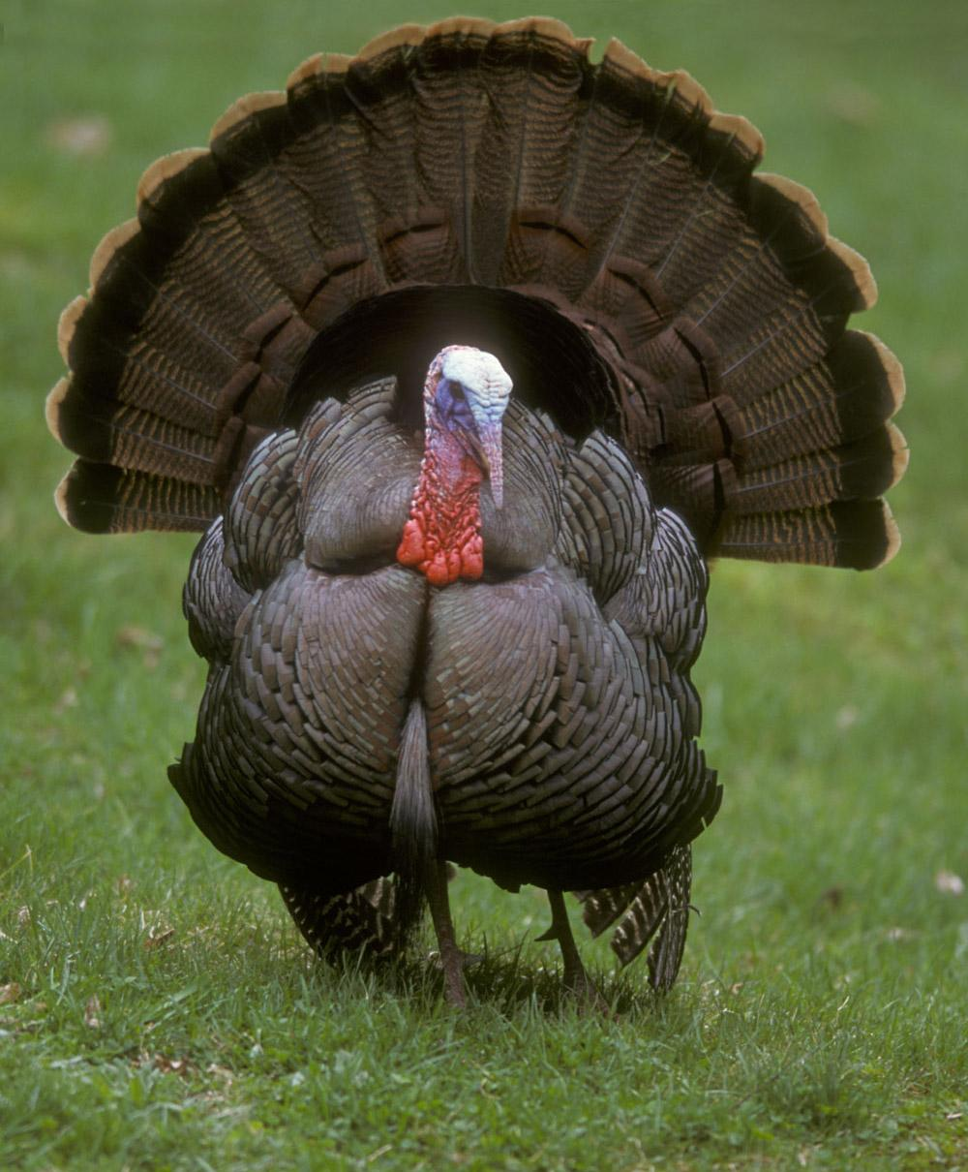
Wild Turkey
Voice

Slide 5
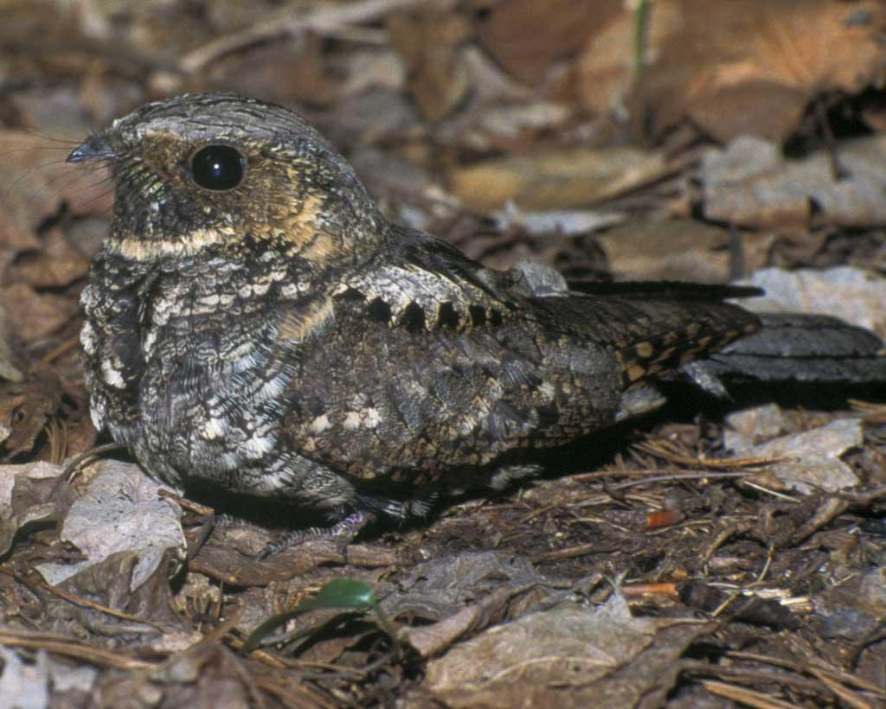
Eastern Whip-poor-will
Voice

Slide 6
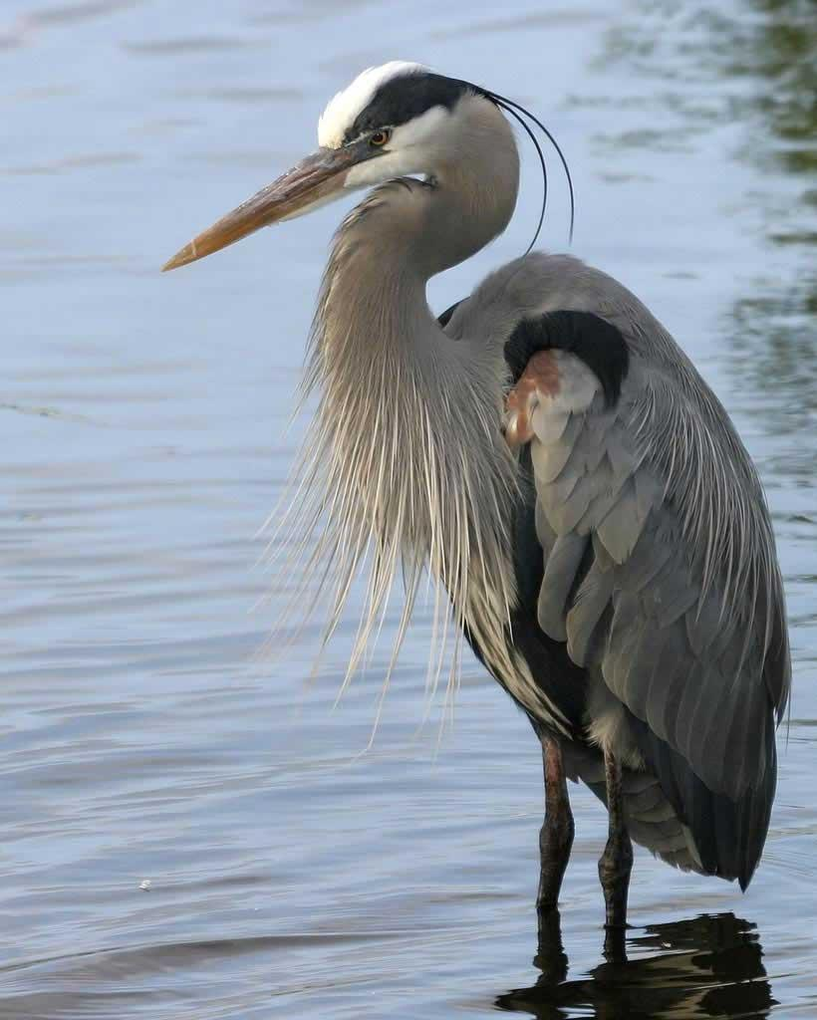
Great Blue Heron
Voice

Slide 7
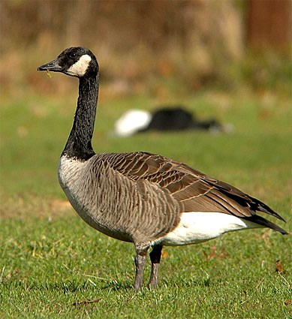
Canada Goose
Voice

Slide 8
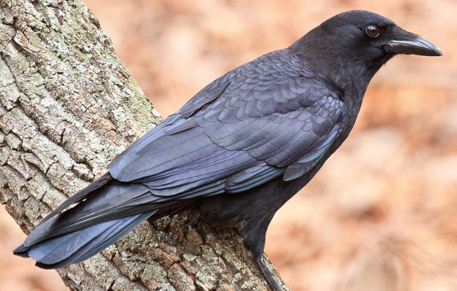
American Crow
Voice

Slide 9
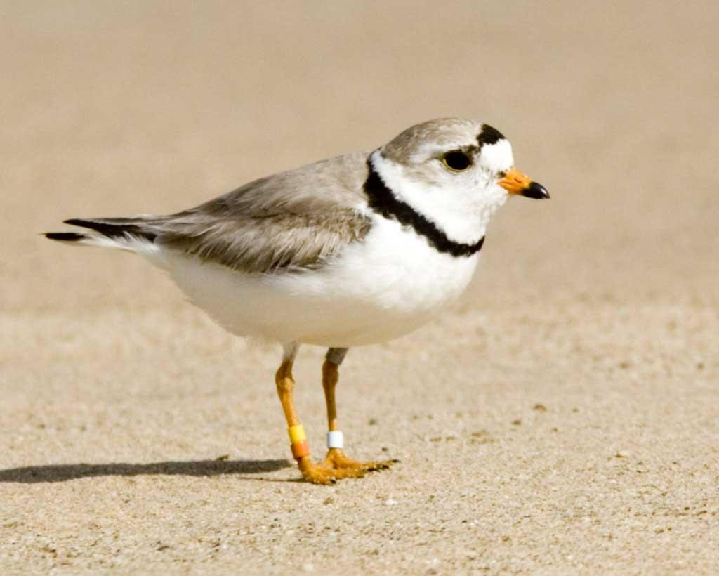
Piping Plover
Voice

Slide 10
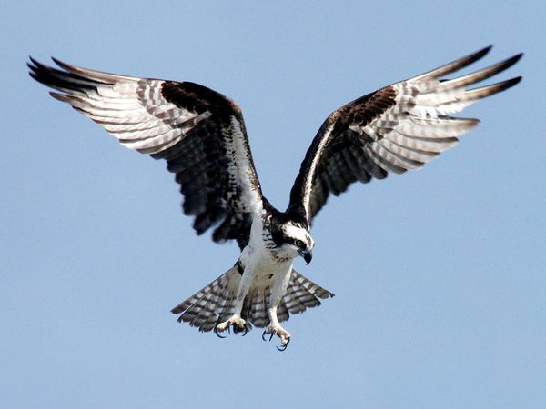
Osprey
Voice

Slide 11
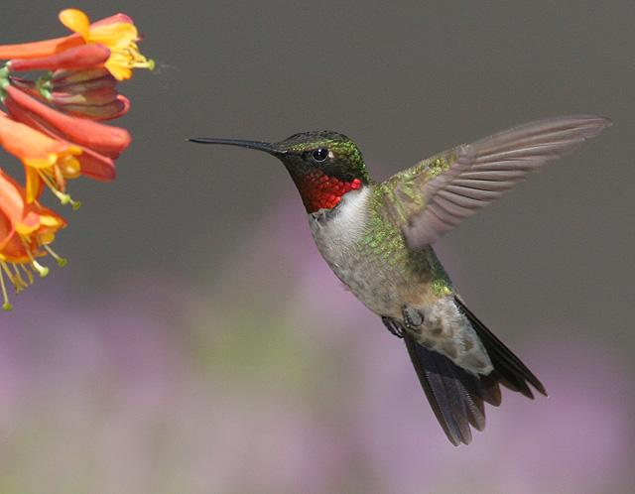
Ruby-throated Hummingbird
Voice

Slide 12
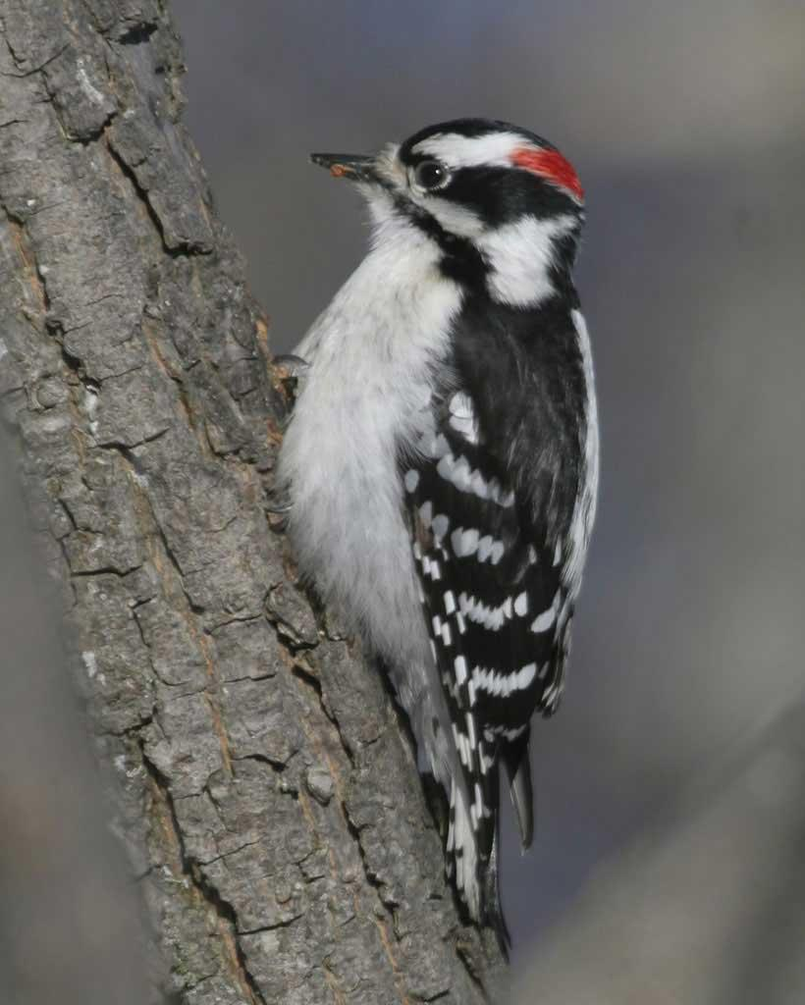
Downy Woodpecker
Voice

Slide 13
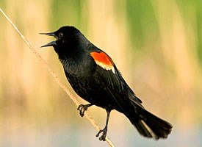
Red-winged Blackbird
Voice

Slide 14
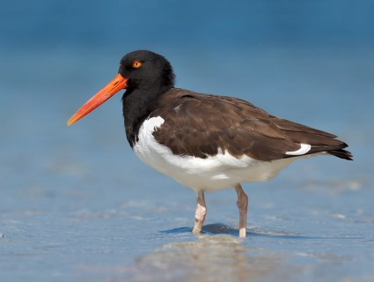
American Oystercatcher
Voice

Slide 15
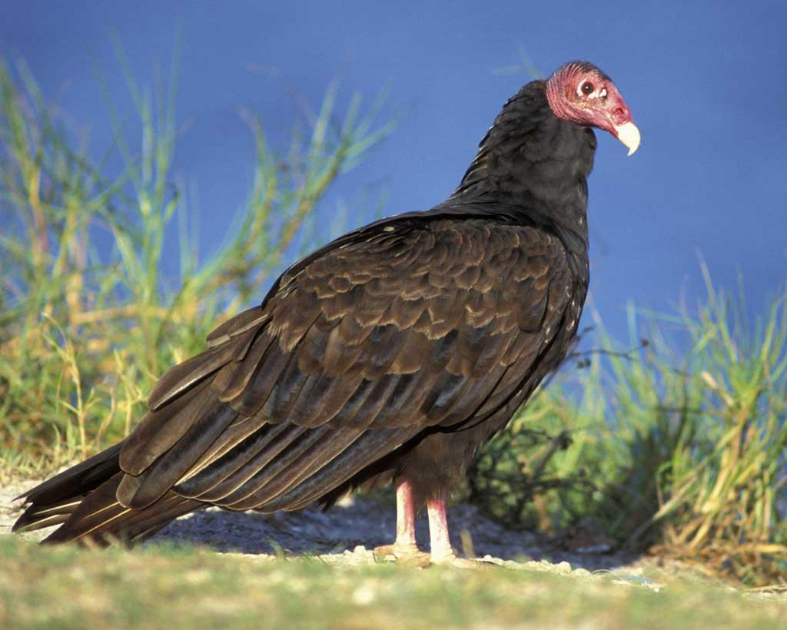
Turkey Vulture
Voice

Slide 16
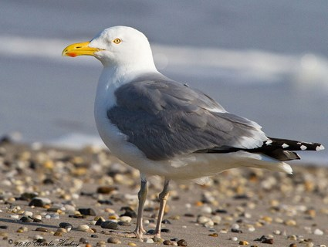
Herring Gull
Voice

Slide 17
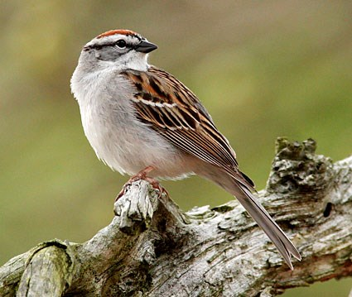
Chipping Sparrow
Voice

Slide 18
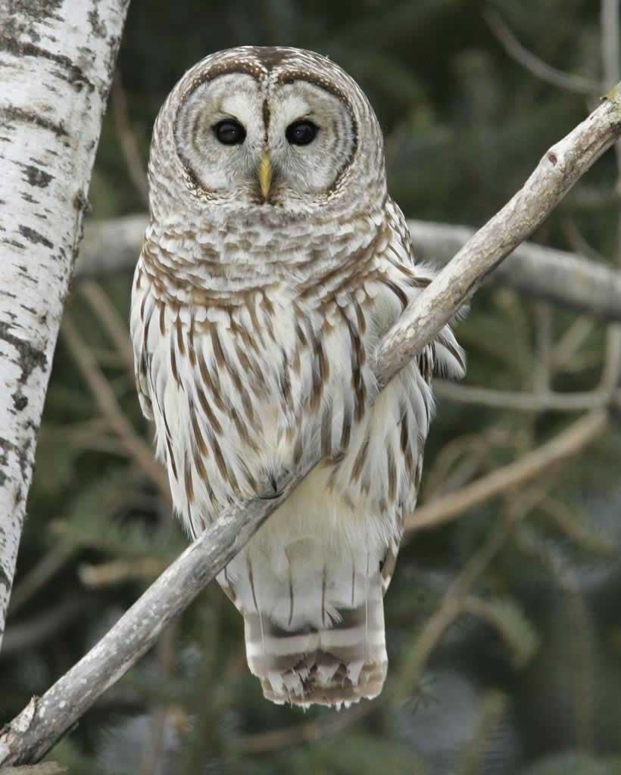
Barred Owl
Voice

Slide 19
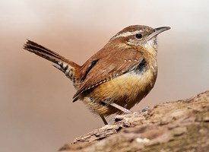
Carolina Wren
Voice

Slide 20
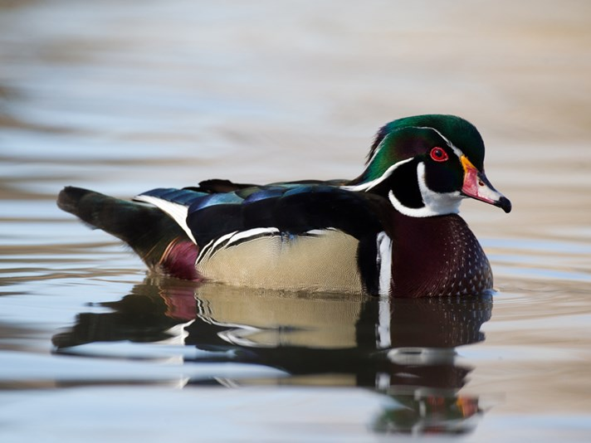
Wood Duck
Voice

Slide 21
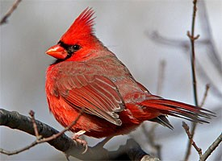
Northern Cardinal
Voice

Slide 22
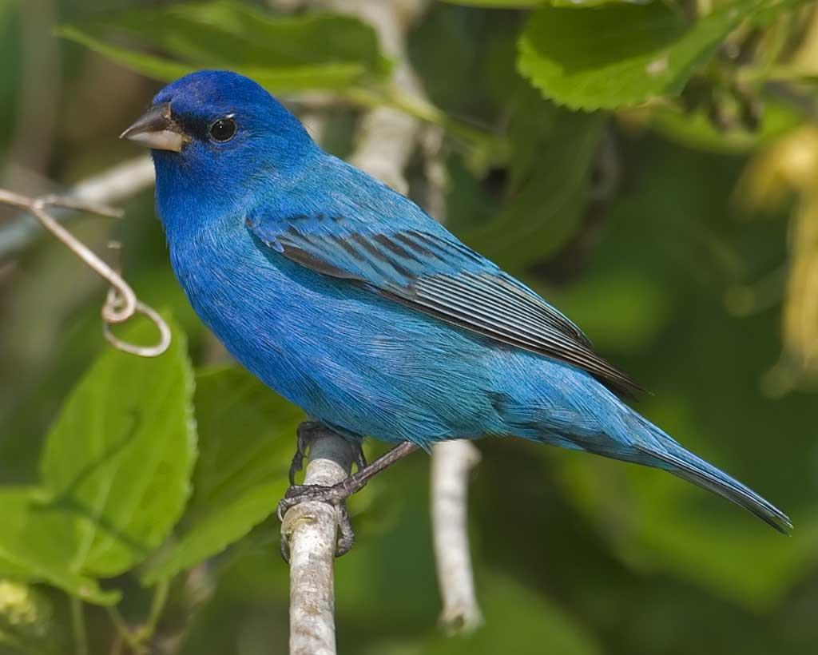
Indigo Bunting
Voice

Slide 23
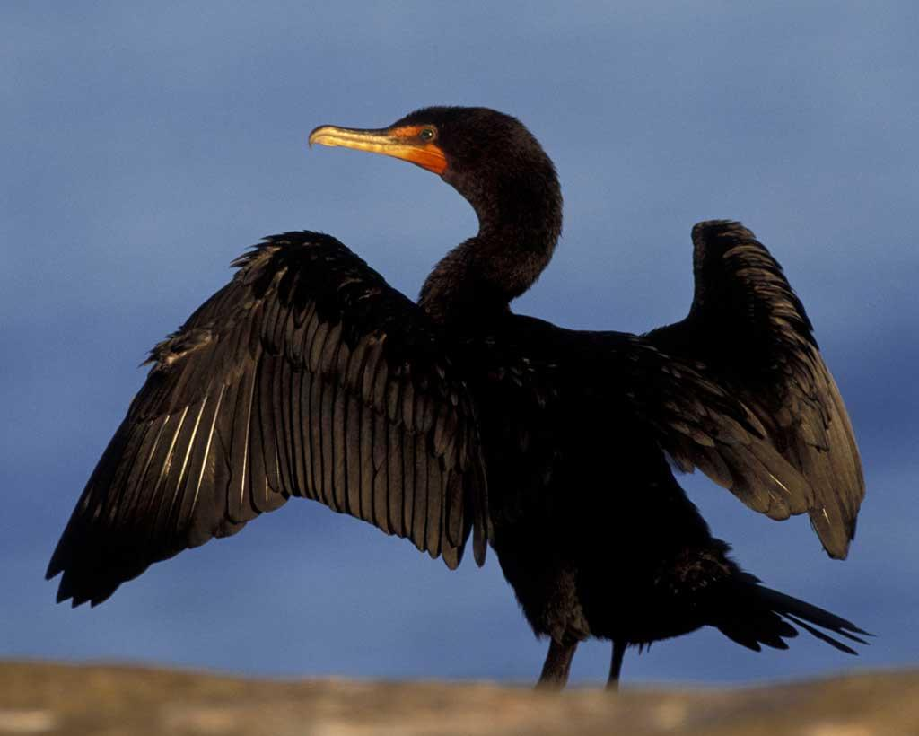
Double-crested Cormorant
Voice

Slide 24
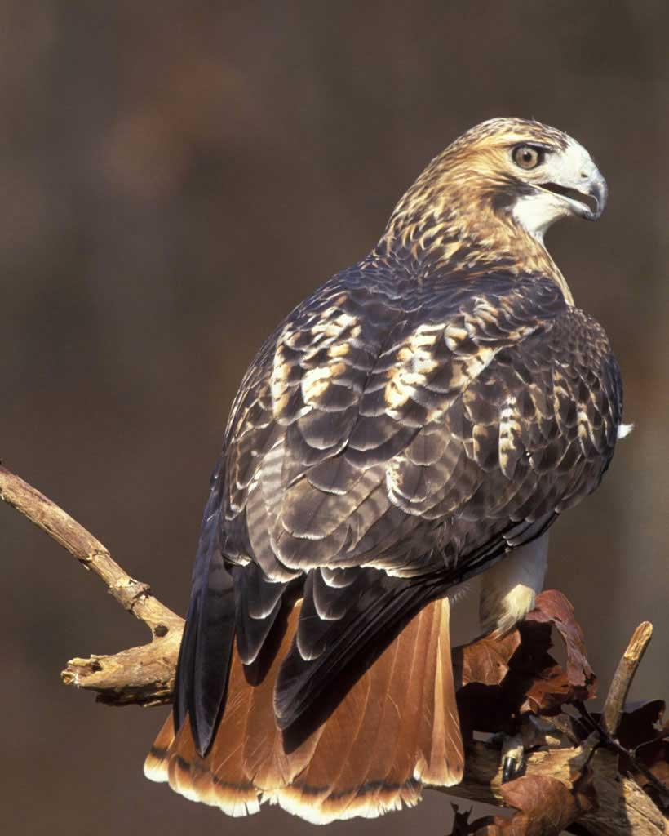
Red-tailed Hawk
Voice

Slide 25
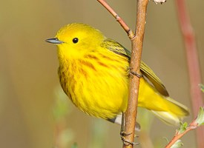
Yellow Warbler
Voice

Slide 26
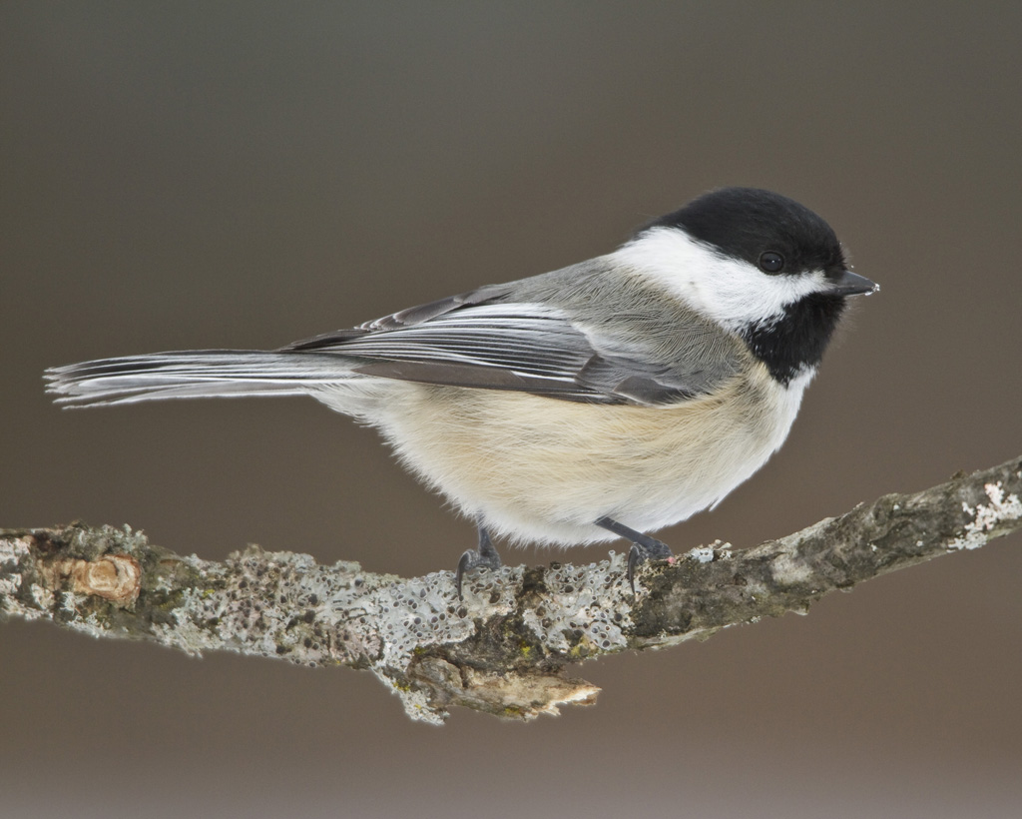
Black-capped Chickadee
Voice

