Slide 1
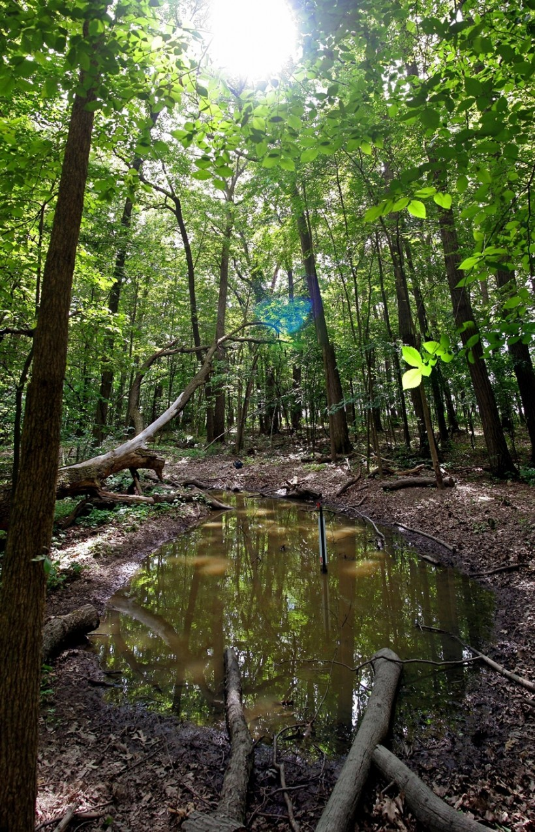
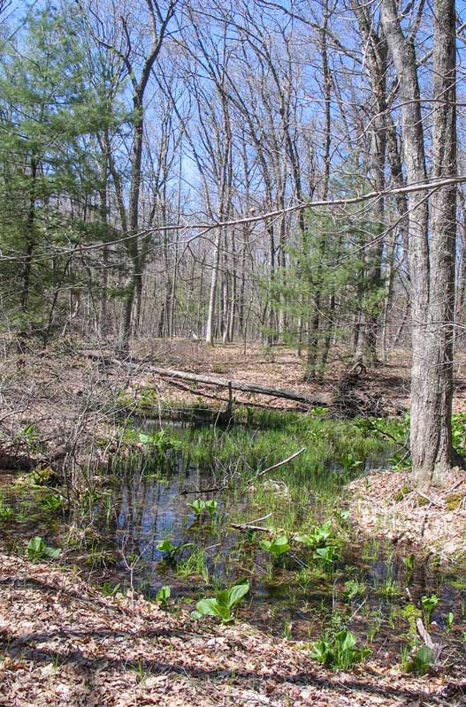
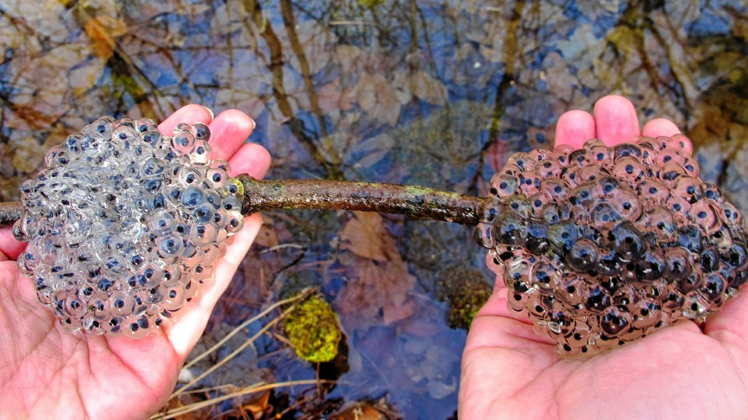
Vernal Pools
Template by Eric Curts

Slide 2
JEOPARDY BOARD
FINAL JEOPARDY
Vernal Pools | Amphibians | Frogs | Toads | Salamanders
$100 | $100 | $100 | $100 | $100
$200 | $200 | $200 | $200 | $200
$300 | $300 | $300 | $300 | $300
$400 | $400 | $400 | $400 | $400
$500 | $500 | $500 | $500 | $500
Notes:
Click on the selected price block and it will bring you directly to the associated question.
Once you are on the question slide, you can press the arrow to see the answer.
Every answer slide has a home link back to the jeopardy board.

Slide 3
Vernal Pools - $100 Question
Where does the water in vernal pools come from?
Click to see answer

Slide 4
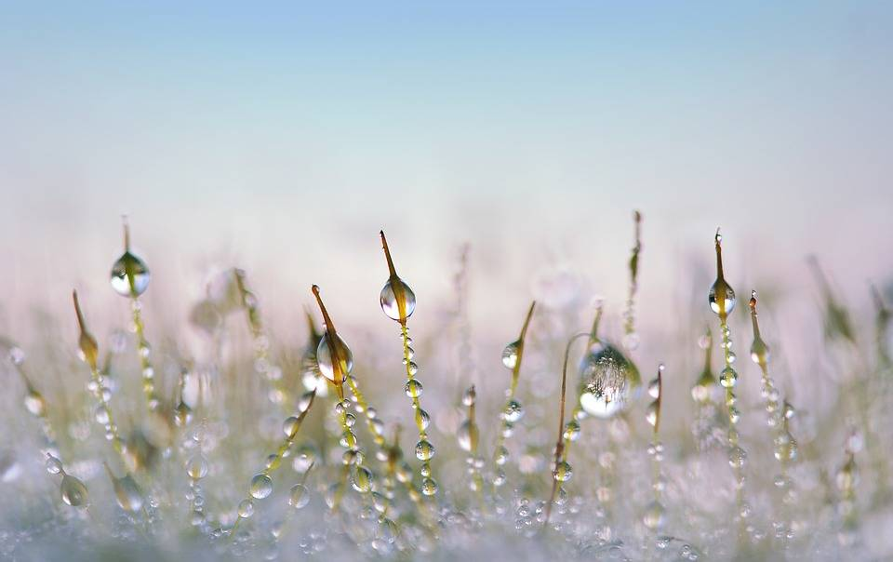
Vernal Pools - $100 Answer
Snow melt and rain
Click to return to Jeopardy Board
Notes:
Snow melt and rain during the springtime fill the empty divet in the forest floor. This water will usually only stay during the springtime, drying up in the heat of summer.

Slide 5
Vernal pools - $200 Question
What does the world “vernal” mean?
Click to see answer

Slide 6
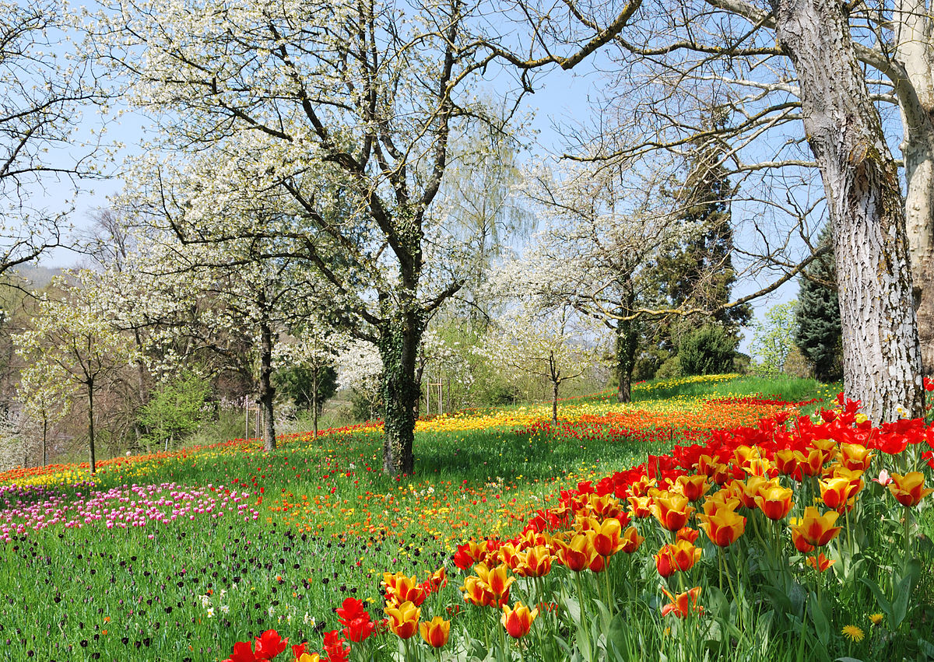
Vernal Pools - $200 Answer
Spring!
Click to return to Jeopardy Board
Notes:
Vernal comes from the Latin word Vernus meaning, “of the spring” since the pools are only full during the springtime.

Slide 7
Vernal Pools - $300 Question
Name one clue that can help identify a vernal pool.
Click to see answer

Slide 8
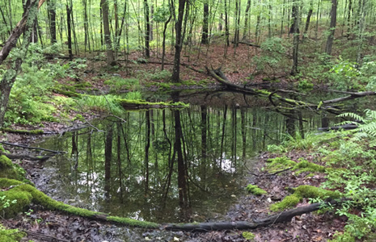
Vernal Pools - $300 Answer
NO FISH
Fairy shrimp
Dries up in summer
Moss on trees
Frogs calling
Click to return to Jeopardy Board
Notes:
Vernal pools are such great places for breeding amphibians because there are no fish present, eating up all of the eggs and larvae.

Slide 9
Vernal Pools - $400 Question
Name one reason why vernal pools are important.
Click to see answer

Slide 10
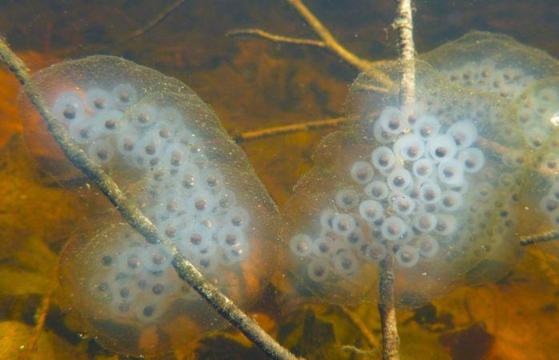
Vernal pools - $400 Answer
Important places for many animals to breed, lay eggs and live.
Click to return to Jeopardy Board
Notes:
Vernal pools are so important because without them, many of our amphibians wouldn’t have safe places to live. They provide temporary wetlands at a very important time when animals are emerging after winter and need a place to rest and breed.

Slide 11
Vernal Pools - $500 Question
Name one animal that depends on vernal pools and how.
Click to see answer

Slide 12
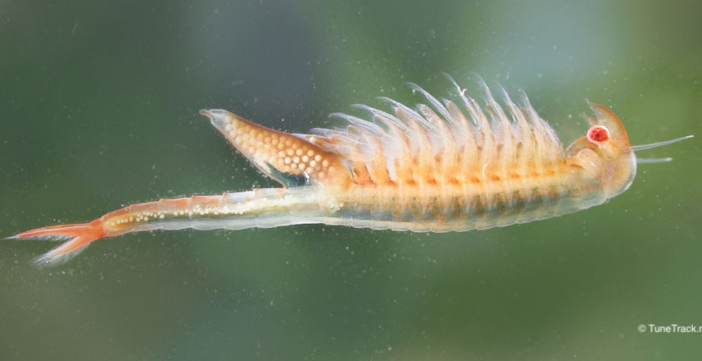
Vernal Pools - $500 Answer
-Fairy shrimp: homes
-Wood frogs and spotted/marbled salamanders: lay eggs
-Many other insects: homes
Click to return to Jeopardy Board

Slide 13
Amphibians - $100 Question
Name one kind of amphibian that lives in Rhode Island.
Click to see answer

Slide 14
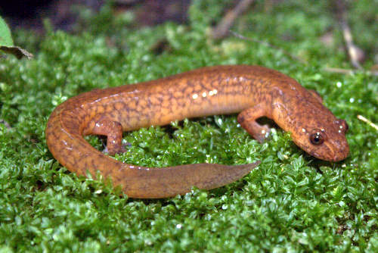
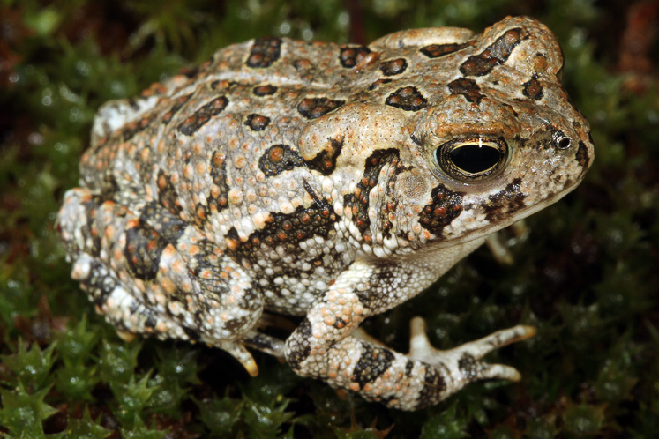
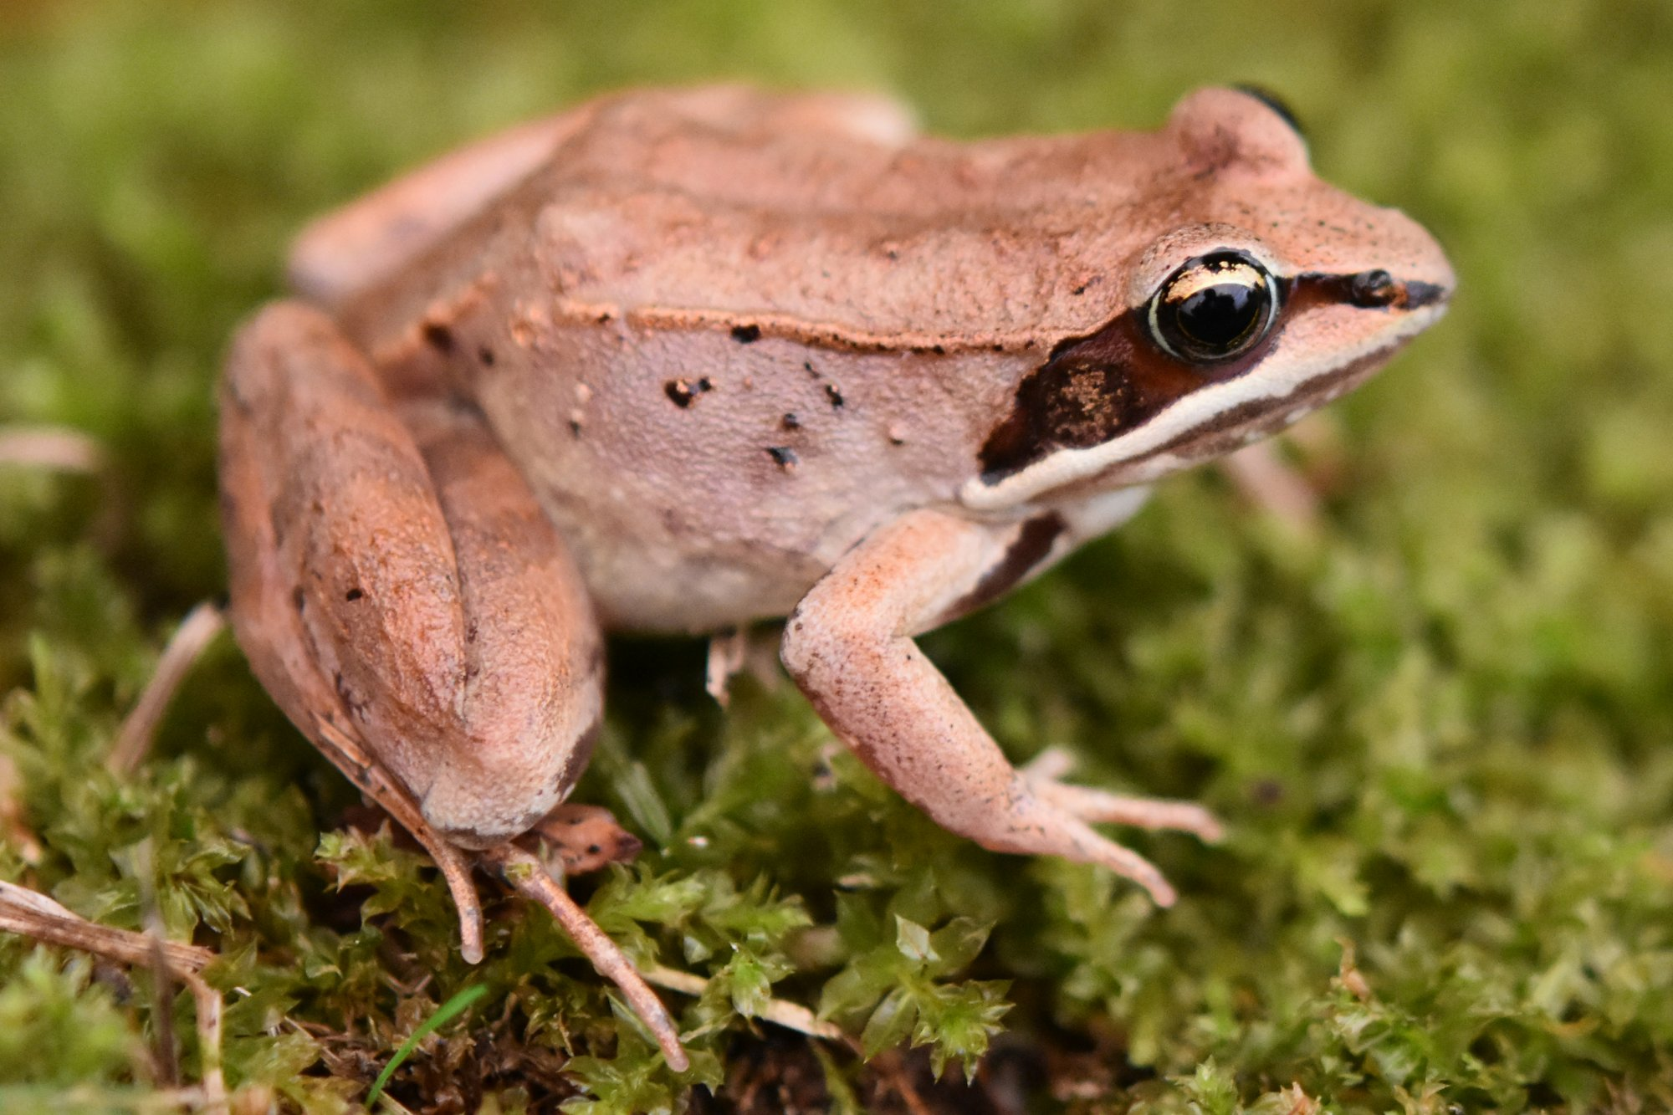
Amphibians - $100 Answer
Frogs, toads, salamanders...
Click to return to Jeopardy Board
Notes:
We have many different species of amphibians that call Rhode Island home. While we enjoy hearing frogs call in the spring and summer, they are also important as food sources for other animals and are indicator species-They tell us if a wetland is healthy or not.

Slide 15
Amphibians- $200 Question
Name two characteristics of amphibians.
Click to see answer

Slide 16
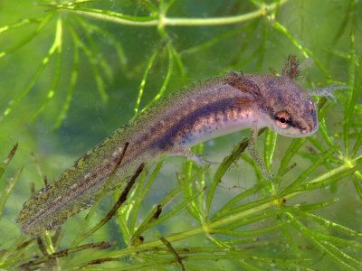
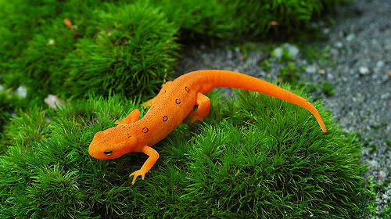
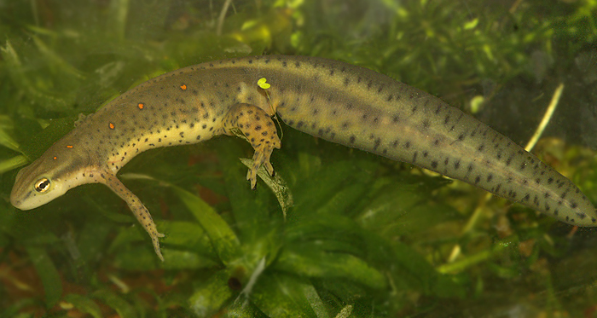
Amphibians - $200 Answer
Cold-blooded (Ectothermic)
Permeable skin
Life spent partly in water
Breathe through skin
Carnivores
Click to return to Jeopardy Board
Notes:
Amphibians are ectothermic-their body temperature depends on the air temperature.
Amphibians have permeable skin- they can absorb things through the many pores in their skin.
Amphibians begin their lives in the water but move onto land as adults
*Our Eastern red-spotted newt actually begins life in the water, then moves onto land as a juvenile “ red eft” and after about 2-7 years, moves back into the water for the rest of its life as an adult!

Slide 17
Amphibians - $300 Question
Name one threat to amphibians.
Click to see answer

Slide 18
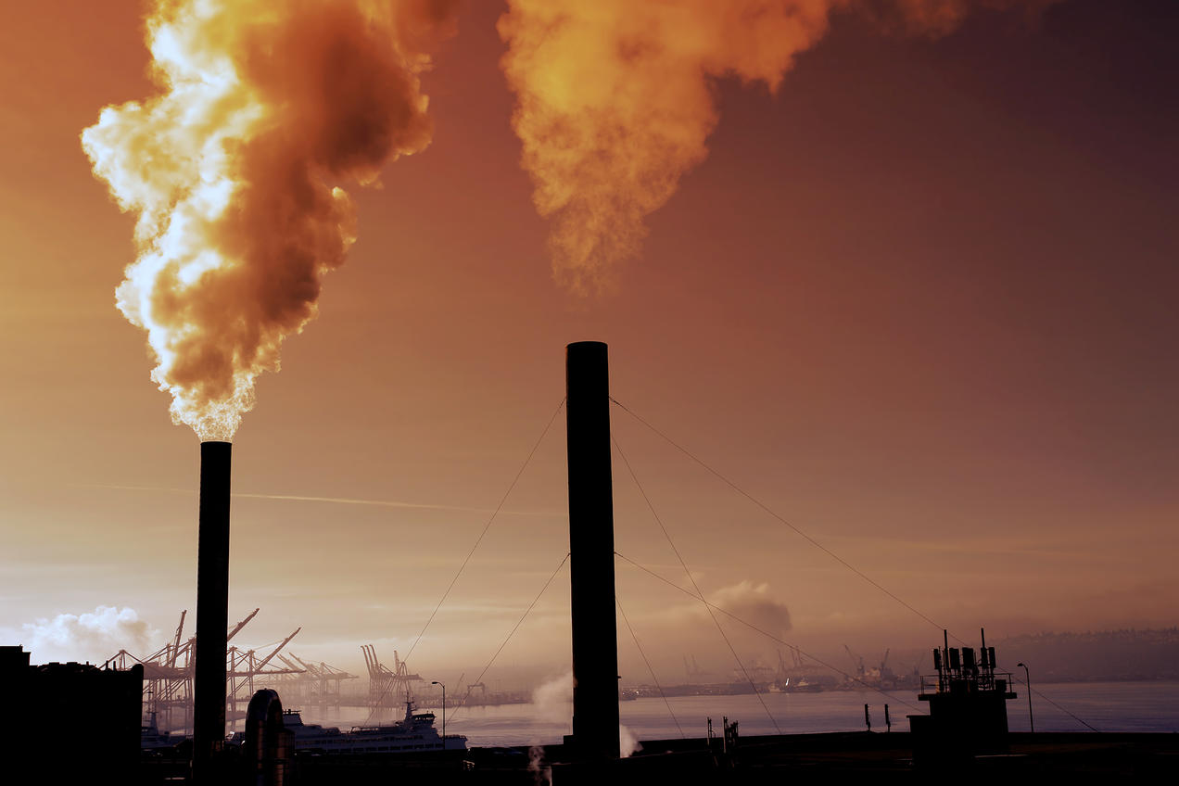
Amphibians - $300 Answer
Pollution
Habitat loss
Fragmentation
Climate change
Click to return to Jeopardy Board
Notes:
Because amphibians have permeable skin, any toxins or pollution that gets into the water can quickly kill entire populations.
Because amphibians spend part of their lives in water and part on land, loss or separation (fragmentation) of either of these two habitat parts can threaten populations.
Because amphibians are ectothermic, climate change, meaning warmer or colder weather, would affect their ability to keep their bodies at the appropriate temperature.

Slide 19
Amphibians- $400 Question
Name one way you can help amphibians.
Click to see answer

Slide 20
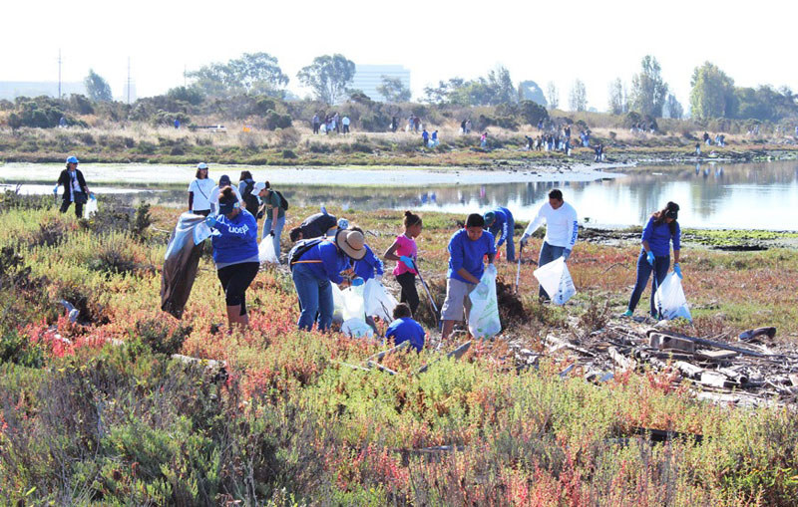
Amphibians - $400 Answer
-Clean up wetlands
-Help protect wetlands
-Tell your friends what you learned today
-Don’t pollute
Click to return to Jeopardy Board
Notes:
One person can make a difference to the health of an ecosystem. If you can start with small changes, it will inspire others to do the same.

Slide 21
Amphibians - $500 Question
What is an indicator species?
Click to see answer

Slide 22
Amphibians - $500 Answer
An animal that is sensitive to environmental changes and helps tell us if a habitat is healthy or not.
Click to return to Jeopardy Board
Notes:
An indicator species, like any of our amphibians, can inform us early on to any changes in the quality of water bodies. Since amphibians have permeable skin, they can absorb any pollution that may have made its way into the water. If we don’t hear or see a lot of amphibians in a vernal pool during the breeding season, something must have happened to the water.

Slide 23
Frogs- $100 Question
Name one kind of frog that lives in Rhode Island
Click to see answer

Slide 24
Frogs - $100 Answer
Green frog
Bullfrog
Wood frog
Pickerel frog
Leopard frog
Gray treefrog
Spring peeper
Click to return to Jeopardy Board

Slide 25
Frogs - $200 Question
What do frogs like to eat?
Click to see answer

Slide 26
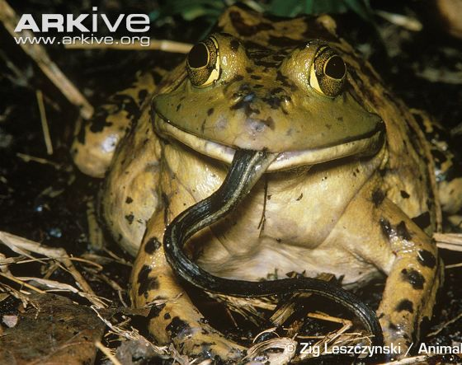
Frogs - $200 Answer
Insects (many kinds) and small fish
*Bullfrogs will eat:
Snakes, frogs, birds, mice!
Click to return to Jeopardy Board
Notes:
Bullfrogs are much bigger than our other native frog species. They will eat just about anything they can fit into their mouths!

Slide 27
Frogs - $300 Question
How do wood frogs survive the winter?
Click to see answer

Slide 28
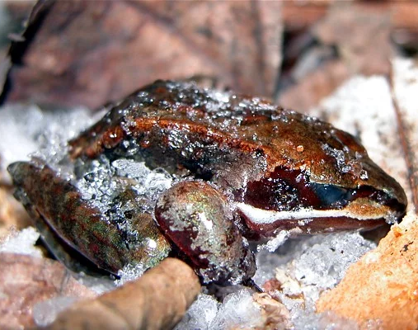
Frogs - $300 Answer
They freeze their bodies!
Click to return to Jeopardy Board
Notes:
Wood frogs have special proteins in their blood, called nucleating proteins. They cause the blood to freeze first, while this is happening the frog’s liver produces glucose, a sugar that prevents the ice crystals from pulling water from inside the cells. Our bodies do not have these proteins and we cannot produce the sugars, so if our cells freeze, they break. In wood frogs, the outside of the cell is frozen but the inside is full of that glucose. When the spring comes, the frogs will thaw out, first the ice crystals will melt, then the heart thaws and the frog is ready to go!

Slide 29
Frogs - $400 Question
Name one stage in a frog’s life-cycle?
Click to see answer

Slide 30
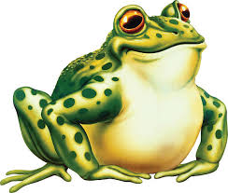
Frogs - $400 Answer
EGG
TADPOLE
ADULT FROG
FROGLET
Click to return to Jeopardy Board
Notes:
This process of changing from one form to another is called metamorphosis. Remember amphibians spend part of their lives in water where they hatch from eggs with gills and when they transform into a froglet, they trade in their gills for lungs and live on land.

Slide 31
Frogs - $500 Question
On which continent are there are no frogs?
Click to see answer

Slide 32
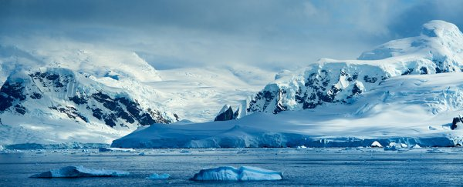
Frogs - $500 Answer
Antarctica
(brrrr!)
Click to return to Jeopardy Board
Notes:
Why are there no frogs on Antarctica?-Too cold for ectotherms!

Slide 33
Toads- $100 Question
Name a kind of toad that lives in Rhode Island.
Click to see answer

Slide 34
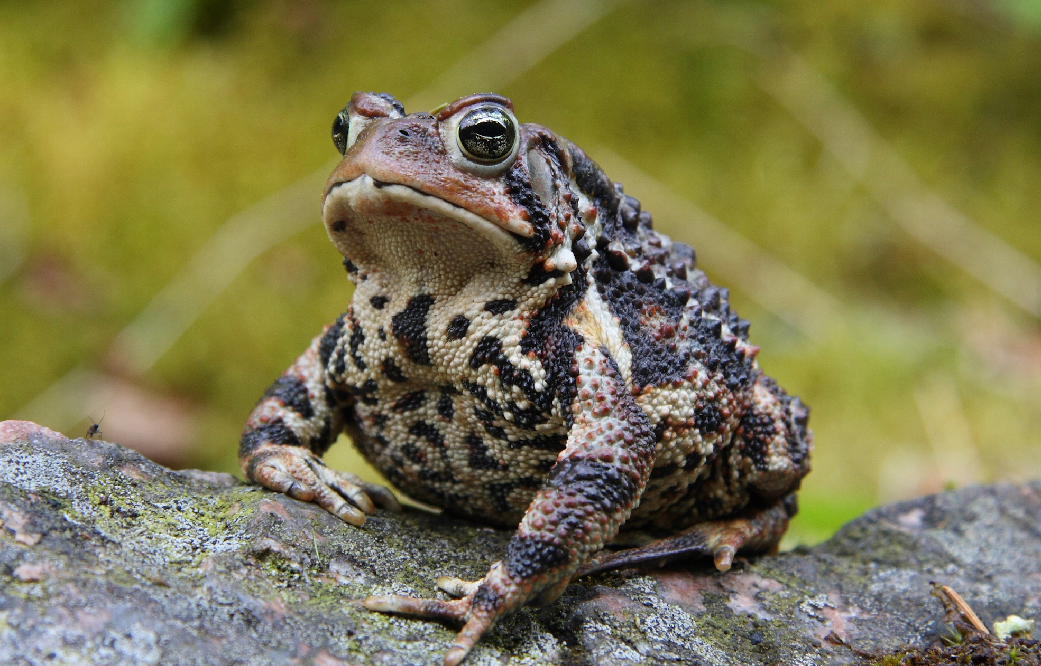
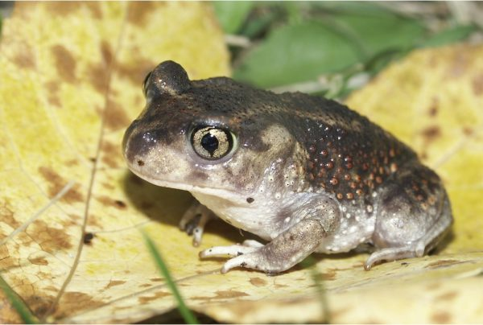
Toads - $100 Answer
American Toad
Eastern Spadefoot Toad
Fowler’s Toad
Click to return to Jeopardy Board

Slide 35
Toads - $200 Question
How do toads catch their prey?
Click to see answer

Slide 36
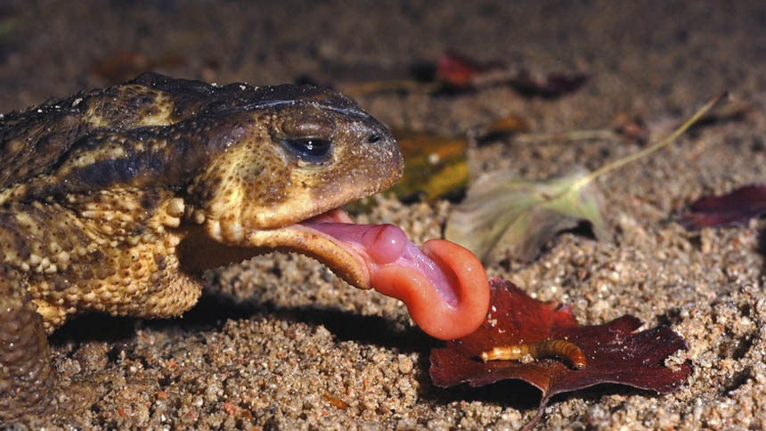
Toads - $200 Answer
With their sticky tongues!
Click to return to Jeopardy Board
Notes:
Toads use their sticky tongues to catch bugs, just like frogs. They are carnivorous so they will not eat plants. Once the toad/frog catches the insect, it uses the back of its eyeballs to push the prey down it throat!!!

Slide 37
Toads - $300 Question
Can toads give you warts?
Click to see answer

Slide 38
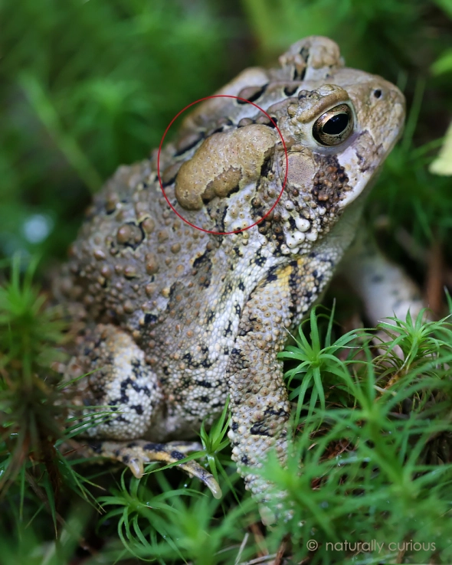
Toads - $300 Answer
NO!
Click to return to Jeopardy Board
Notes:
Toads cannot give you warts, that is a myth! But…. those bumps on a frogs back are called parotoid glands and they secrete toxins when they are threatened. This is to stop them from being eaten by predators. So as long as you don’t try to eat a toad…. You will be fine!

Slide 39
Toads 4 - $400 Question
Do toads require water at any time in their lives?
Click to see answer

Slide 40
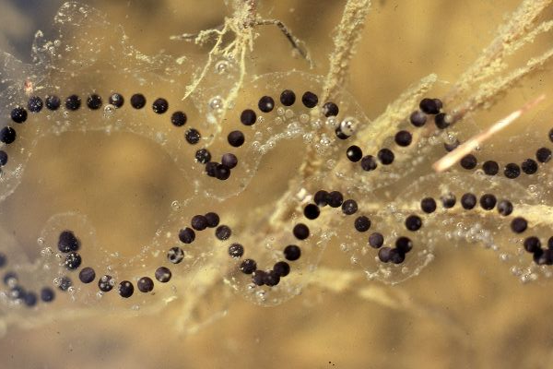
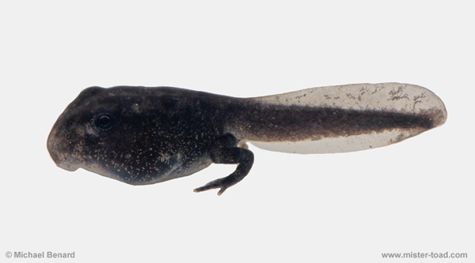
Toads 4 - $400 Answer
Yes!-eggs and tadpoles
Click to return to Jeopardy Board
Notes:
Yes! When they are eggs and tadpoles they are in the water. They also need water to soak in occasionally so they won’t get dried out.

Slide 41
Toads 4 - $500 Question
How are toads different from frogs?
Click to see answer

Slide 42
Toads - $500 Answer
Toads
Dry/bumpy skin
Can live away from water
Poison glands on back
Short legs, small hops
Frogs
Moist/smooth skin
Need to be near water
No poison glands
Long back legs, leap far
Click to return to Jeopardy Board

Slide 43
Salamanders - $100 Question
Name one kind of salamander that lives in Rhode Island.
Click to see answer

Slide 44
Salamanders - $100 Answer
Spotted salamander
Marbled salamander
Eastern red-backed
Two-lined salamander
Four-toed salamander
Northern spring salamander
Red-spotted newt
Click to return to Jeopardy Board

Slide 45
Salamanders - $200 Question
Are salamanders lizards?
Click to see answer

Slide 46
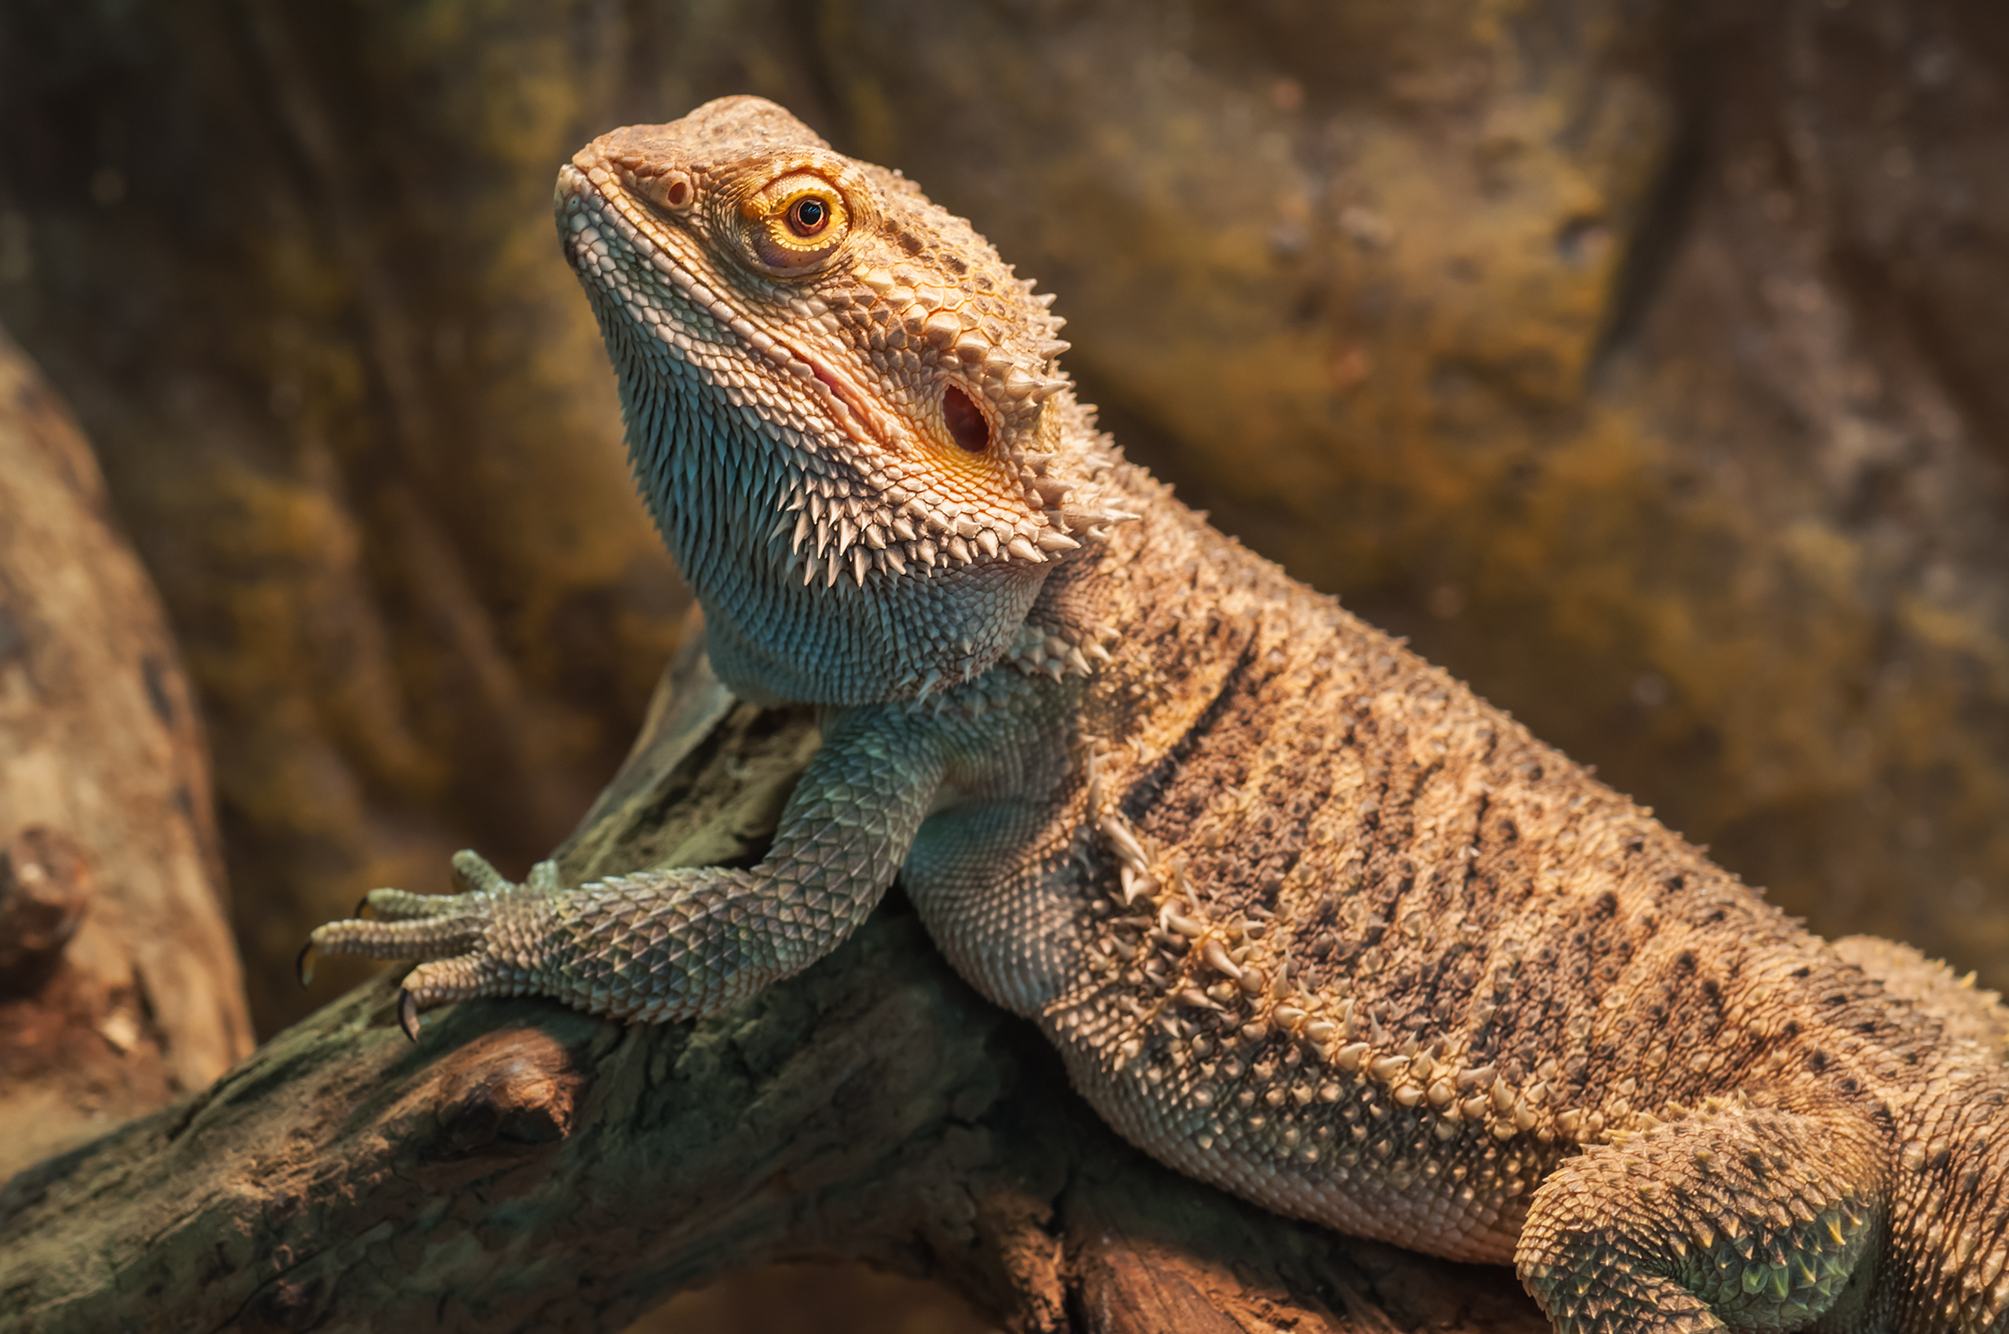
Salamanders - $200 Answer
NO!- Lizards are reptiles
Click to return to Jeopardy Board
Notes:
Reptiles are also ectothermic but….They have SCALES not permeable skin like salamanders. Reptiles don’t need to spend part of their lives in water (though some do).

Slide 47
Salamanders - $300 Question
Do salamanders lay their eggs on land or in the water?
Click to see answer

Slide 48
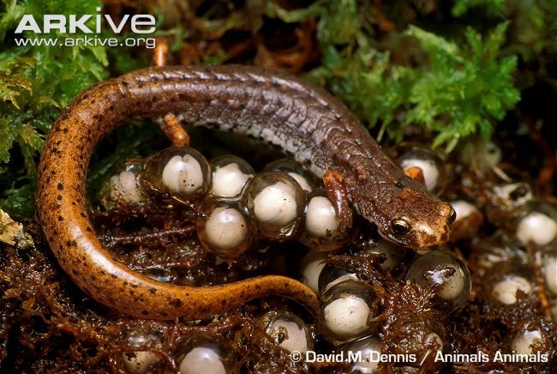
Salamanders- $300 Answer
Both!- some on land, some in water
Click to return to Jeopardy Board
Notes:
The four-toed salamander likes to lay its eggs in sphagnum moss by the waters edge. When the eggs hatch, the larvae make their way down into the water. Four-toed salamanders will lay their eggs in groups so if one mom needs to go eat, the others will still keep her eggs safe.

Slide 49
Salamanders - $400 Question
Do salamanders have gills at any time in their lives?
Click to see answer

Slide 50
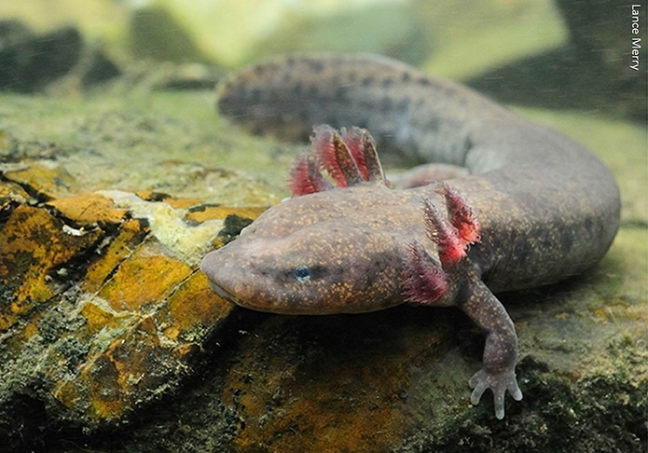
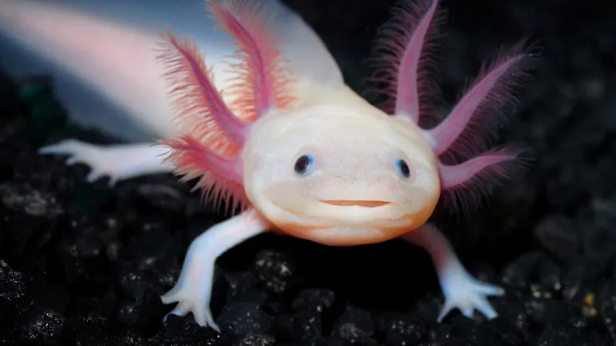
Salamanders - $400 Answer
Yes- some when they are larvae and others keep them their whole lives.
Click to return to Jeopardy Board
Notes:
The mudpuppy is born in the water with gills and lives its whole life in the water. Has anyone heard of an axolotl? This is another kind of salamander that keeps its gills.

Slide 51
Salamanders- $500 Question
Do salamanders have backbones?
Click to see answer

Slide 52
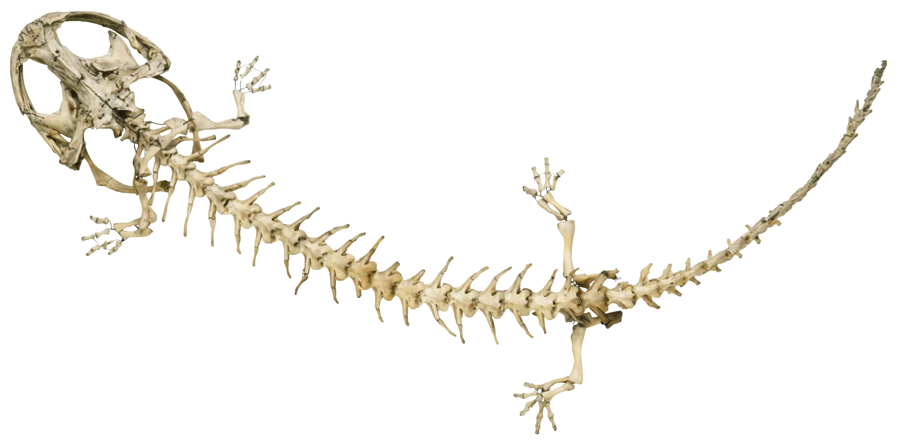
Salamanders - $500 Answer
YES!-all amphibians are VERTEBRATES
Click to return to Jeopardy Board
Notes:
We are also vertebrates because we have a backbone. If you reach behind you and feel those bumps on your spine, those are your vertebrae!

Slide 53
FINAL
Topic: Climate Change
Click to see question

Slide 54
Final Jeopardy Question
How does climate change impact amphibians?
Click to see answer

Slide 55
Final Jeopardy Answer
Change/destroy habitats
Less rain/snow would mean smaller or no vernal pools
Food sources might disappear
(many, many different ways)
Click to return to Jeopardy Board

