Slide 1
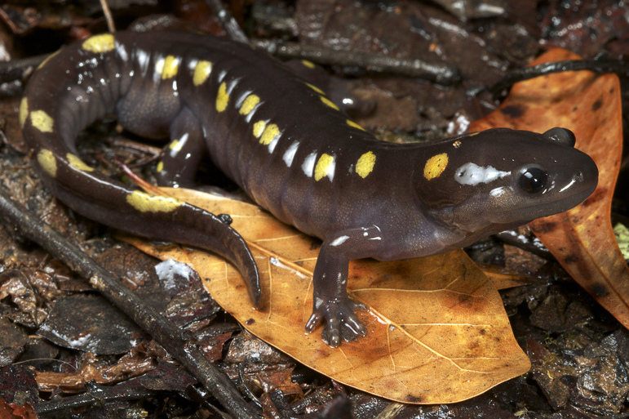
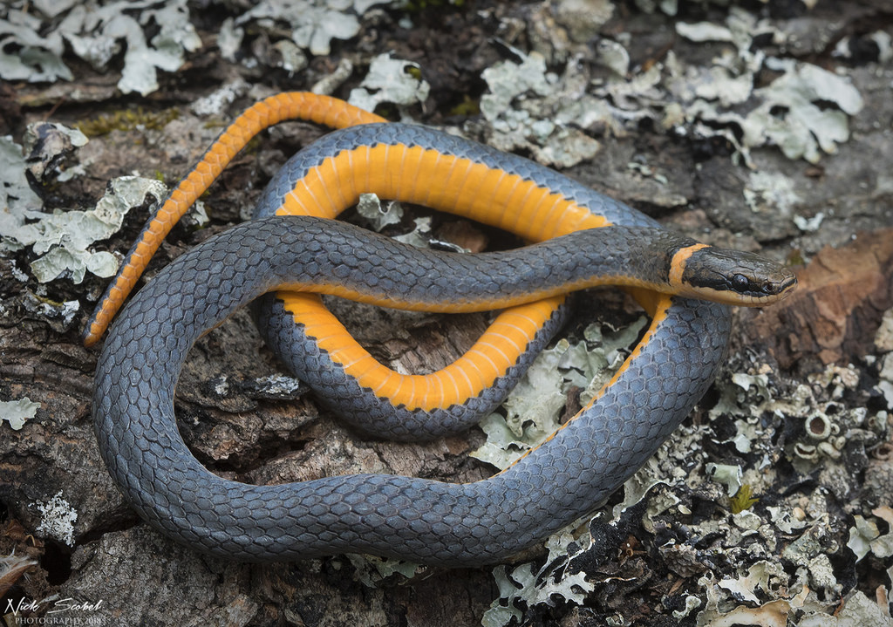
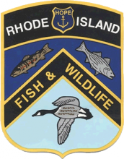
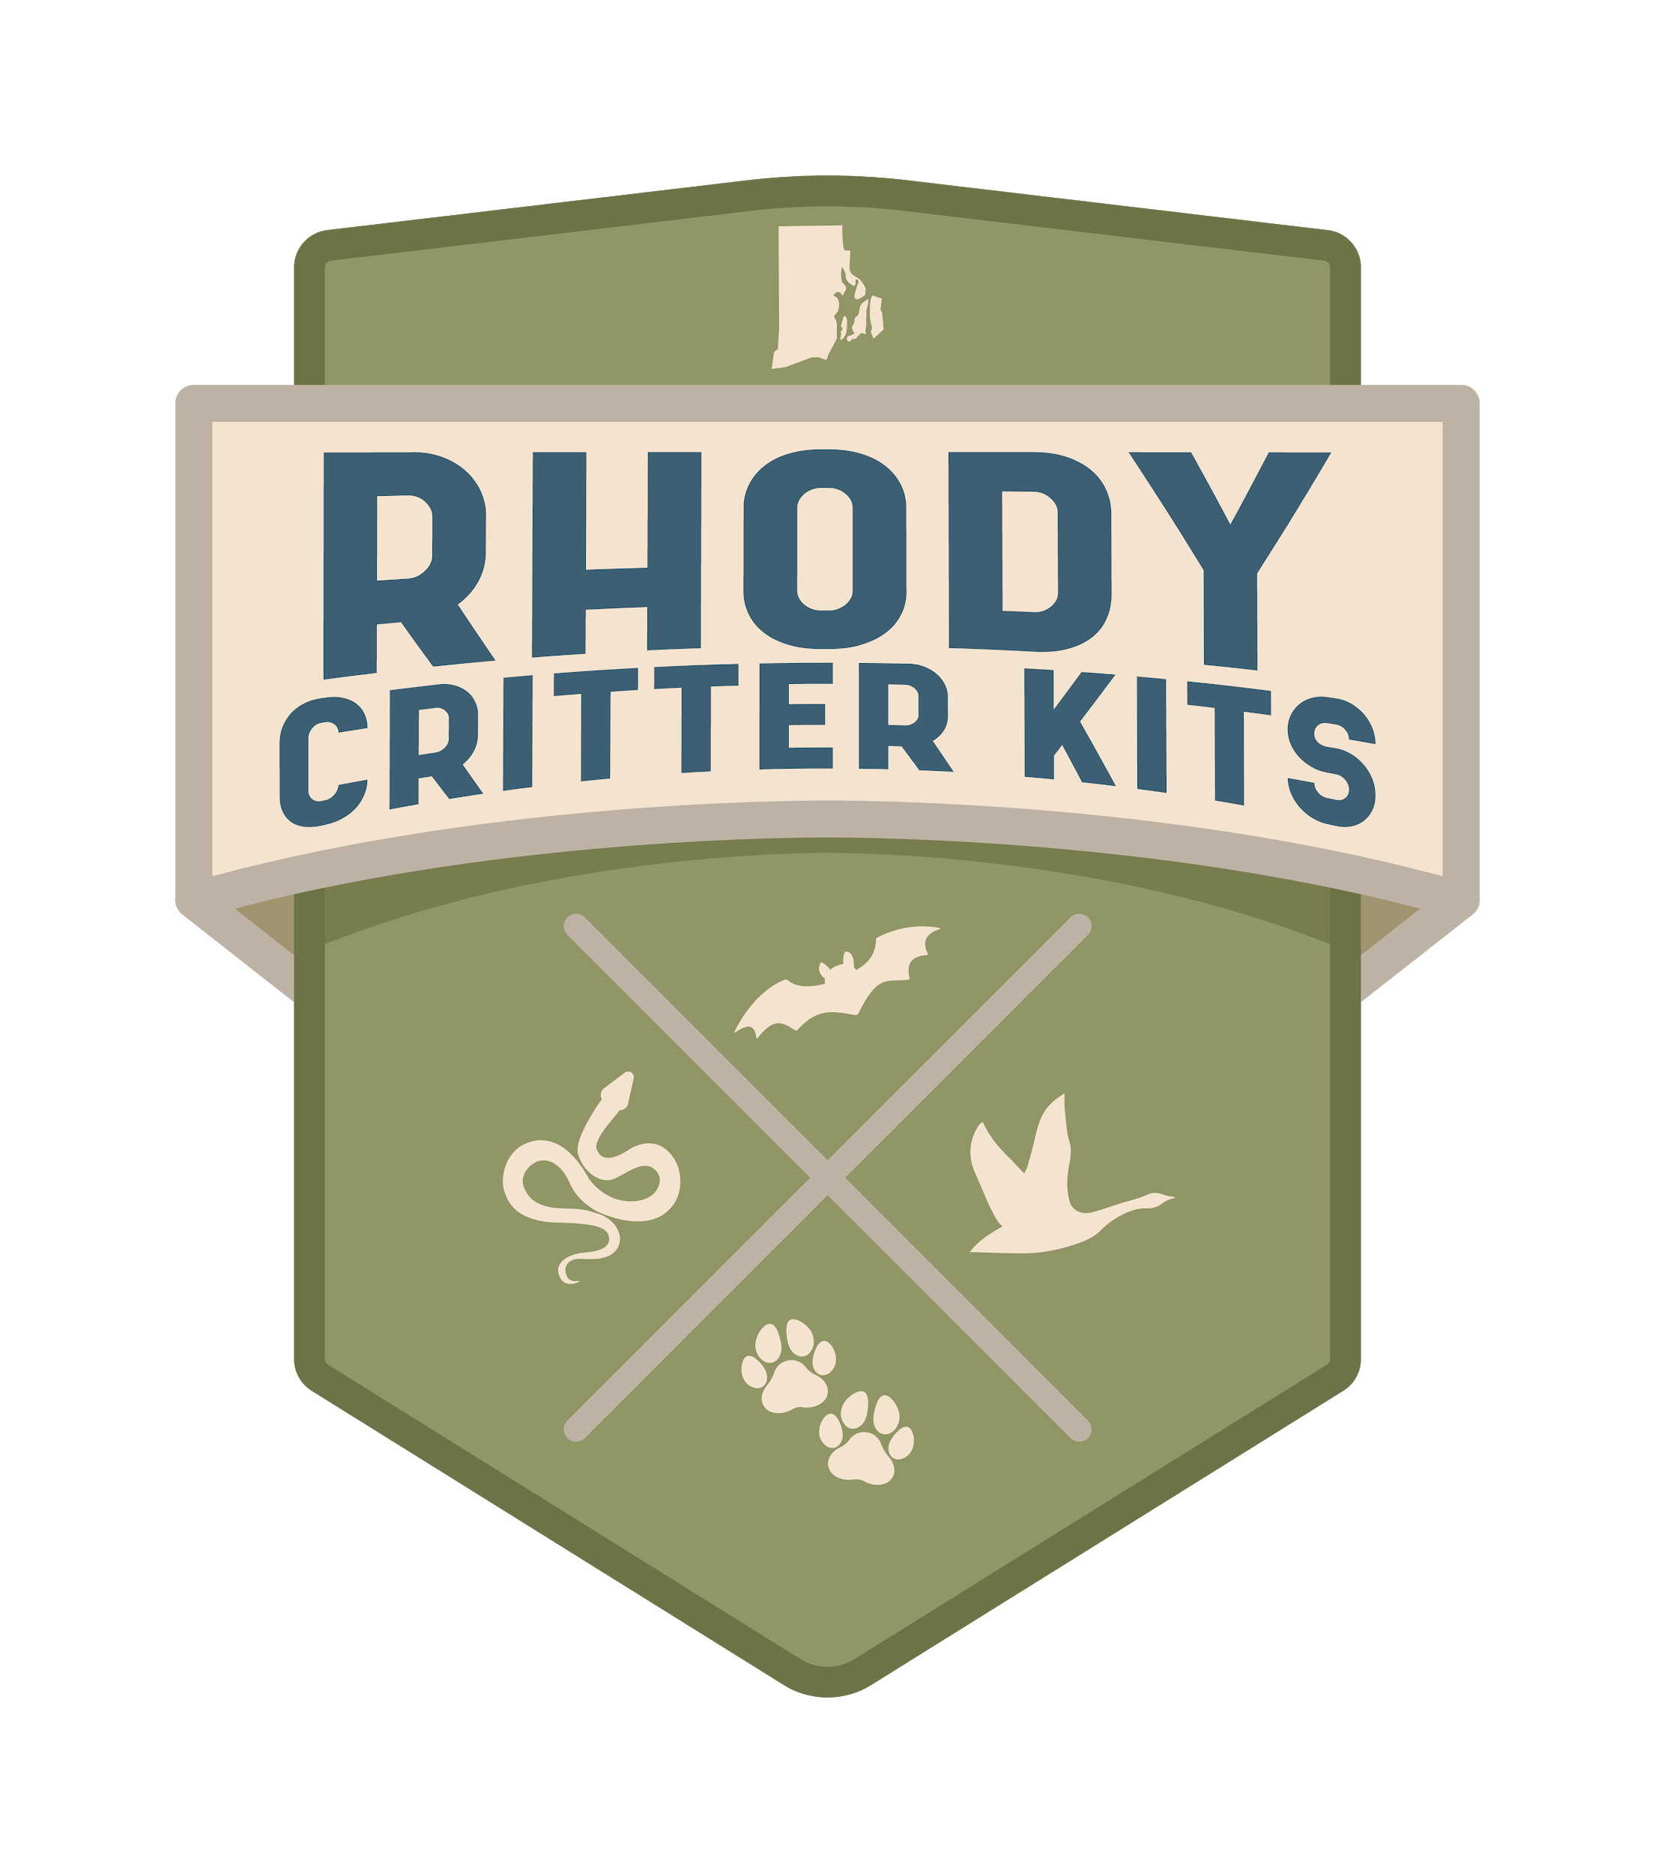
Helping Herps
Rhode Island DEM Division of Fish and Wildlife
Rhody Critter Kits Program
Notes:
“Herps” are what scientists call reptiles and amphibians and the term stems from the Latin phrase meaning “things that creep”. We have 20 species of reptiles in Rhode Island which include turtles and snakes, plus 4 species of sea turtles that visit our coasts. In addition, we have 18 different species of amphibians, including frogs, toads and salamanders. All herps are vertebrates; they all have backbones (that’s right, even snakes).

Slide 2
Slink and Think
Gallery Walk
-What do you think is “cool” about herps?
-How do you think herps can help humans?
-Why do you think herps are important to the ecosystem?
-Why should humans protect herps?
-How can you help herps?
Notes:
Take students through the “Slink and Think” Gallery Walk activity or discuss as a group.
What do you think is “cool” about herps?
When discussing this question, introduce the term “intrinsic value”.
ex. they have armor, they can live on land and in water, they can climb trees without arms...
How do you think herps can help humans?
When discussing this question, introduce the term “instrumental value”.
ex. Snakes act as pest control, amphibians are indicator species, toads eat bugs...
Why do you think herps are important to the ecosystem?
Explain that when herps benefit the ecosystem, it is beneficial to humans as well.
ex. act as prey items for other animals, help keep a balance...
Why should humans protect herps?
People value wildlife for many different reasons but no matter the motive, it is important to protect them. Humans have caused a lot of damage to populations of herps and their habitats so it falls on us to help them.
ex. They are important to the ecosystem, then provide benefits to humans, because we caused them harm, because they are awesome...
How can I help herps?
There are many easy ways that you can help herps! One of the best ways that you can help herps is simply by sharing your knowledge. Many people don’t realize that snakes help control rodent and tick populations or that frogs are indicator species and can tell us the health of the environment. Letting your neighbors, friends and family know all of the instrumental value that herps have might make them also see their intrinsic value! Herps are awesome!
ex. protect their habitat, don’t litter, help a turtle cross the road...

Slide 3
Intrinsic value
vs.
Instrumental value
INTRINSIC = valued for its own existence
ex. beauty, diversity, emotional impact, history
INSTRUMENTAL = valued for its usefulness
ex. food, building material, pest control
Notes:
Have students put things in their life into these two categories. ex. sports, art, food, home
Many times, things can have both values.
What do you think is “cool” about herps?
When discussing this question, introduce the term “intrinsic value”.
ex. they have armor, they can live on land and in water, they can climb trees without arms...
How do you think herps can help humans?
When discussing this question, introduce the term “instrumental value”.
ex. Snakes act as pest control, amphibians are indicator species, toads eat bugs...
Why do you think herps are important to the ecosystem?
Explain that when herps benefit the ecosystem, it is beneficial to humans as well.
ex. act as prey items for other animals, help keep a balance...
Why should humans protect herps?
People value wildlife for many different reasons but no matter the motive, it is important to protect them. Humans have caused a lot of damage to populations of herps and their habitats so it falls on us to help them.
ex. They are important to the ecosystem, then provide benefits to humans, because we caused them harm, because they are awesome...
How can I help herps?
There are many easy ways that you can help herps! One of the best ways that you can help herps is simply by sharing your knowledge. Many people don’t realize that snakes help control rodent and tick populations or that frogs are indicator species and can tell us the health of the environment. Letting your neighbors, friends and family know all of the instrumental value that herps have might make them also see their intrinsic value! Herps are awesome!
ex. protect their habitat, don’t litter, help a turtle cross the road...

Slide 4
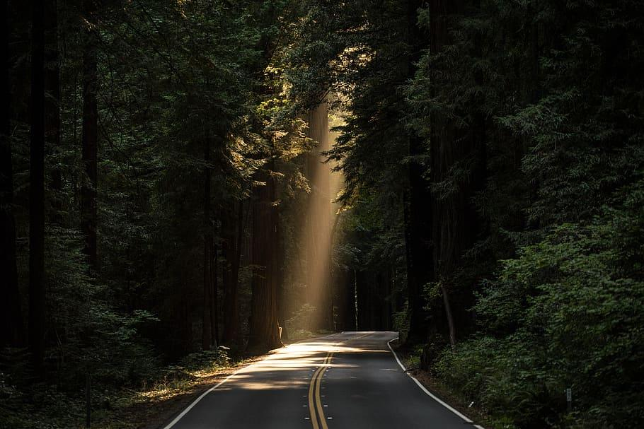
Threats to Herps
#1: Habitat Loss and Fragmentation
Road mortality, Loss of Resources
Disease
Ranavirus, Chytrid Fungus, Snake Fungal Disease
Human Conflict
Persecution, Illegal Collection, Pollution, Subsidized Predators
Notes:
Habitat Loss and Fragmentation: The biggest threat to reptiles and amphibians, similar to many other animals, is habitat loss and fragmentation. While Rhode Island’s herps live in a variety of habitats, it is essential that these habitats are connected to allow animals to safely access the resources they require. Fragmentation increases road mortalities, killing snakes, turtles, frogs and salamanders as they attempt to cross the road to reach isolated sources of food and shelter.
Disease:
Snake Fungal Disease (SFD) is a newly emerging pathogen that causes dermatitis, or skin lesions, in snakes and can lead to death in many snake species.
Chytridiomycosis is an infectious disease caused by the Chytrid Fungus (Batrachochytrium dendrobatidis) that has devastated amphibian populations world-wide. The Chytrid fungus causes thickening of the normally permeable skin, disrupting an amphibian’s ability to absorb water and breathe. This disease has caused declines in over 500 frog and salamander species.
Ranavirus is an infectious disease affecting reptiles, amphibians and fish with up to a 90-100% mortality rate. There are several different kinds of ranavirus that impact species at different levels. This disease is believed to be responsible for many recent massive mortality events around the world and, unchecked, could eliminate entire species.
Human Conflict:
Although snakes are incredibly beneficial in pest control, many people fear snakes and would rather kill them than learn to live with them. It is illegal to kill snakes and attempting to do so only increases the chance of being bitten.
Turtles are taken from the wild and brought home as pets or gathered in massive numbers to be sold in the pet trade. These kidnapped animals can become malnourished and are discarded back into the wild after a few months of “fun”. Taking turtles or their eggs from the wild hurts our native turtle populations, which are already fighting to survive against many other threats.
Reptiles and amphibians are also harmed by pollution to their habitats. Runoff from roads and pesticides from lawns can transfer toxic chemicals into adjacent wetlands, harming the sensitive plants and wildlife found there.
Subsidized predators such as cats, raccoons and foxes prey on reptiles and amphibians, and the more predators there are, the more pressure there is on herp populations. Unnatural, human-supplied sources of food, water and shelter are provided through houses, compost piles, garbage cans and pet food dishes left outside. As more humans inhabit an area, unintentionally providing these resources, populations of subsidized predators increase, sometimes growing to numbers higher than the ecosystem can support. There needs to be a balance of predators and prey to keep the ecosystem healthy. Cats should be kept indoors and everyone in the community must do their part to remove human-supplied food sources.

Slide 5
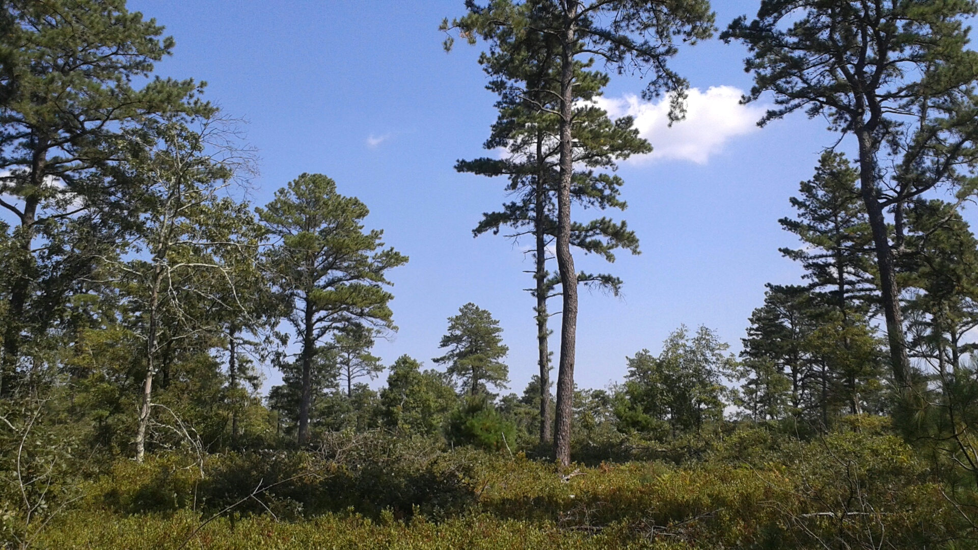
Helping Habitats Helps Herps
The RIDEM Division of Fish and Wildlife protects over 60,000 acres of land!
Healthy habitat=healthy herp populations
Notes:
The biggest threat to herps is habitat loss and fragmentation.
By helping restore and protect herp habitat, we can provide better resources for the reptiles and amphibians that live in our state.
The Division of Fish and Wildlife helps protect over 60,000 acres of land in Rhode Island in Wildlife Management Areas. These areas have plenty of herp habitat and no new roads or houses can be built in them.
For herps that need very special habitats, that are lacking in Rhode island, like vernal pools, biologist build them, like in “Operation Spadefoot”! (see notes)
Biologists at the DFW are also figuring out how to help herps outside of the Management Areas by surveying roads at night to locate places where a lot of herps are crossing. Once these dangerous places have been identified, hopefully new passages can be built under the road, to allow herps to safely travel between fragmented pieces of habitat.

Slide 6
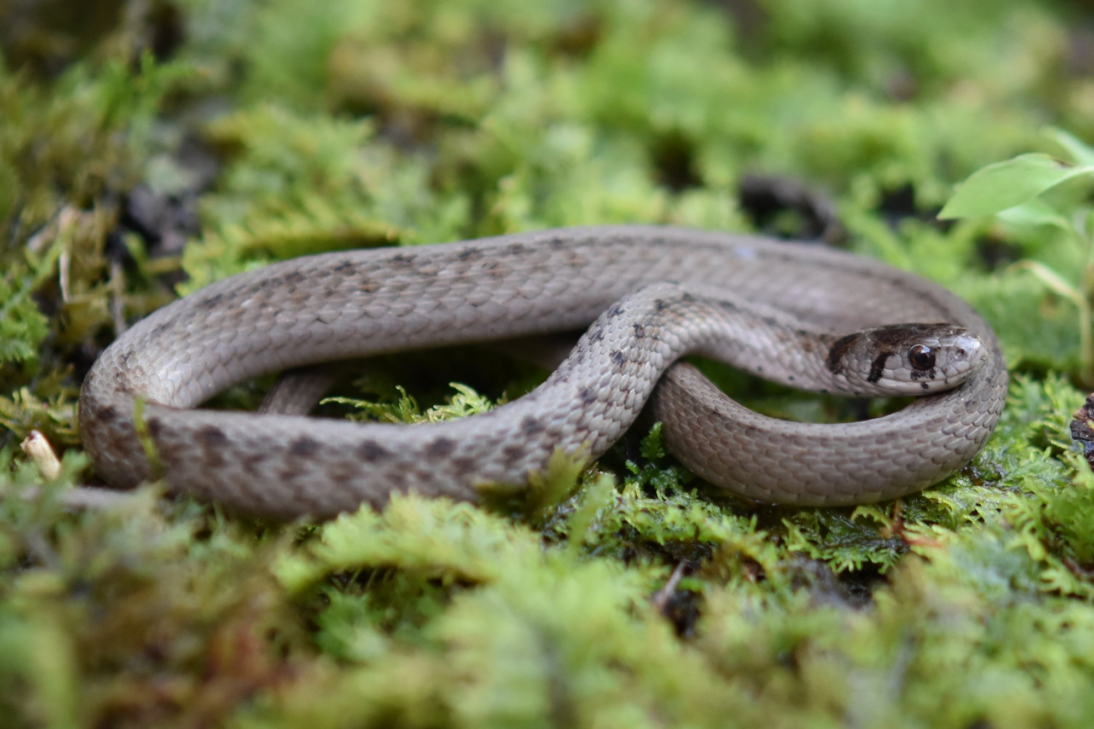
How can you help herp habitat?
Don’t Litter!
Share your knowledge
Plant native species
Don’t use pesticides
Clean up wetlands
Notes:
Answers appear on click:
Don’t litter
Clean up wetlands
Help and encourage wetland protection
Plant native species
Don’t use pesticides
Share your knowledge!

Slide 7
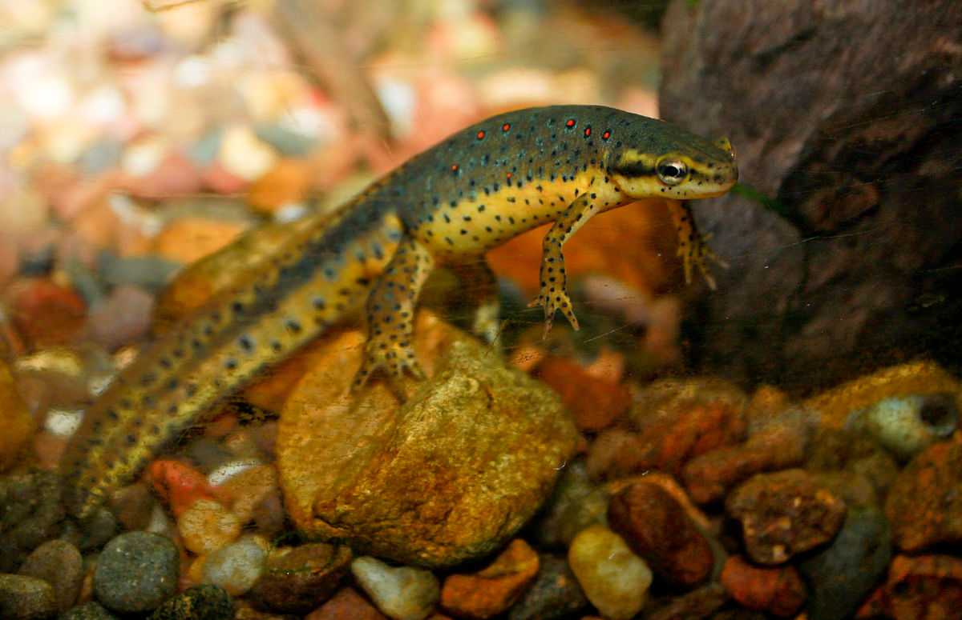
Let’s Play a Game!
Fragmentation Frenzy

