Slide 1
BROWNFIELDS TO BEAUTY
RI DEM’s Urban Green Space Initiative
“The Rhode from Remediation to Recreation”

Slide 2
Agenda
What is a Brownfield?
Types of Brownfields
Funding Opportunities
Reuse and Redevelopment of Brownfields
Why transform Brownfields into Green Space?
Success Stories

Slide 3
What is a Brownfield?
A brownfield is a property, the expansion, redevelopment, or reuse of which may be complicated by the presence or potential presence of a hazardous substance, pollutant, or contaminant
The redevelopment of brownfields is part of a broader strategy to improve the environment, create and retain jobs, revitalize urban areas, and reduce blight.

Slide 4
Types of Brownfields
Manufacturing Companies
Abandoned Mills
Dry Cleaners
Former Gas Stations
Rail Yards / Steel Yards
Sawmills
Paint Stores
Print Shops
Doctor, Dentist, Veterinary Clinics
Hair & Nail Salons
Landfills, Illicit Dump Sites, Junk Yards

Slide 5
Funding Opportunities
Targeted Brownfield Assessment (TBA) Program
EPA’s Brownfields Assessment Grant
EPA’s 128(a) Grant / BIL Funds
Brownfields Remediation and Economic Development Fund (the RI Bond Fund)
RIDEM-Dedicated Settlements/Legal Actions

Slide 6
Reuse & Redevelopment of Brownfields
Open Space/Green Space
Industrial/Commercial
Mixed-Use Space
Affordable and/or Residential Housing
And Many More!

Slide 7
Why transform Brownfields into Green Space?
Provides recreational areas for residents
Enhances beauty and environmental quality of neighborhoods
Increases local property values, thereby strengthening municipal tax base
Lack of community and public access to safe open and green space is a critical concern for urban residents in New England

Slide 8
Green Space: Examples
Parks
Open Space
Community Gardens
Bike ways / Bike paths
Recreation
Ballfields
Playgrounds
Golf Course

Slide 9
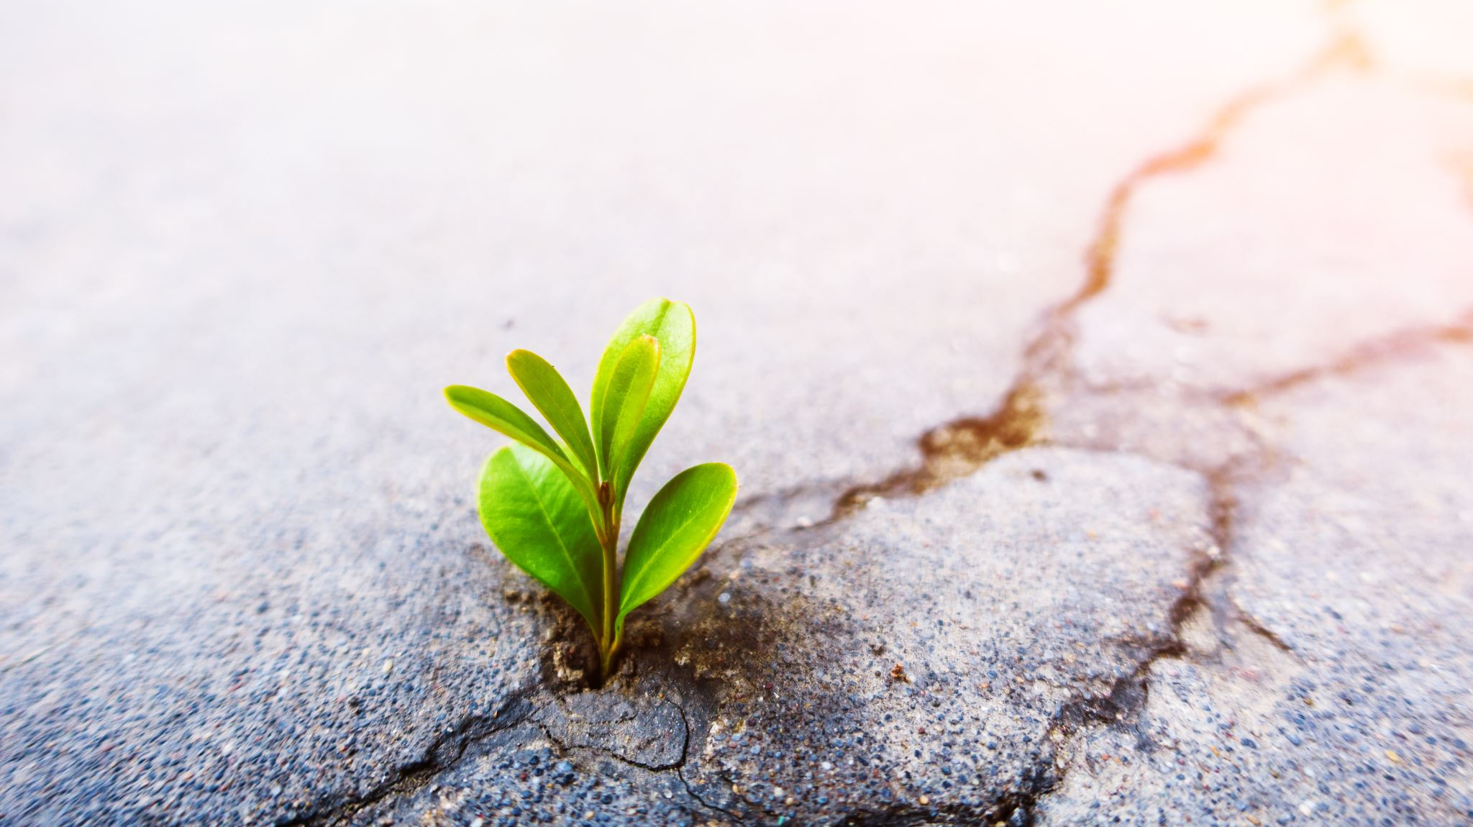
Success Stories

Slide 10
Festival Pier, School Street, Pawtucket
From 1922 through 1977, this Brownfield site was the location of a petroleum storage terminal. Investigations found releases of petroleum in soil and groundwater.
Festival Pier is currently one of the few riverfront access points in the City of Pawtucket. It serves as home to the Rhode Island Dragon Boat Races and Taiwan Day Festival, and provides picnicking, a boat launch, and fishing.
Awarded TBA, 128(a), EPA Cleanup Grant, RIDEM Grant for Open Space, US Fish & Wildlife Boat Ramp, Community Development Grant – over $2 million in assessment, remediation, and redevelopment was awarded

Slide 11
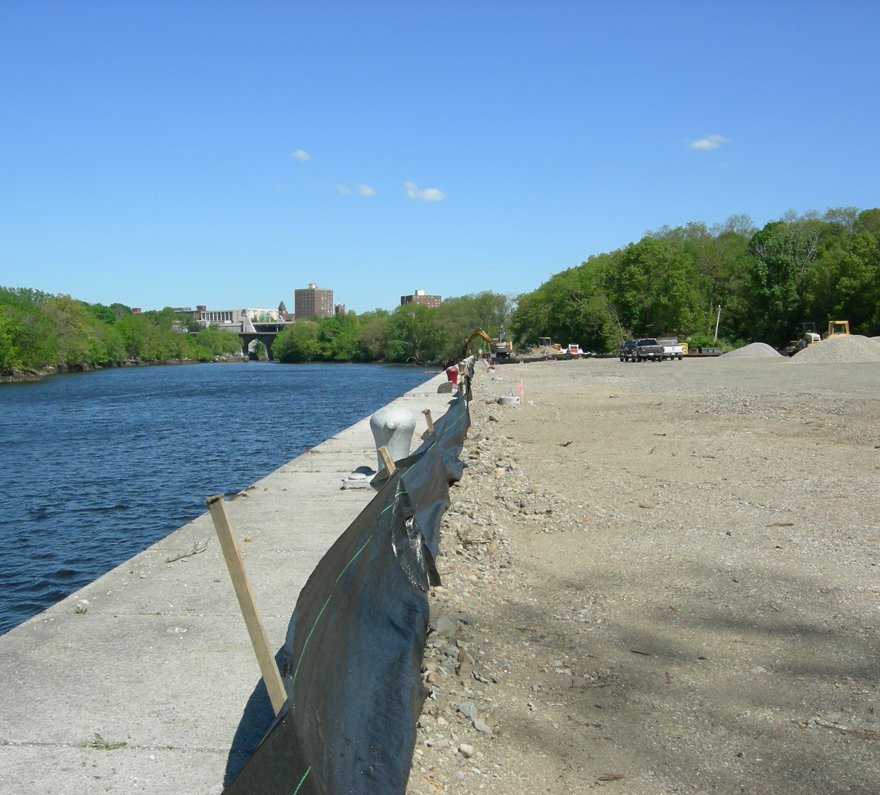
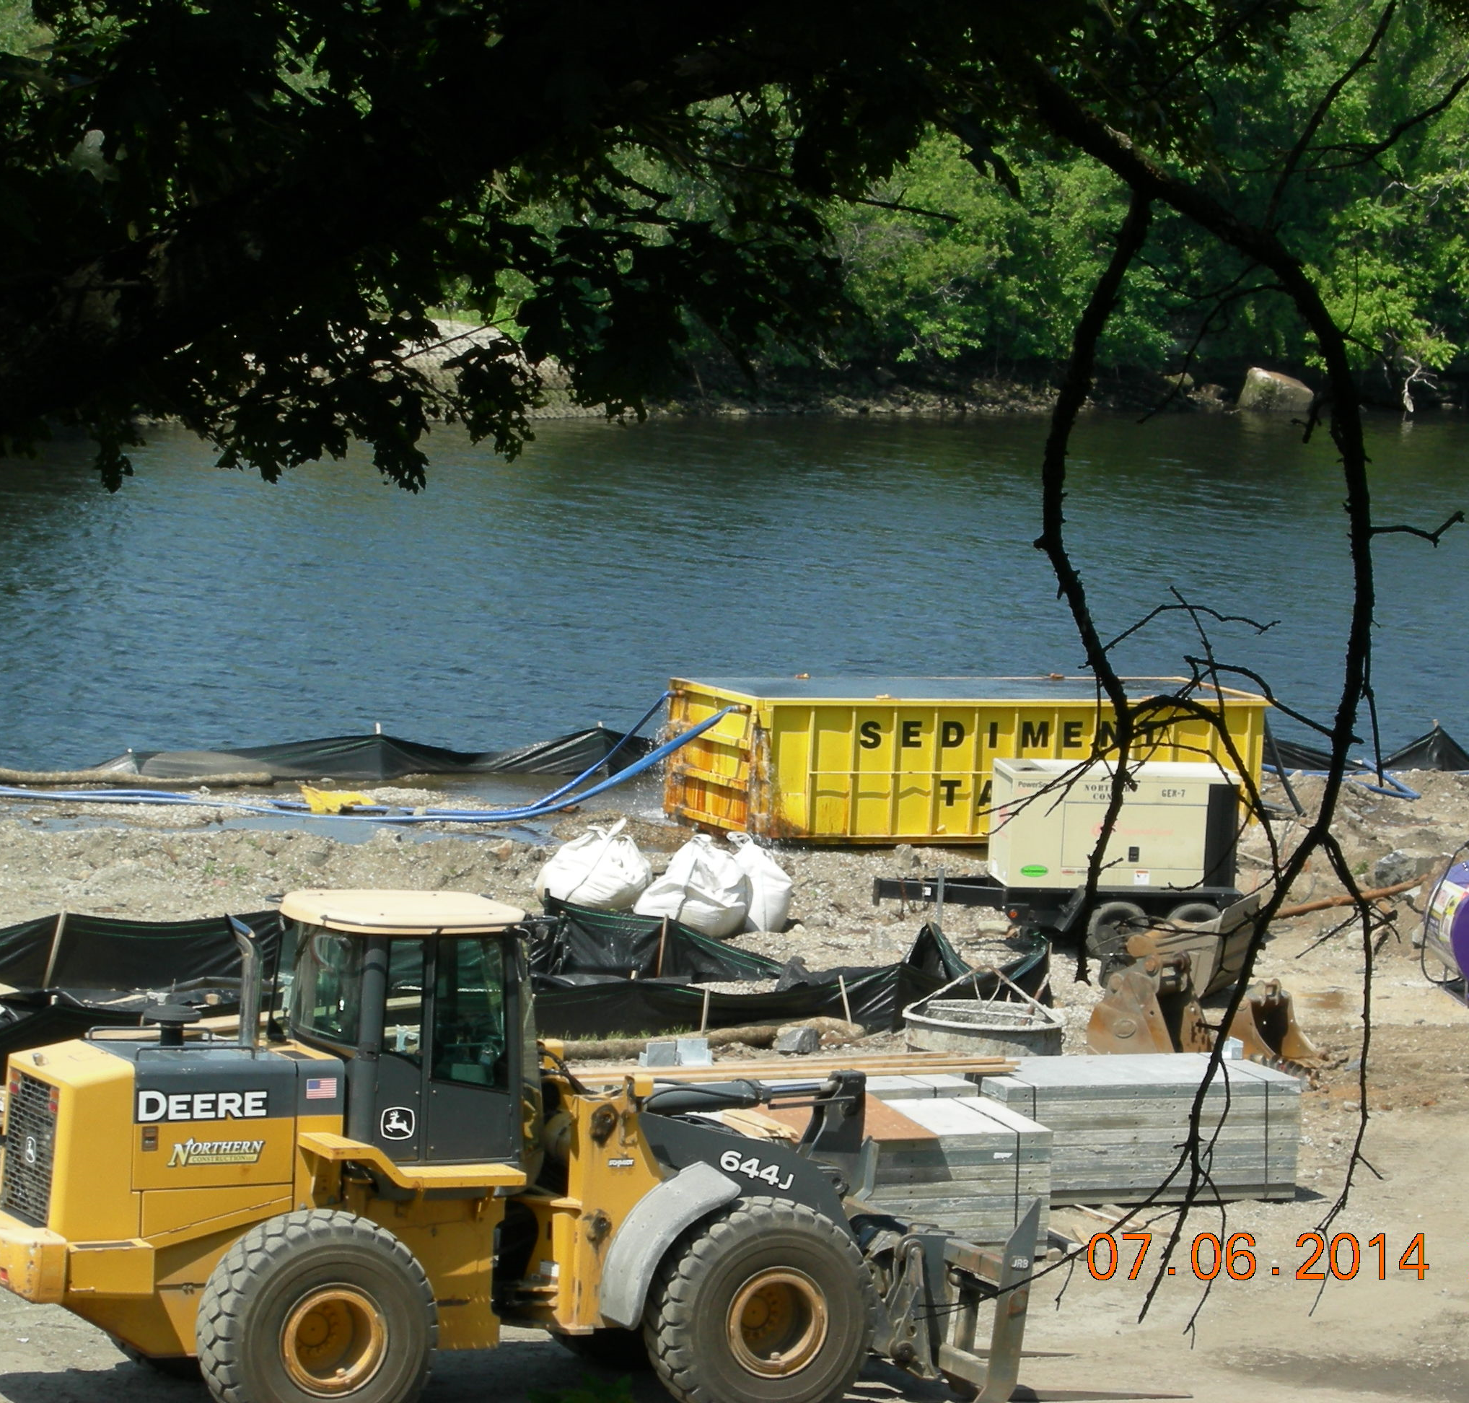
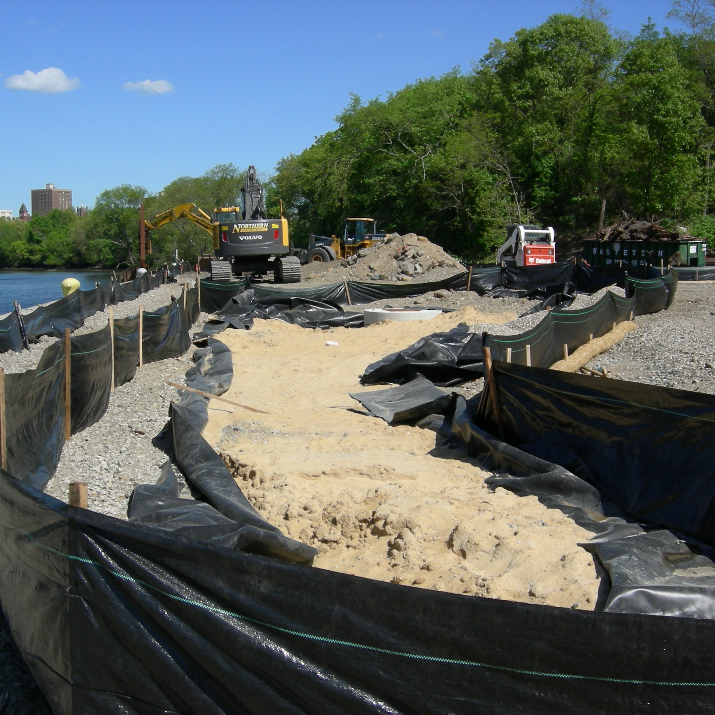
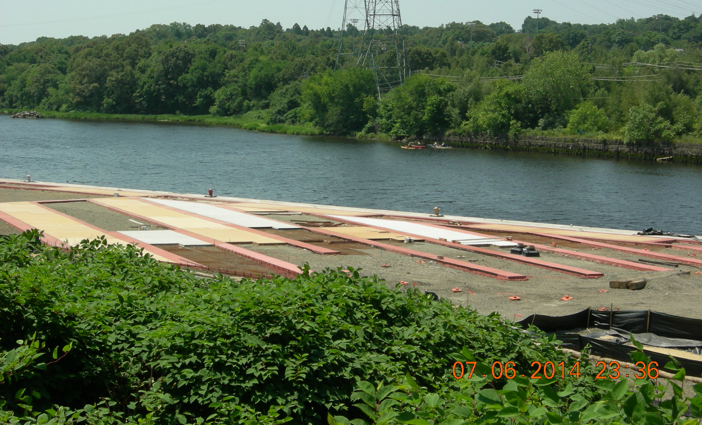
Festival Pier – BEFORE

Slide 12
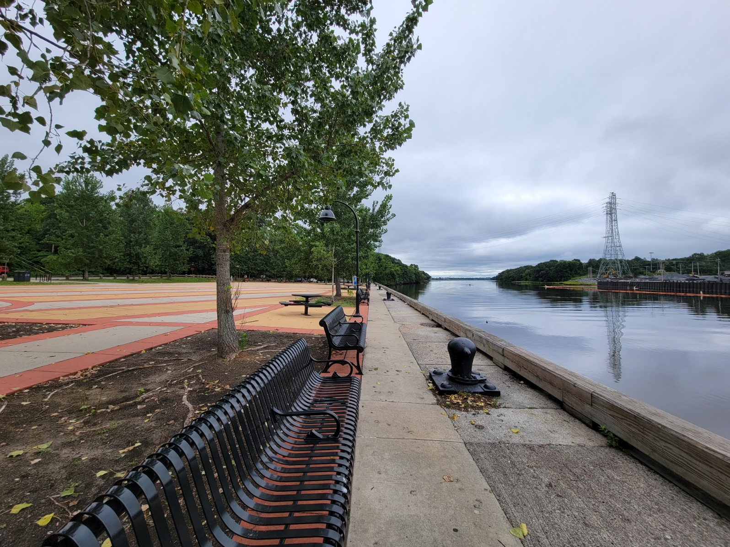
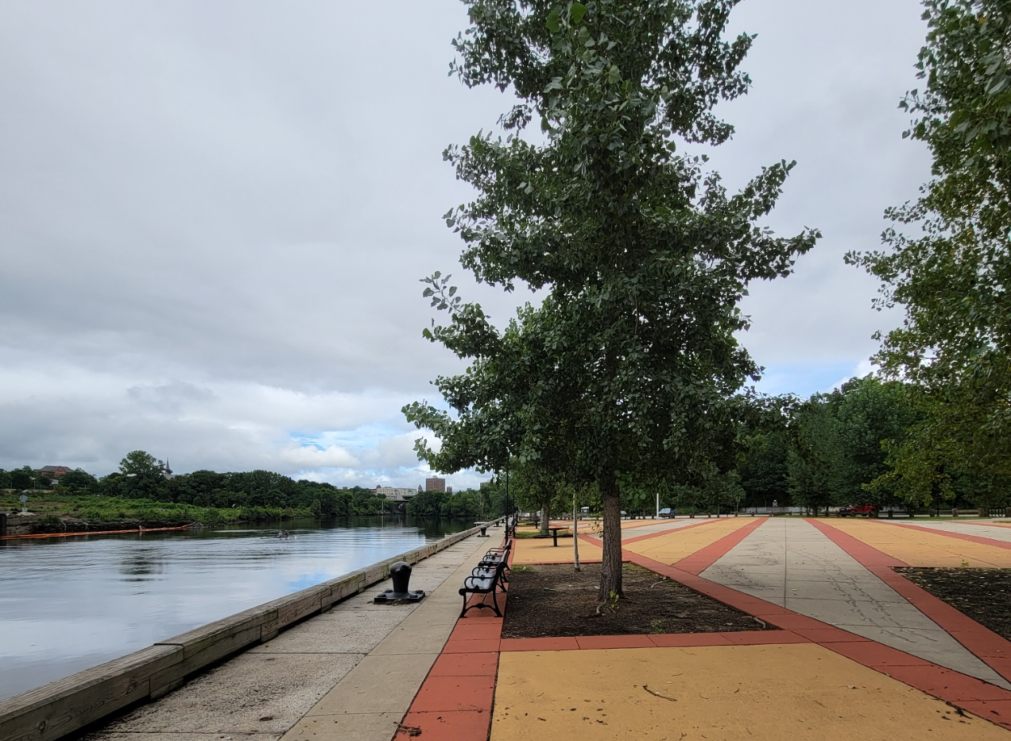
Festival Pier – AFTER

Slide 13
Riverside Mills Park 50 Aleppo Street, Providence
The former Riverside Mills began in 1863 as a 4-story mill complex run by the Champlin & Downes Company (woolen & cotton textiles manufacturers). In 1837, the company filed for bankruptcy and the business incorporated under the name of Riverside Worsted Mills. A fire destroyed the Riverside Mills complex in December of 1989.
The off-road section of pike path opened in Riverside Park opened in September 2007, and the park itself was open and ready in 2008.
Today, the Park is home to the Atlantic Mills fish ladder, Red Shed Bike Shop, a community garden, a portion of the Woonasquatucket River Bike Path, and so much more!

Slide 14
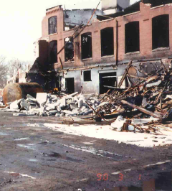
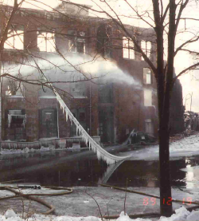
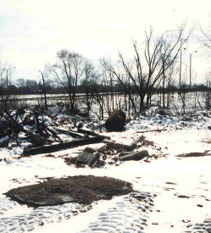
Riverside Mills Park – BEFORE

Slide 15
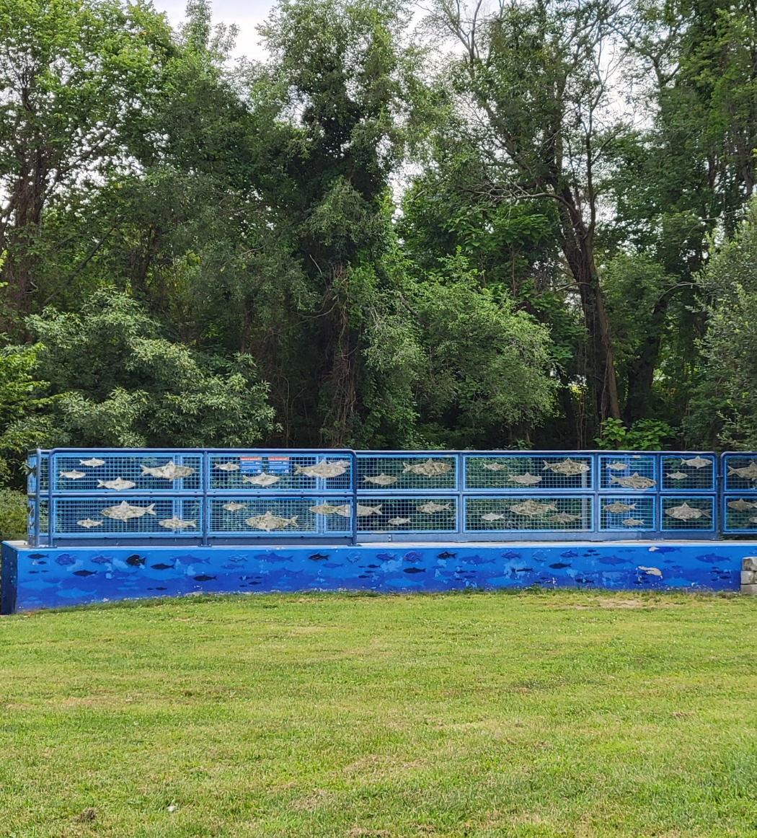
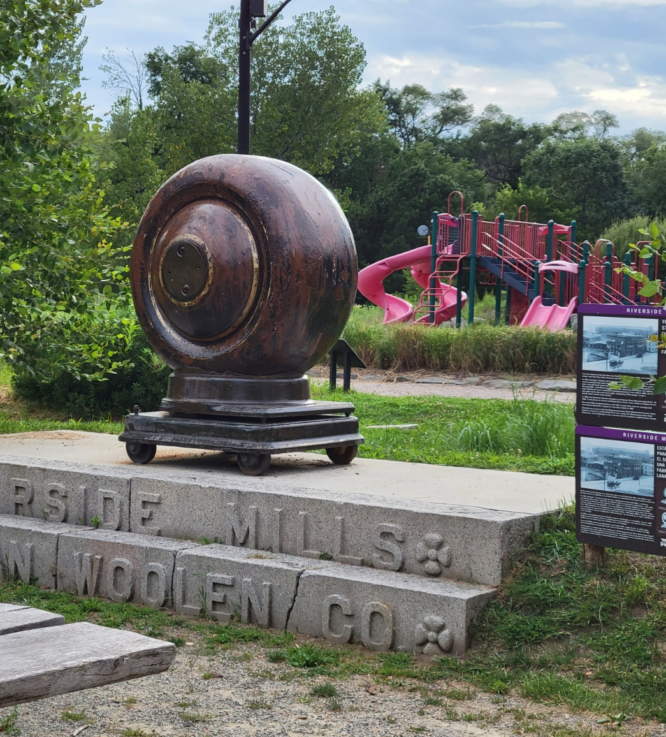
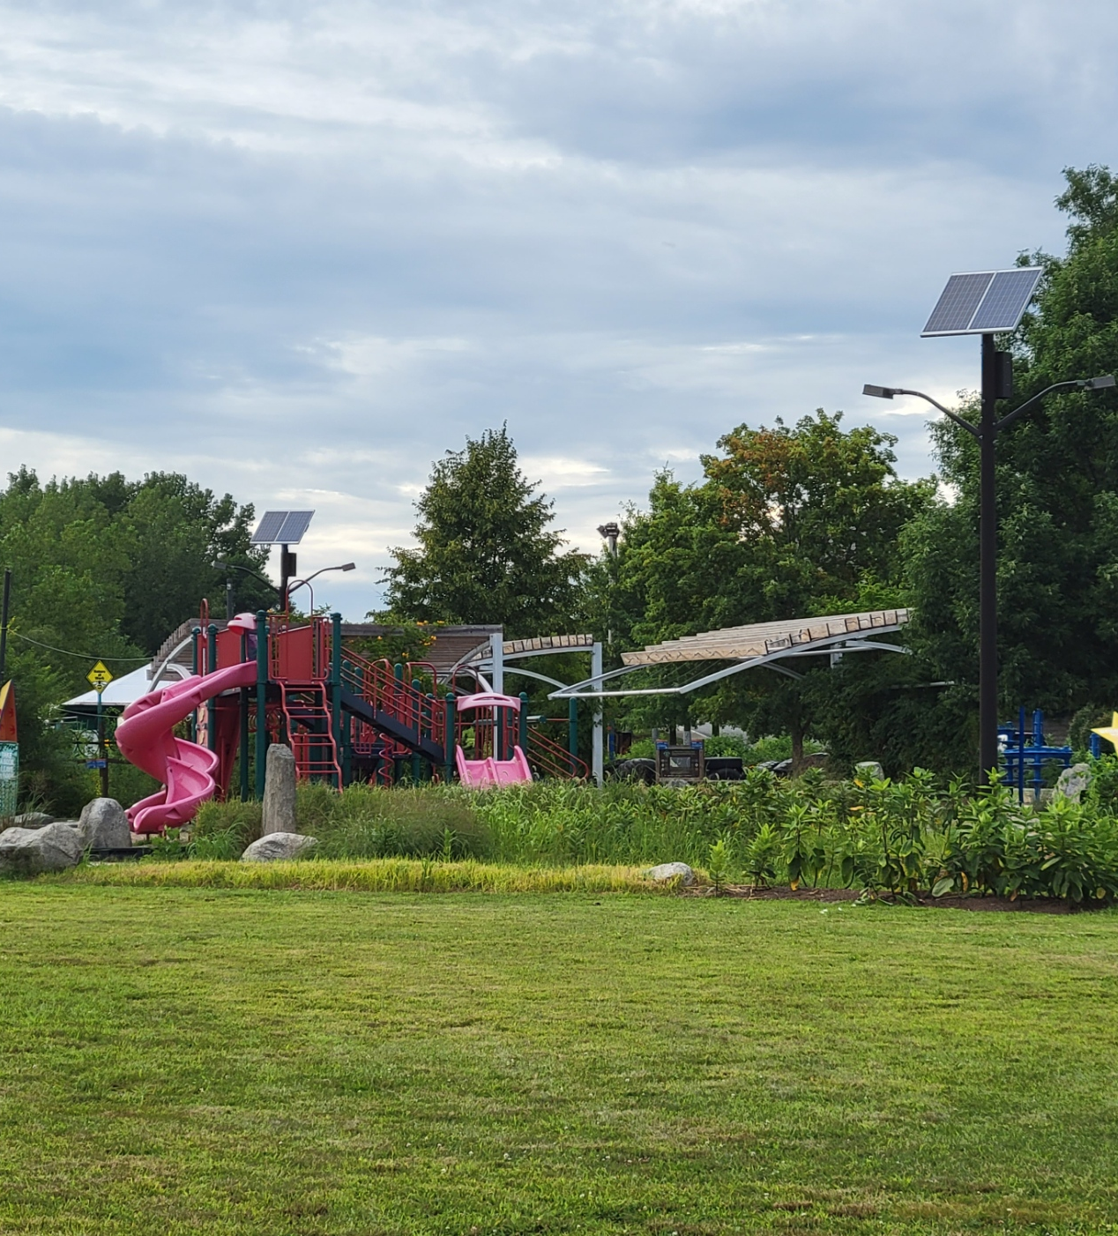
Riverside Mills Park – AFTER

Slide 16
Lincoln Lace & Braid 55-61 Ponagansett Drive, Providence
Located along the Woonasquatucket River, the Lincoln Lace and Braid factory was established in 1812 as a manufacturer of fabric. The facility closed in the late 20th century and a fire in 1994 destroyed the main building. The site’s long industrial history and the illegal dumping that occurred after the fire resulted in a host of environmental contaminants.
The 6-acre Lincoln Lace and Braid property is adjacent to residential areas and abuts Merino Park, a large recreational area. Today, the property is part of the Woonasquatucket River Greenway Project.
Awarded EPA Assessment Grant, funds from RI for remediation, EPA Cleanup Grant, RIDEM Oil Spill Restoration Fund, funds from the City of Providence

Slide 17
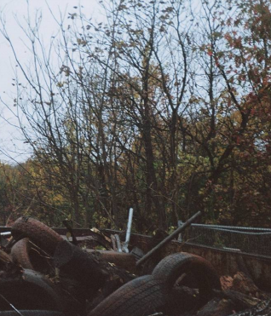
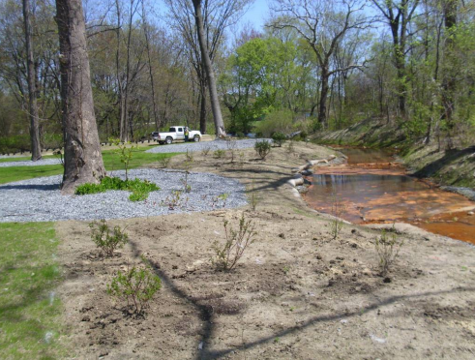
Lincoln Lace & Braid – BEFORE

Slide 18
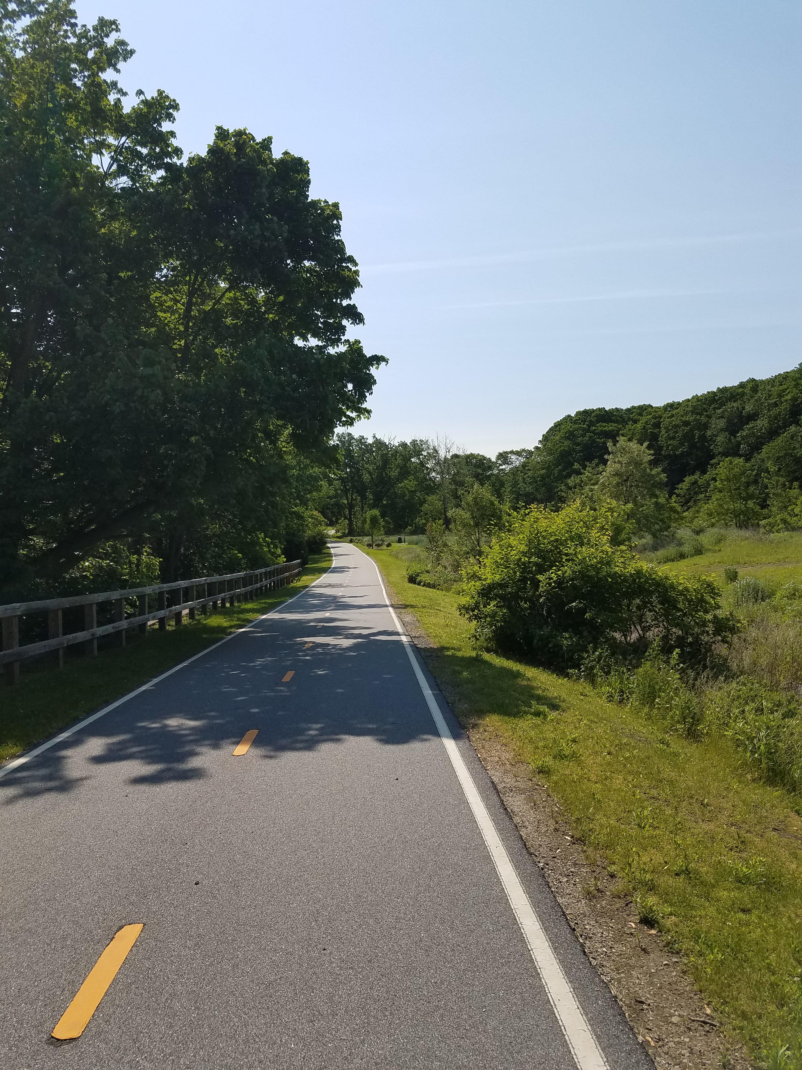
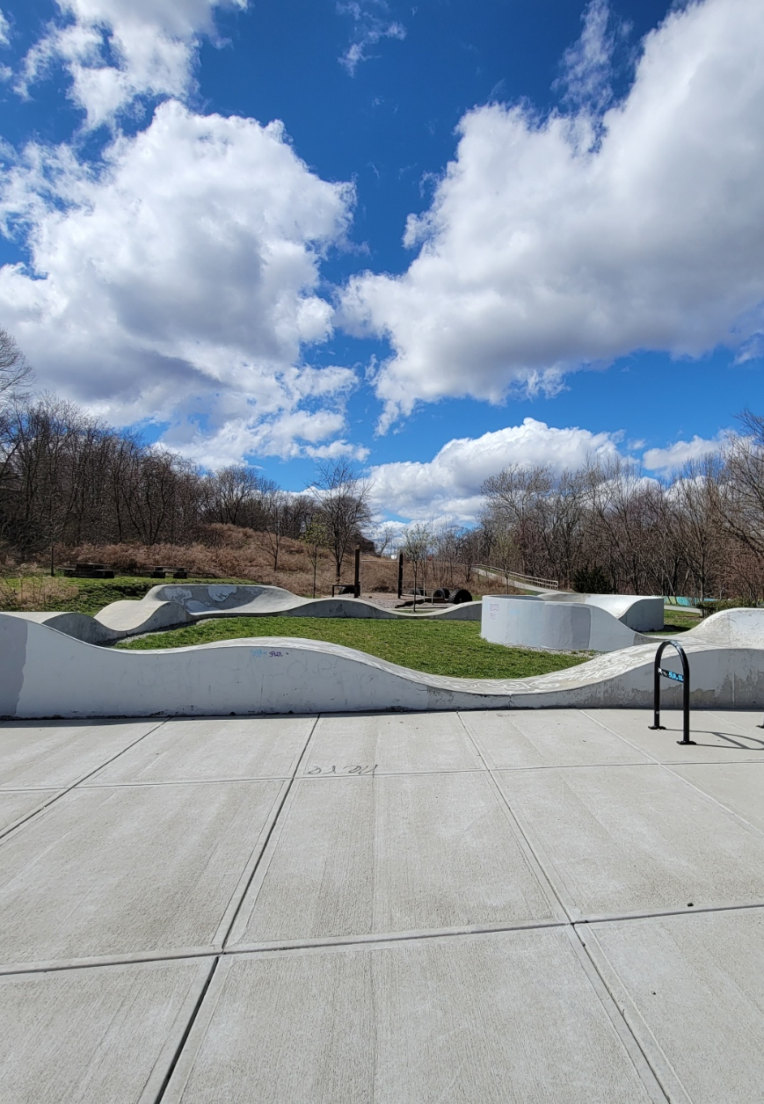
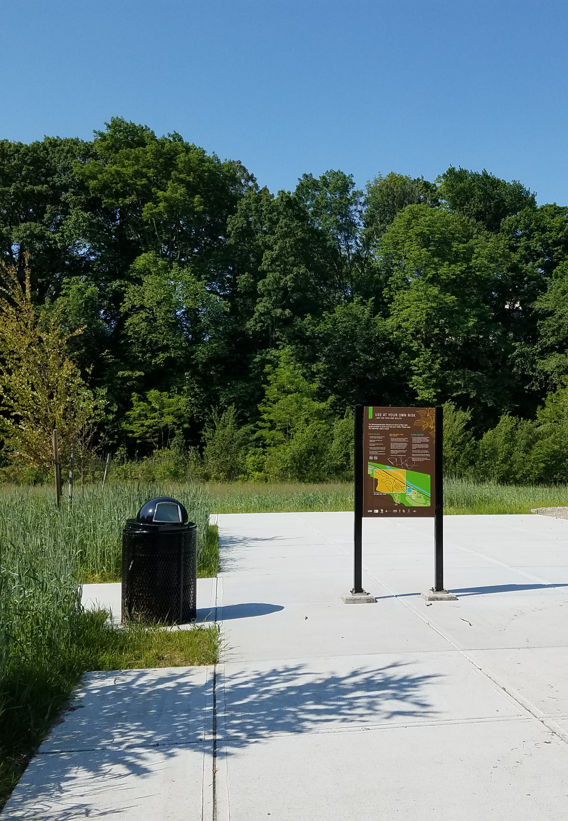
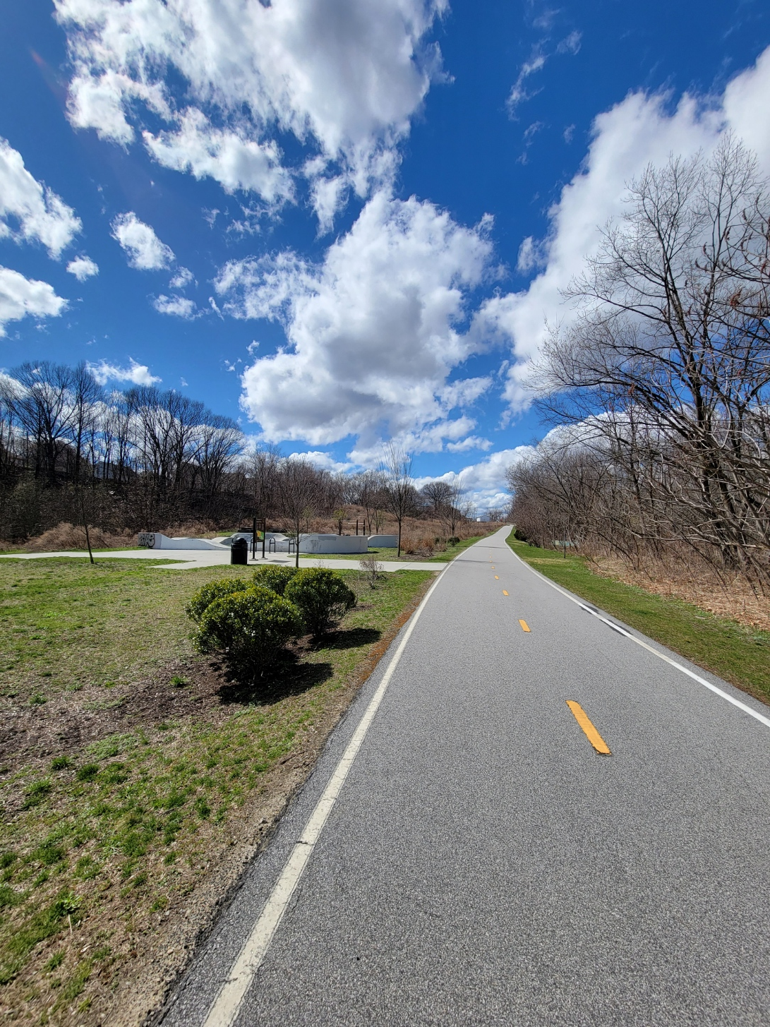
Lincoln Lace & Braid – AFTER

Slide 19
Macomber Stadium 964 High Street, Central Falls
Historically the location of the New England Electrolytic Copper Co., metals and PAHs were discovered during investigation activities.
Remedial action began in late 2019 and was completed in October 2020. The Site has been revamped into a recreational field for a variety of sports.
Awarded $50,000 in TBA Funds for assessment

Slide 20
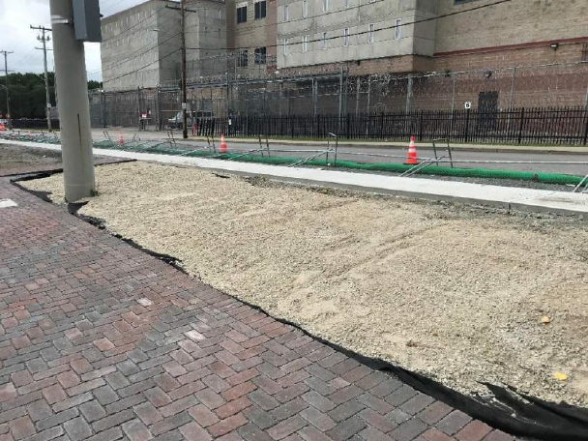
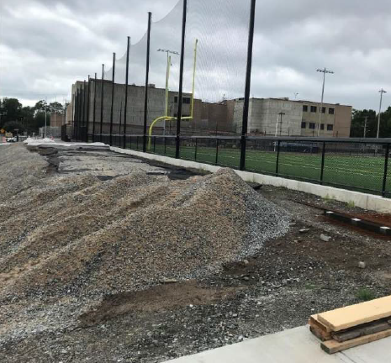
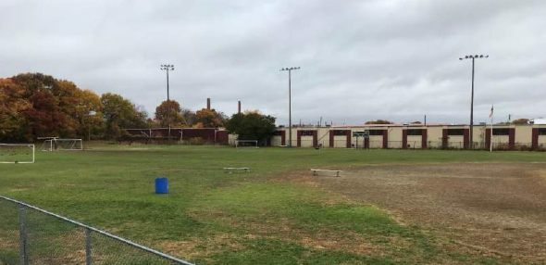
Macomber Stadium – BEFORE

Slide 21
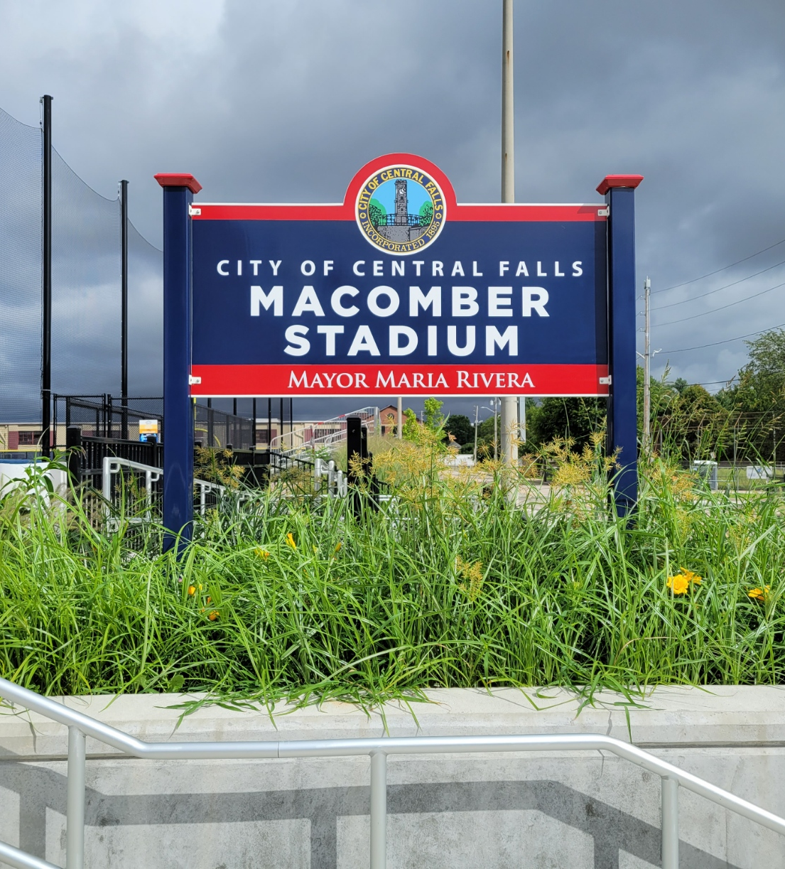
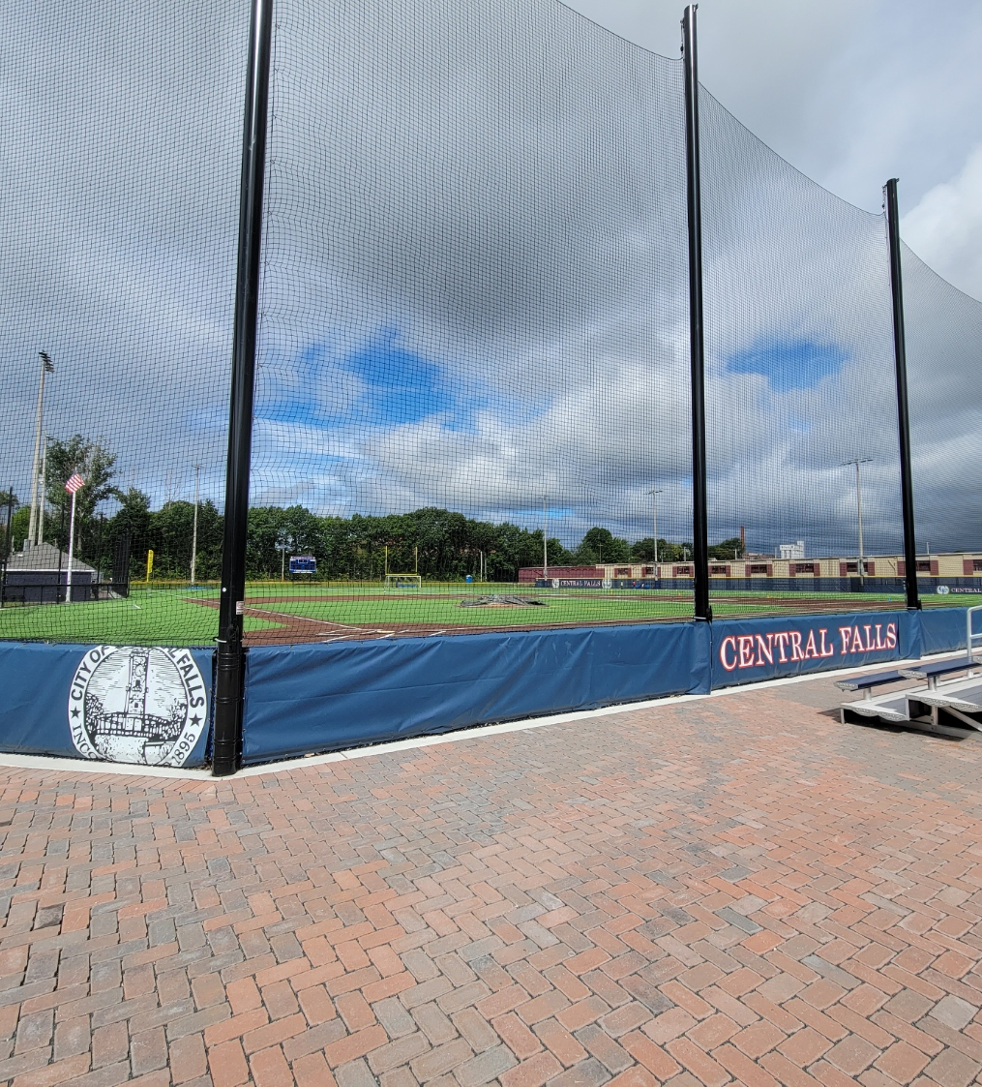
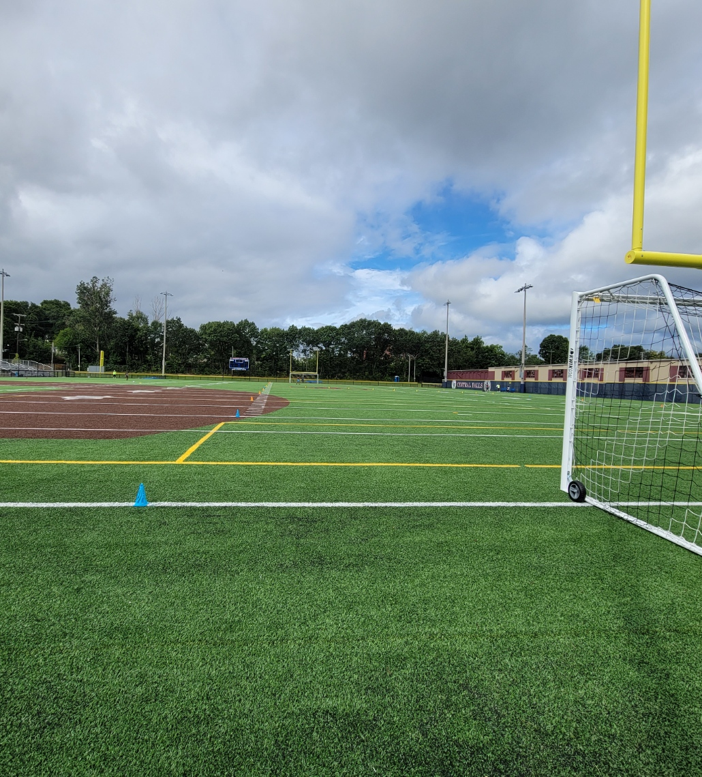
Macomber Stadium – AFTER

Slide 22
1304 High Street, Central Falls
Beginning in 1949, maps depict the Site as the location of the Air Reduction Sales Co. Oxygen Plant. Later, in 1984, maps depict the Site with two buildings, occupied as Motor Transport Depot and Oxygen T’k. The City of Central Falls obtained ownership of the Site in 2017. Assessment identified arsenic, petroleum, and PAHs in soils.
Today, the Site has been transformed into a recreational field.
Awarded TBA & 128(a) Funds totaling almost $26,000 for assessment

Slide 23
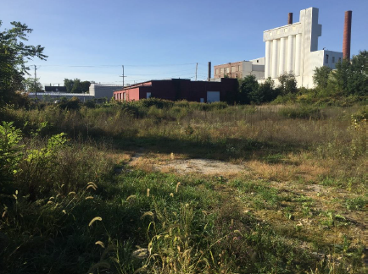
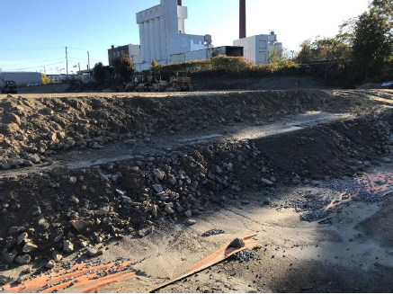
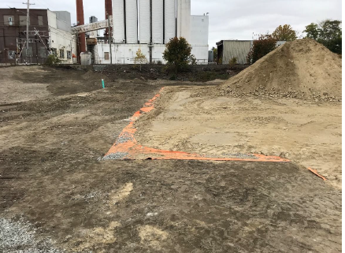
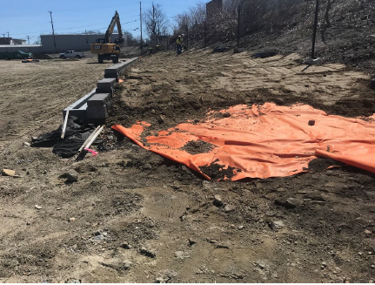
1304 High Street - BEFORE

Slide 24
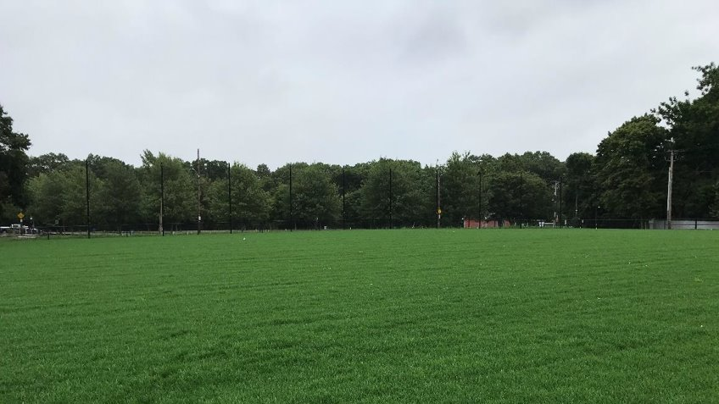
1304 High Street – AFTER

Slide 25
Summary
Brownfields are excellent locations for green space
The options for redevelopment are endless

Slide 26
Contact Information
Rachel Simpson, Sr. Environmental Scientist & TBA Program Manager
Email: Rachel.Simpson@dem.ri.gov
Phone: (401) 222-2797 ext. 2777105
Kelly Owens, Associate Supervising Engineer
Email: Kelly.Owens@dem.ri.gov
Phone (401) 222-2797 ext. 2777108
Ashley L. Blauvelt, P.E., Environmental Engineer IV & Bond Fund Program Manager
Email: Ashley.blauvelt@dem.ri.gov
Phone: (401) 222-2797 ext. 2777026

