Slide 1
Luck Isn’t Enough!
Working Toward An Even Better [Name of Town]
[VENUE]
[DATE]

Slide 2
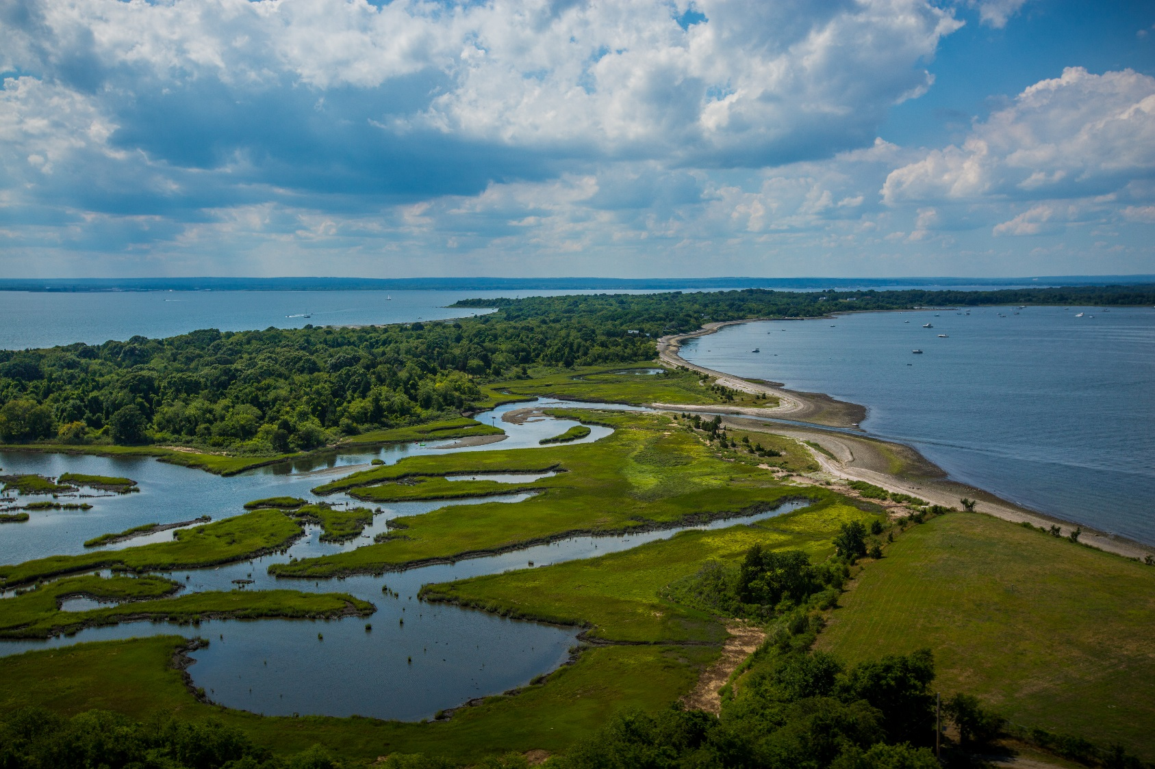
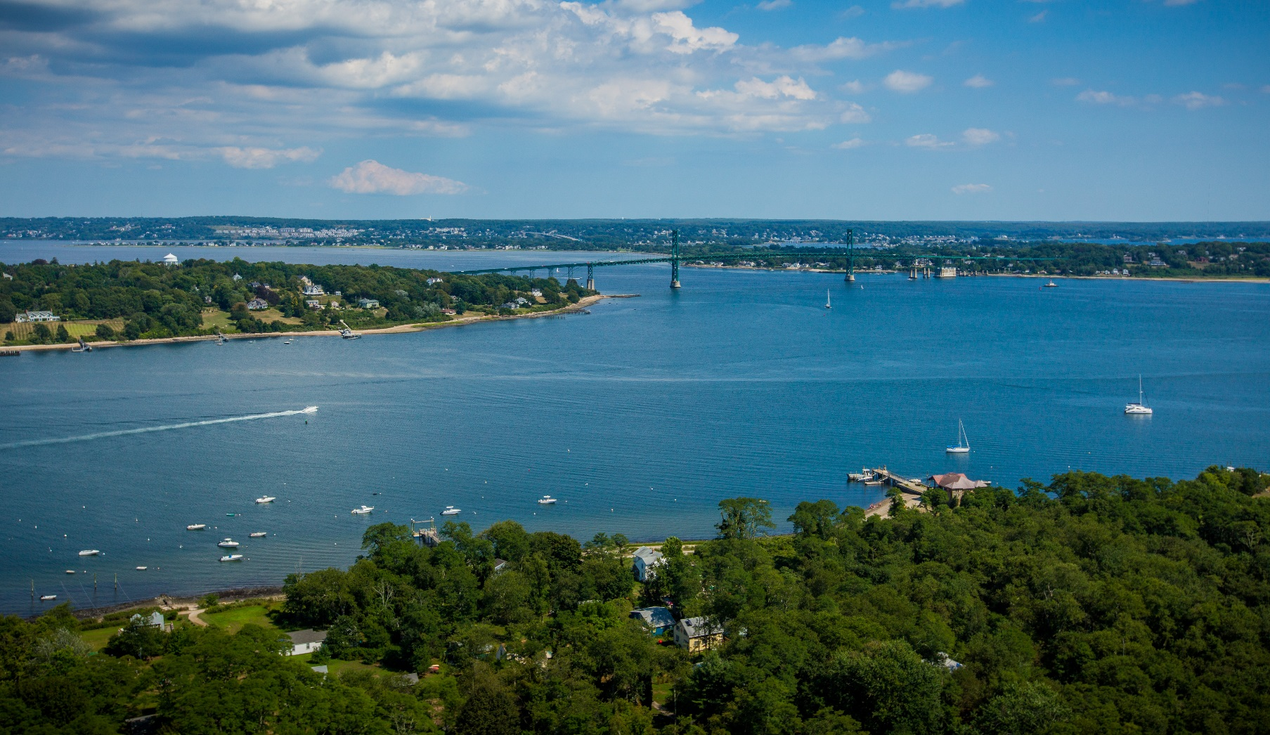
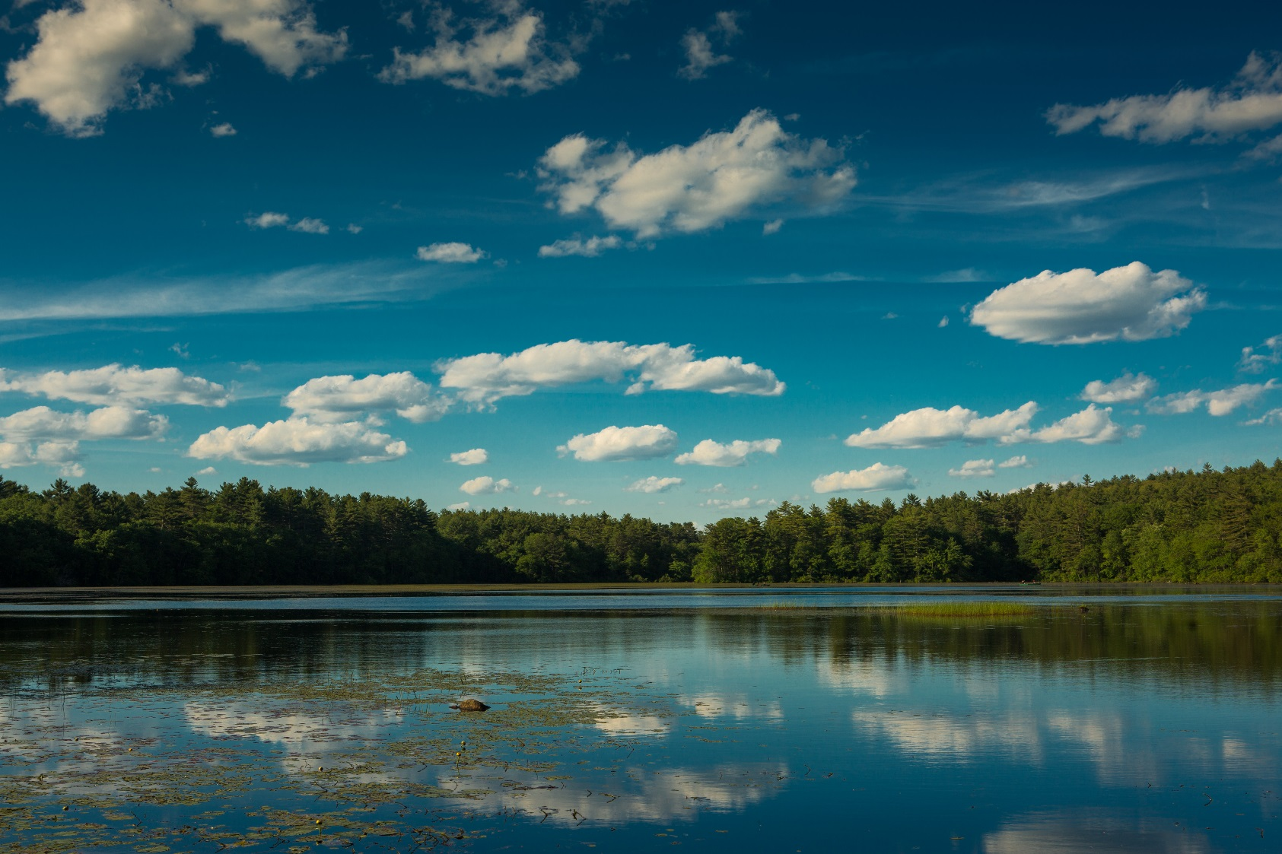
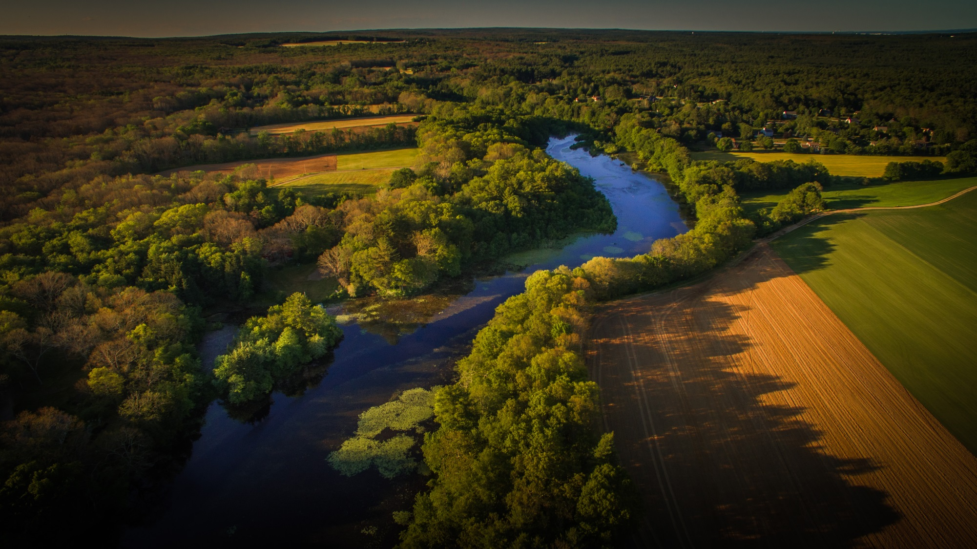
Why Do We Need A Self-Assessment?
Notes:
We are lucky! We live in a state filled with beautiful landscapes and a rich variety of water resources. (CLICK THROUGH FOUR IMAGES.)
[Insert town-specific information about water resources. e.g. Here in [TOWN NAME] we have….]

Slide 3
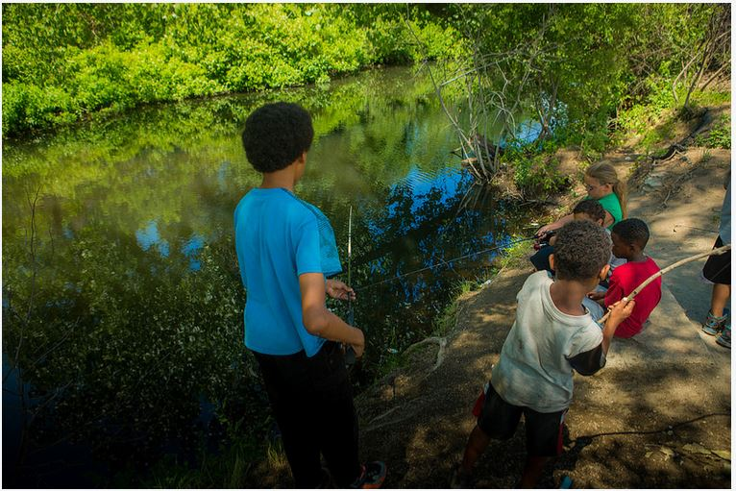
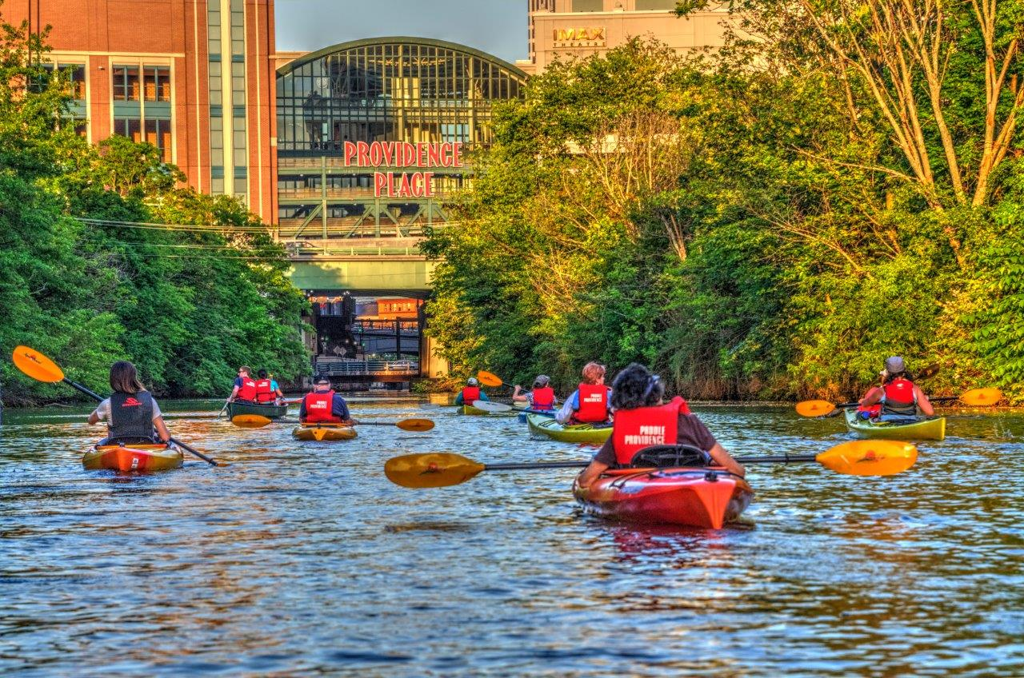
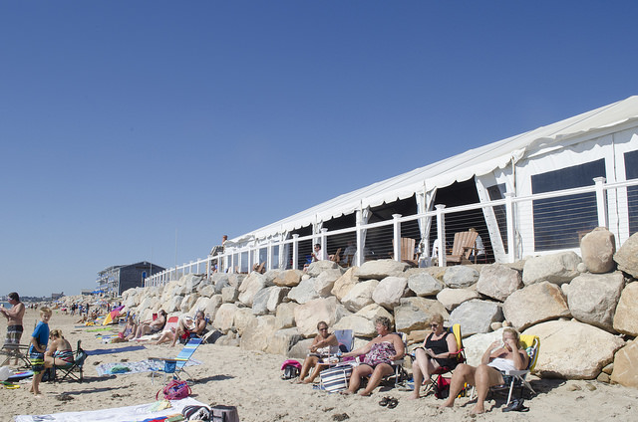
Notes:
Those water resources are vital to our economy, and they offer us a bounty:
drinking water;
delicious seafood;
amazing quahogging and fishing;
fun on the water—kayaking, swimming, surfing, boating;
scenic views;
and of course, days at the beach.
They also enhance our overall community character, which is so important to most of our residents.

Slide 4
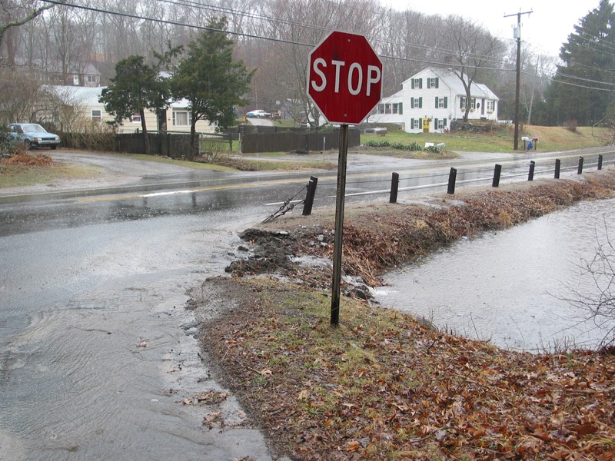
Notes:
Unfortunately, while we have made significant progress cleaning up many of our local waters, even the most pristine waters statewide are affected by a threat that is dangerous in its subtlety.
Today’s leading cause of poor water quality in Rhode Island is subtle because it doesn’t come from one specific source, as it did in the past. According to the EPA, today’s leading cause of water pollution is stormwater runoff.
And while we are lucky to have the water resources that we do, luck isn’t going to be enough to solve this problem!

Slide 5
Image credit: naturalsuburbanrunoff_Phila.gov.jpg
Notes:
In order to understand why stormwater runoff is a problem, we have to understand the differences between rainwater in a natural versus a developed area. When land is forest or field, some water flows slowly overland and seeps into the soil. When that rainwater seeps into the ground, it’s filtered naturally by the soil and then re-enters the water cycle.
(CLICK FOR SECOND IMAGE) In a developed setting, rooftops, pavement, and compacted land (all forms of impervious surfaces) inhibit or prevent rainwater from seeping in and being filtered naturally.
The result is a dramatic increase in the total amount of stormwater runoff and how quickly it reaches local waters, causing more water to flow more rapidly overland.
The problem is that stormwater runoff is not just rain, and there’s nothing natural about it!

Slide 6
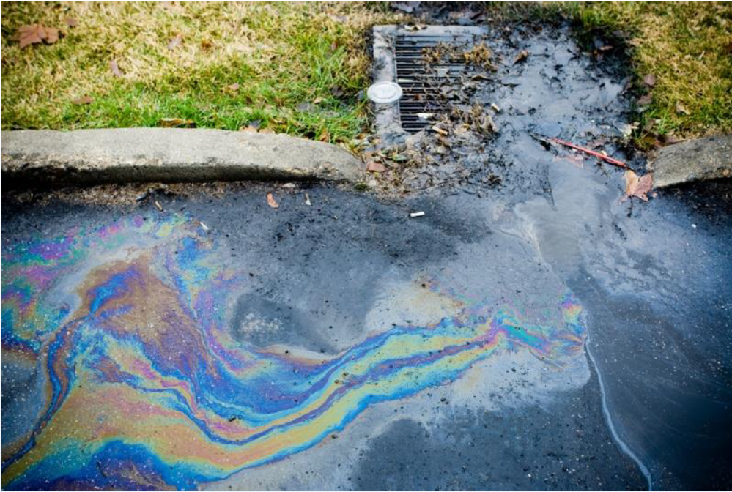
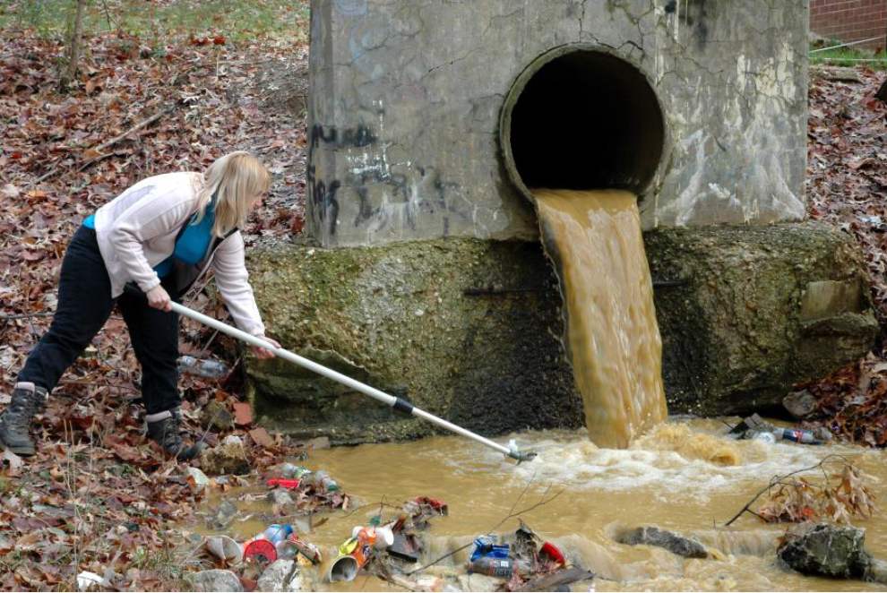
Notes:
As stormwater runoff flows over impervious surfaces, the problem is not just the amount of water and the speed at which it’s flowing.
Those impervious surfaces also collect waste and pollutants, which stormwater runoff picks up as it flows down the street or over a construction site. Those pollutants include:
Oil and automotive fluids;
Fertilizers and pesticides;
Bacteria from pet waste and improperly maintained septic systems;
Sediment from poorly managed construction sites;
Sand from wintertime snow removal; and
Debris and litter. (CLICK FOR SECOND IMAGE)
In most communities across Rhode Island, as in [INSERT TOWN NAME], that stormwater runoff is NOT treated. It flows through storm drains or directly into our local waters.

Slide 7
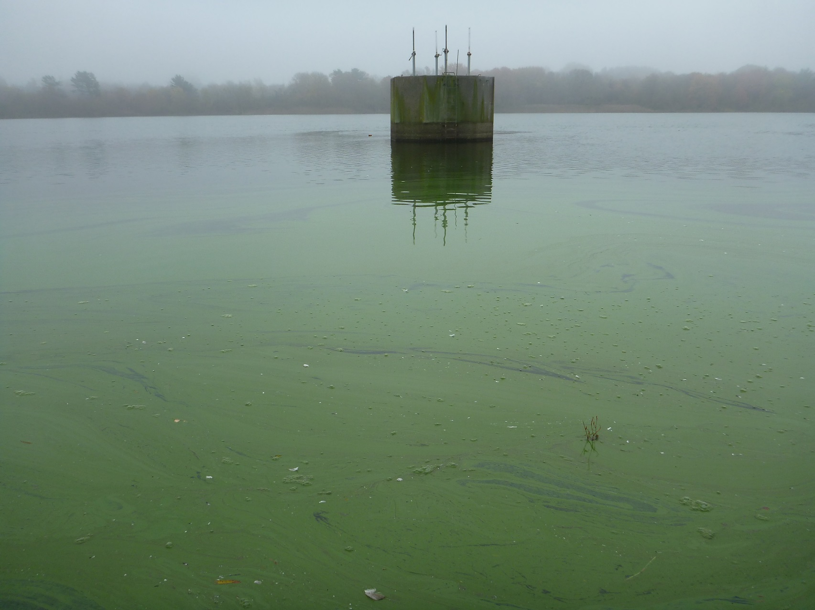
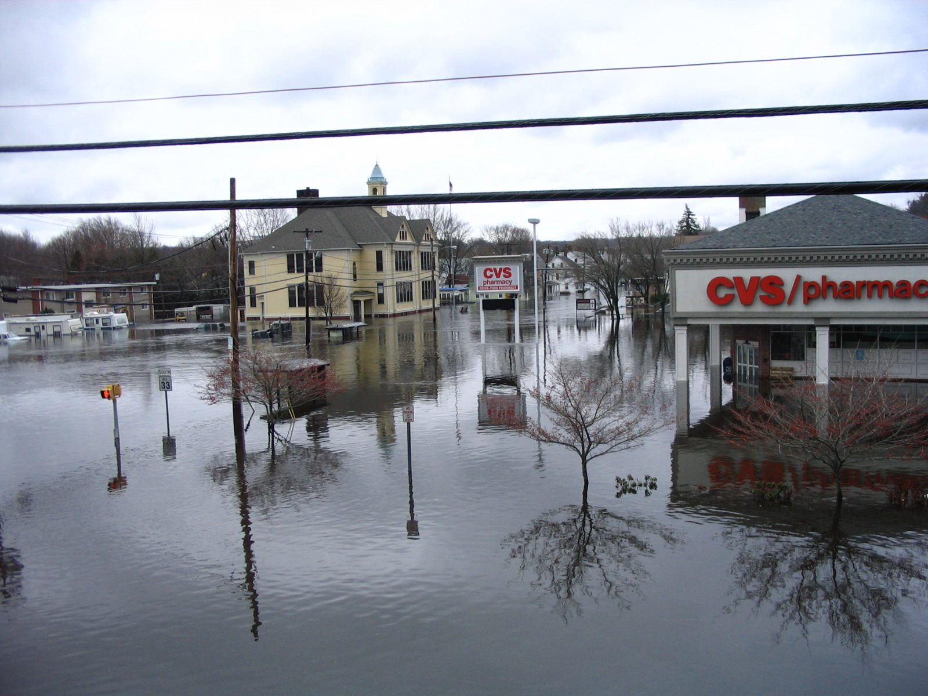
Notes:
Across the state, unmanaged stormwater runoff causes flooding, closes beaches, closes shellfishing areas, and sometimes makes people sick, as it introduces dangerous bacteria.
Stormwater runoff also adversely affects the flow of streams, can cause algal blooms (which can be toxic) and fish kills, and generally degrades the waters that people like to fish, swim, and even drink.
In short, it causes a cascade of problems that significantly degrade our community character and cost us all money.
Unfortunately, as our climate changes, causing more frequent and intense storms and more precipitation, the impacts of stormwater will be even greater. (CLICK FOR SECOND IMAGE)
We need to act now!

Slide 8
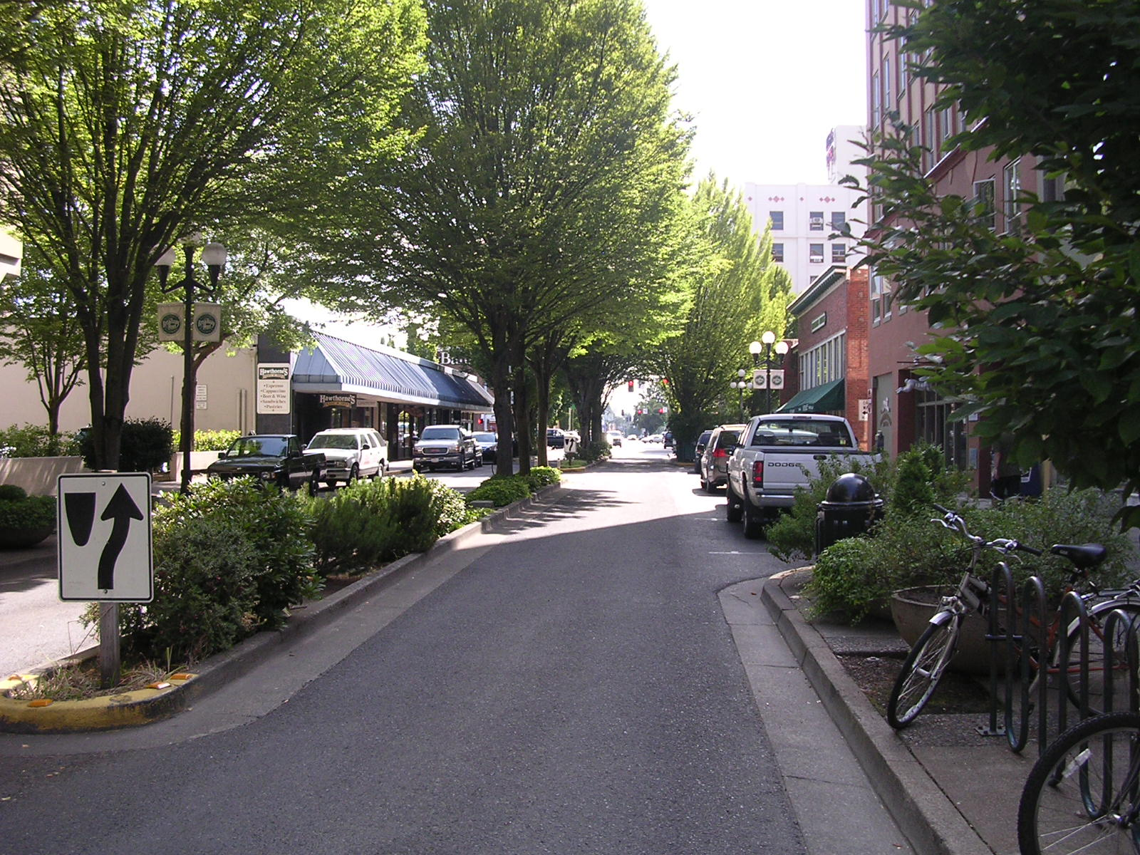
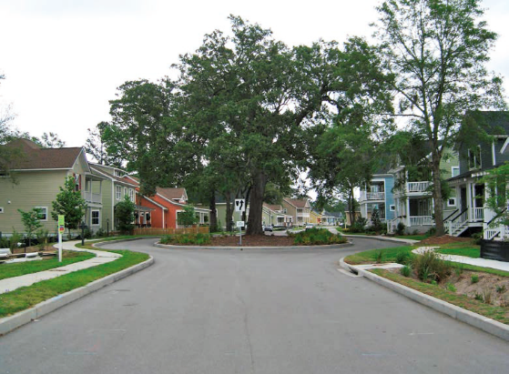
What Does The Self-Assessment Have To Do With All Of This?
Notes:
As you saw a few slides back, how land is developed has a huge effect on the flow of water across that land.
Community planners and developers have known for a long time about alternative development practices that offer improved methods for preventing and dealing with stormwater runoff.
Those practices are called Low Impact Development, or LID for short. A few examples are shown in the images here and will be explained more in the next slide.
The State of Rhode Island had the foresight to see the importance of this method of development for combatting the interrelated problems of stormwater runoff, and we have both the Cleaner Bay Act and the State’s Stormwater Rules requiring that non-structural techniques (such as LID) be used to the maximum extent practicable.
So what exactly does LID require?

Slide 9
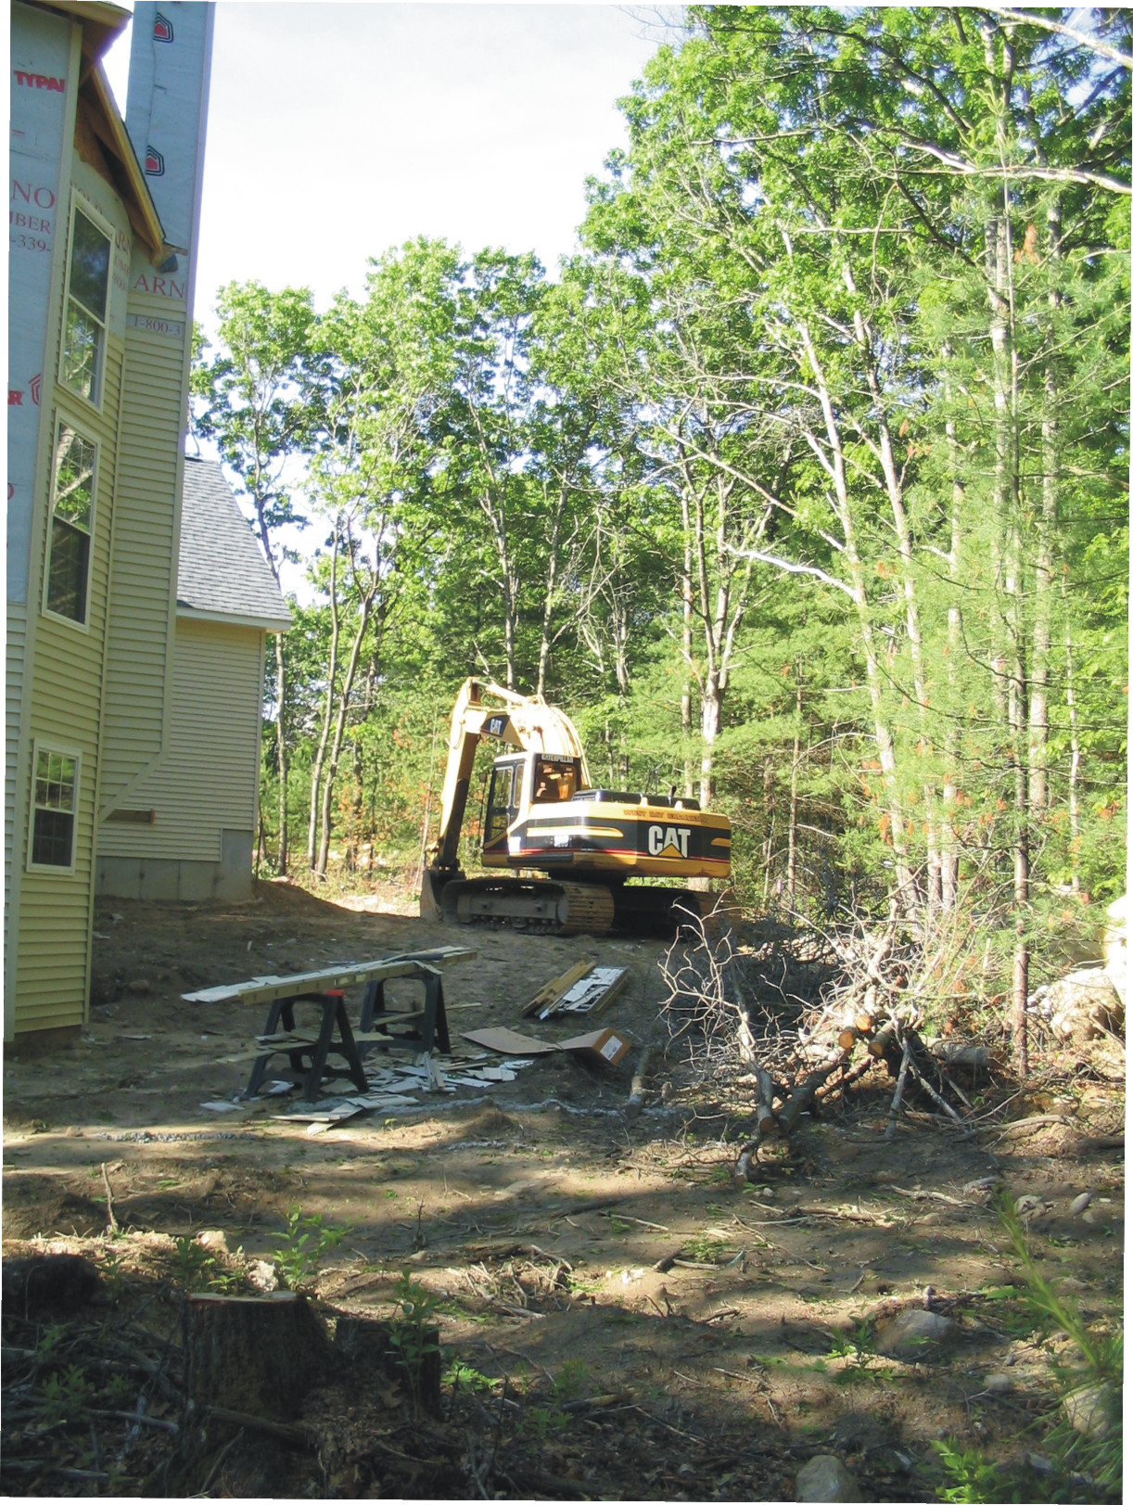
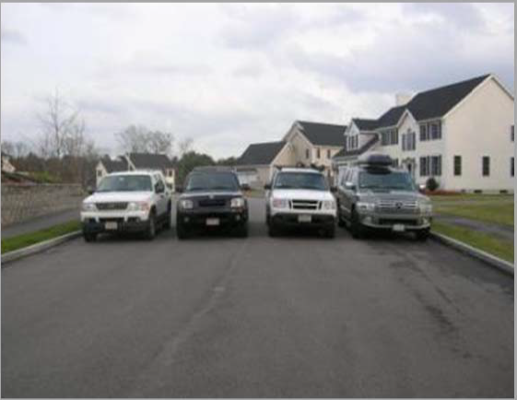
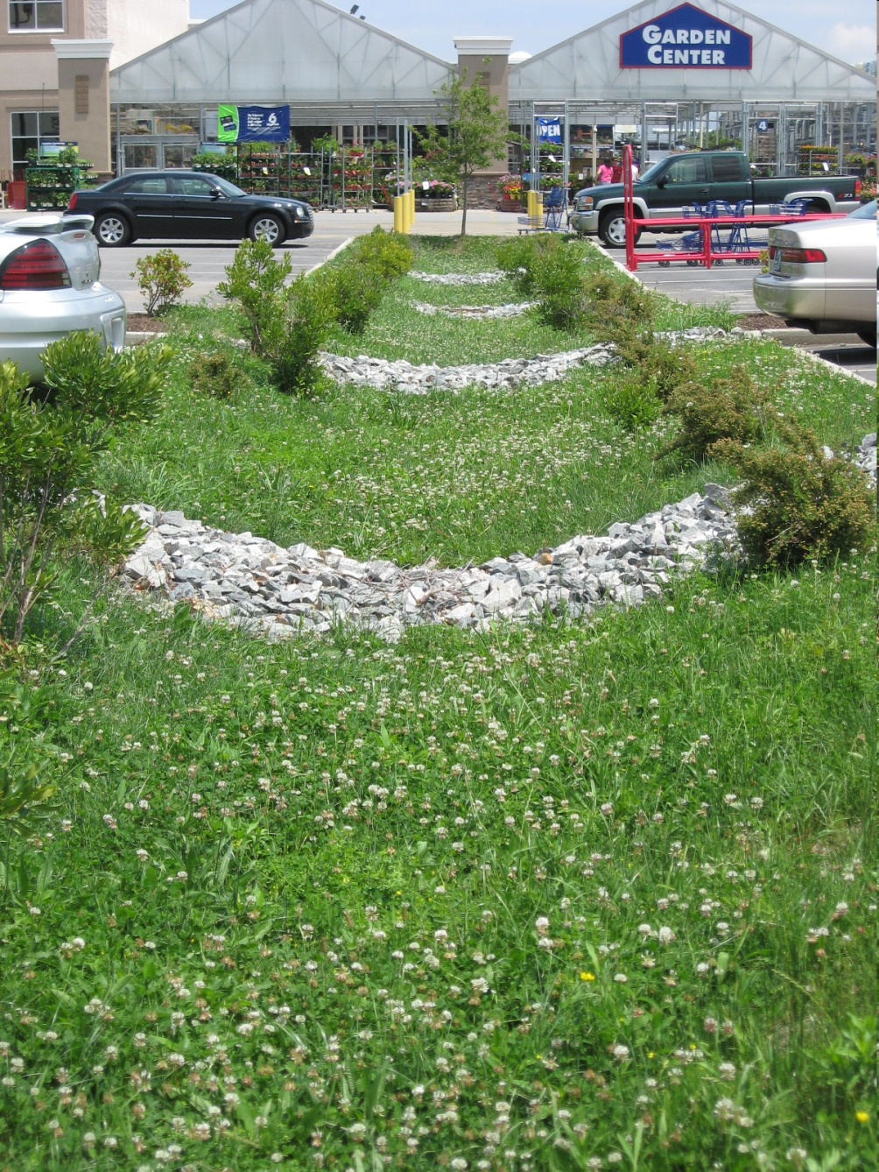
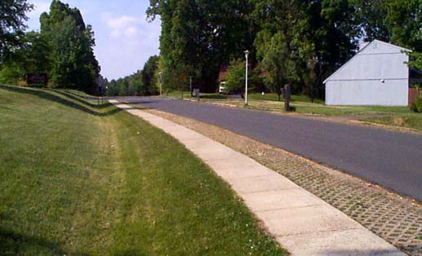
Avoid
Reduce
Manage
Conventional Design
~ 20 ft
Low Impact Design
Notes:
LID is a three-pronged approach that attempts to:
Avoid impacts by preserving and protecting as much of the natural site condition as possible. (CLICK FOR SECOND IMAGE)
Reduce impacts by minimizing the amount of impervious surfaces (such as pavement, rooftop, and compacted soil) which don’t allow rainfall to soak into the ground. (CLICK FOR THIRD IMAGE)
Manage impacts by treating stormwater runoff as closely as possible to the point where it reaches the ground. LID uses small, often vegetated, treatment systems rather than managing stormwater through pipes or large drainage systems which are costly to build and maintain.
Although developers are required by the state to apply LID stormwater practices, municipal ordinances often either prevent the use of LID designs or favor conventional practices.
Because municipalities have primary authority over land use, we are responsible for implementing LID. RIDEM does not do LID site design to avoid and reduce impacts for us. They only focus on design of engineered structures.
And that brings us to the Self-Assessment…

Slide 10
Notes:
The Self-Assessment was designed to guide communities through a systematic comparison of our local development rules against current model development principles.
The questions identify specific methods to reduce stormwater runoff from new construction and redevelopment. They cover topics ranging from open space and land disturbance to impervious surfaces and soil erosion control.

Slide 11
Learning More About Each Topic
Notes:
The Self-Assessment was designed with a detailed Primer that links directly from questions within the interactive PDF to a thorough explanation of the topics addressed in those questions.
There are a total of 28 Primer topics and examples include an SESC Control Ordinance and (CLICK FOR SECOND IMAGE) Maximum Lot Impervious Cover Limits.

Slide 12
INSERT A PHOTO OF YOUR COMMUNITY
Notes:
The short-term goal of the Self-Assessment is to identify standards that need to be changed in order to meet LID goals, then to begin the process of updating zoning ordinances and subdivision regulations.
The long-term goal of the Self-Assessment is to help our municipality protect and restore the quality of local waters while becoming a greener, more attractive, and more livable community.

Slide 13
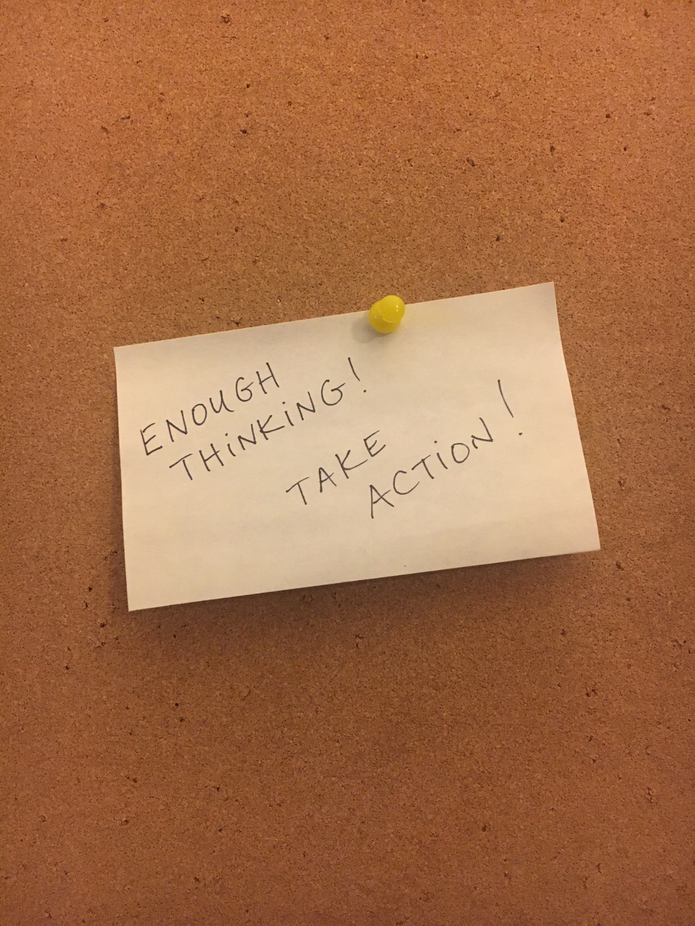
What Happens Now?
Action Items:
INSERT TOP GOAL
INSERT SECOND GOAL
INSERT THIRD GOAL, ETC.
Notes:
The team we put together to complete the Self-Assessment included: [INSERT INFORMATION ABOUT WHO WAS INVOLVED]
Together, we reviewed our existing ordinances and regulations, then answered the Self-Assessment questions.
Based upon those results, we’re here tonight to recommend these major updates:
[INSERT YOUR COMMUNITY’S SUGGESTED UPDATES TO ORDIANCES AND REGULATIONS]

Slide 14
For Additional Answers To Your Questions…
www.uri.edu/nemo
Lorraine Joubert
ljoubert@uri.edu
401.874.2138
www.dem.ri.gov/programs/water
Jenny Paquet
Jenny.Paquet@dem.ri.gov
401.222.4700 x 7263

